Slide 1
The Struggle For Existence
The Revolutionary idea of Evolution in determining species diversification
For time changes the nature of the whole world, and one state of things must pass into another, and nothing remains as it was: all things move, all are changed by nature and compelled to alter. For one thing crumbles and grows faint and weak with age, ...”

Slide 2
History of Evolution
Lamarck published a theory of evolution in 1809
Lamarck thought that species arose continually from nonliving sources. These species were initially very primitive, but increased in complexity over time due to some inherent tendency.
This type of evolution is called orthogenesis.

Slide 3
Orthogenesis continued
an organism's acclimation to the environment could be passed on to its offspring; species never go extinct
for example, he thought proto-giraffes stretched their necks to reach higher twigs. This caused their offspring to be born with longer necks.
This proposed mechanism of evolution is called the inheritance of acquired characteristics
Who might like this idea for structuring society?

Slide 4
Darwin Observed
Variability exists within a given species
Variant traits may be passed on/inherited
In this "struggle for existence", variants that were slightly better suited to the environment would be more likely to survive
This does *NOT* mean “Survival of the Fittest”

Slide 5
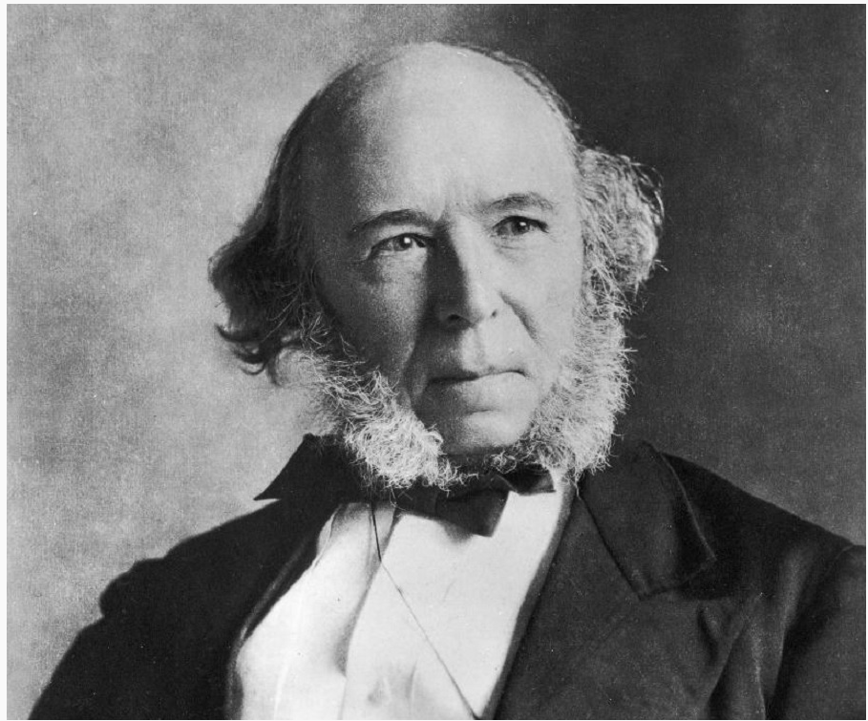
Darwin Never Said
Survival of the Fittest
In “Origin of Species” (1859)
Herbert Spencer 1864
And This Directly Leads
To Social Darwinism

Slide 6
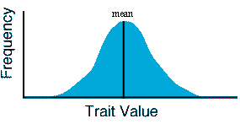
Variation of Traits → passed on to population
Populations Evolve; Not Individuals
A population is a collection of individuals which have some distribution of traits:

Slide 7
Darwin Says
“I have called this principle, by which each slight variation, if useful, is preserved, by the term Natural Selection
It is not the strongest of the species that survives, nor the most intelligent, but the one most responsive to change
Intelligence is based on how efficient a species became at doing the things they need to survive
In the survival of individuals and species, during the constantly-recurring struggle for existence, we see a powerful and ever-acting form of selection.”

Slide 8
One More
I think it inevitably follows, that as new species in the course of time are formed through natural selection, others will become rarer and rarer, and finally extinct. The forms which stand in closest competition with those undergoing modification and improvement will naturally suffer most.

Slide 9
Final Exam Questions
Is Natural Selection inconsistent with the idea of the Mechanical Universe? (what would Descartes Say?)

Slide 10
Darwin – Origin of Species -1859
Mechanism for Evolution is Natural Selection
New variants continually arose within populations → Darwin observes this but does not understand what mechanism causes this
Numerous instances of selecting the variant (due to higher survival probability) slowly leads to species modification/diversification

Slide 11
Favorable Variations Drive Evolution
Darwin: If certain variants will be preserved over time over other variants then that population will change over time in their composition. This is evolution by natural selection.
But Darwin does not understand how the variations of traits are generated in the first place

Slide 12
Natural Selection
Random pairings of mating contributes to the overall Gene Pool/traits of the population (Darwin does not know this)
Each Random pairing has a different survival probability within some Ecosystem according to the ecosystem rules
If the ecosystem is stable the end results is a distribution of most probable values (slow vs fast rabbits)
This statistical process takes a large number (100 to 1000s) of generations to manifest itself
Most ecosystems are not stable on this required time scale of “larger number of generations”. Only the oceans are stable, but that is not a diverse ecosystem and the does not drive much species diversification.

Slide 13
Survival of the Fittest
Why the confusion remains.

Slide 14
The Fittest Survive
This is the OUTCOME of natural selection which is based on the RANDOM input of mating. Natural selection is – the organism that is the most adaptable to their environment (e.g. the fittest) has the highest survival probability
This takes thousands of generations to manifest
Nature does not know A PRIORI who is fit and who is not.

Slide 15
Survival of the Fittest
This implies (both explicitly and implicitly) that the fittest can be IDENTIFIED a priori.
Nature can’t do that
Social Engineering (Spencer) posits, because it’s a “scientific fact” that the FIT can be identified and they need to be protected so they can flourish, generally at the expense of other weaker species (superior vs. inferior cultures)

