Slide 1
Bruno and the Inquisition
Bruno espoused a wide variety of theories some new, some older but reformulated [e.g., not only that of Copernicus but also those of Nicholas of Cusa on plural worlds, etc.] and he was also open to elements of magic and of heresy [the Arianist, which denies the orthodox dogma as stated in the Credo esp. the dual nature of Christ].
Most importantly and like Galileo, Bruno was a very public and a very controversial and even charismatic figure; unlike Galileo, he refused to abjure his beliefs
The charges brought him before the inquisition were many and included themes of direct heresy against the Catholic church (Arianism) and charges that are Atomistic in nature (interpreted to deny free will and salvation
It is really the sheer number of charges against him, instead of one specific thing, that gets him burned at the stake in the year 1600.

Slide 2
ON DIRECT HERESY
Holding opinions contrary to the Catholic Faith and speaking against it and its ministers.
Holding erroneous opinions about the Trinity, about Christ's divinity and Incarnation.
Holding erroneous opinions about Christ.
Holding erroneous opinions about Transubstantiation and Mass.
Denying the Virginity of Mary

Slide 3
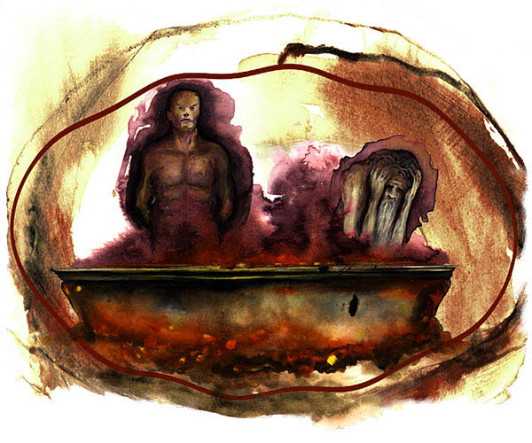
“Atomist Charges”
Claiming the existence of a plurality of worlds and their eternity.
Believing in metempsychosis and in the transmigration of the human soul; the same soul inhabits in succession the bodies of different beings, both humans and animals.
The proper place for Bruno according to Dante, the 7th circle of hell.

Slide 4
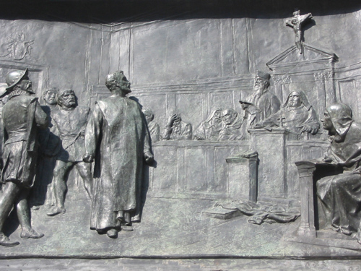
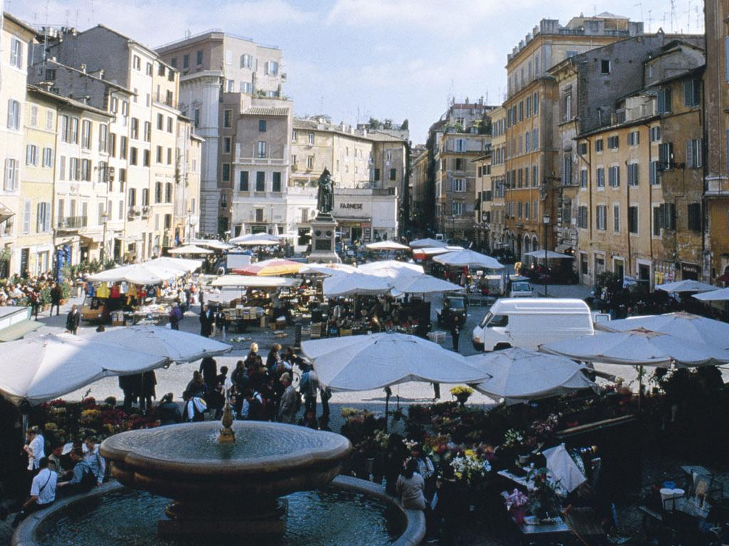
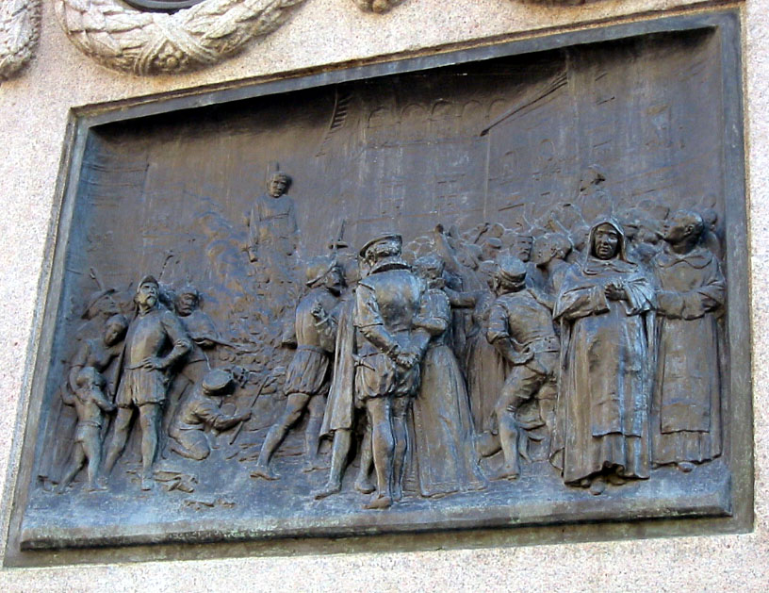
The Trial and Execution of Bruno
When in Rome, go to the Campo dei Fiori square

Slide 5
Bruno’s book is still Forbidden
Note that other prominent scholars of the period dabbled in many of the same things, tho not quite as conspicuously as did Bruno.
His espousal of heresy and of the Copernican model seemed to be related, eventually ensuring that Copernicus' thesis would end on the Index of Forbidden Books in 1616.

Slide 6
Other Notable Stake Burnings
Servetus...a notable pioneer in the field of physiology; Calvinists in Geneva charged him with destroying the very foundations of Christianity by rejecting orthodox positions on the Trinity, the person of Christ, the immortality of the soul, and the efficacy of infant baptism; and finally, and most importantly, also charging that he had defamed Calvin. As Bruno he too leaned toward the Arian heresy.
In Geneva, Switzerland, there was dedicated in 1912 a monument bearing the following inscription: "In memory of Michael Servetus--victim of religious intolerance of his time, and burned for his convictions at Champel, on September 27, 1553. Erected by the followers of John Calvin, three hundred and fifty years later, as expiation for that act, and to repudiate all coercion in matters of faith."

Slide 7
The Intolerance of Luther
Walther Kohler , a Lutheran church historian writes:
In Luther's case it is impossible to speak of liberty of conscience or religious freedom . . . The death-penalty for heresy rested on the highest Lutheran authority . . . The views of the other reformers on the persecution and bringing to justice of heretics were merely the outgrowth of Luther's plan; they contributed nothing fresh.
Luther says : "I am on the heels of the Sacramentaries and the Anabaptists; . . . I shall challenge them to fight; and I shall trample them all underfoot."

Slide 8
The Intolerance of Calvin
Will Durant
"Calvin was as thorough as any pope in rejecting individualism of belief; this greatest legislator of Protestantism completely repudiated that principle of private judgment with which the new religion had begun. He had seen the fragmentation of the Reformation into a hundred sects, and foresaw more; in Geneva he would have none of them.“
Tolerance is not to be found in very many places

