Slide 1
The Heliocentric Model
Proposed by Aristarchus of Samos, 280 BC - While the model is not accepted it is preserved and written about extensively by Archimedes.

Slide 2
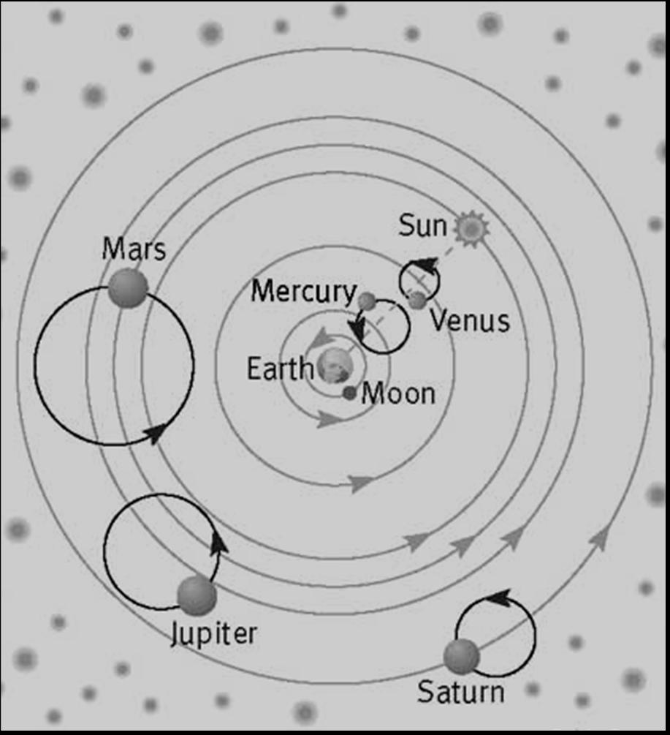
Previous Models:
Ptolemaic System with Epicycles - Note that the Earth and Sun are "joined" to constrain Mercury and Venus

Slide 3
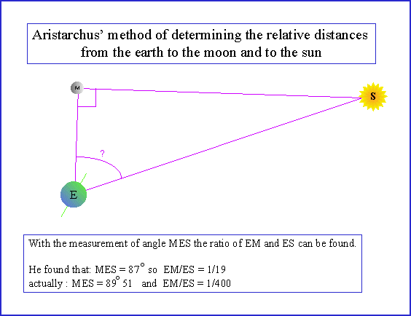
The New Model
He concludes that the Sun is 19 times farther away from the Earth than the Moon is. Since they appear to be the same angular size in the sky then the Sun must also be 19 times bigger than the Moon.

Slide 4
More Measurements
During a lunar eclipse, he measured the duration of time between the moment when the edge of the Moon first became eclipsed and the moment when the Moon was first totally obscured. He also measured the duration of totality. Because he found the two times to be the same, he concluded that the width of the Earth's shadow at the distance where the Moon crosses it must be twice the diameter of the Moon. Therefore, the Moon must be 1/2 the size of the Earth
Even though his measurements are incorrect, he does correctly conclude that the Sun is much bigger than the moon, and therefore bigger than the Earth. The Sun is then the central object in the Solar System and therefore the Earth must revolve around the Sun.

