Slide 1
Copernicus
Does he deserve all the historical elevation and fuss about him? Did he change anything? Was their a Copernican Revolution?

Slide 2
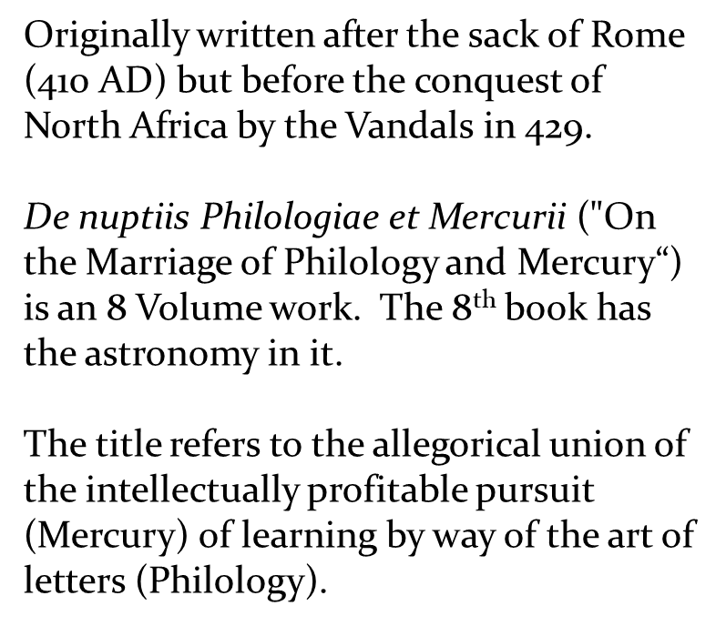
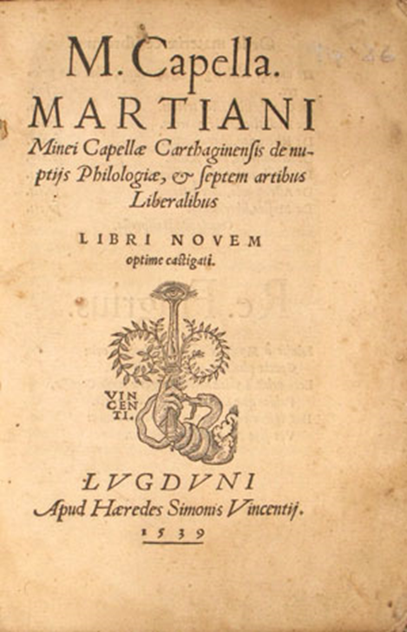
Martinius Cappela Revision to Ptolemy

Slide 3
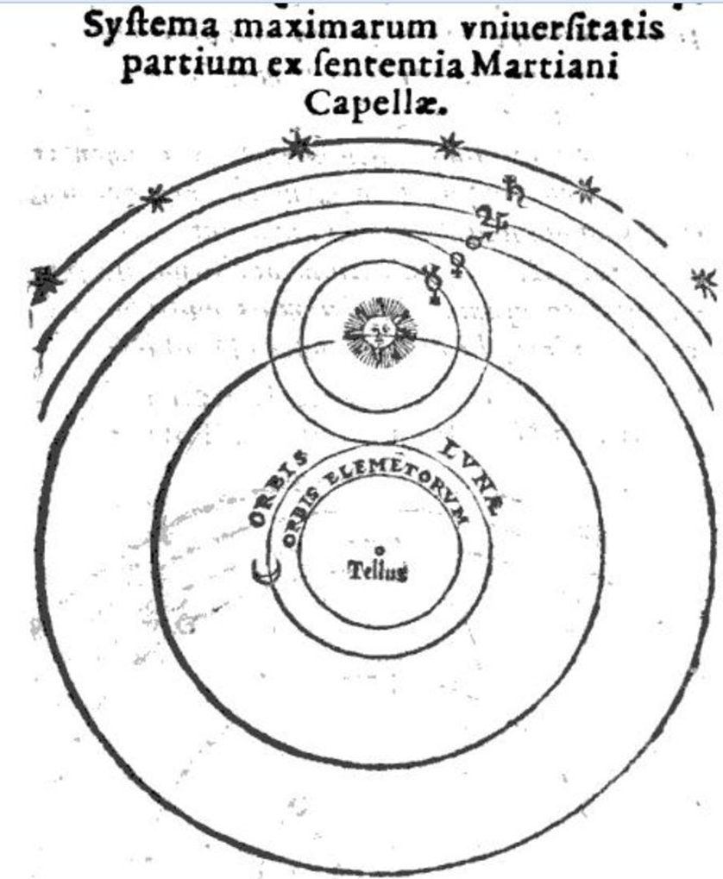
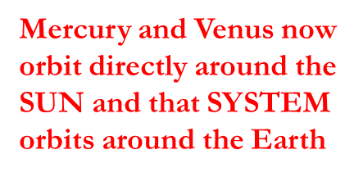

What do you notice here?

Slide 4
Avoiding the wrath of the Church
Copernicus published an early description of this model in 1530 in a private manuscript but full publication was delayed until 1543 to avoid the wrath of the Church. Remember that Capella’s model was published in 1539
The major difference in quality between the models of Aristarchus, Ptolemy and de Cusa was that Copernicus worked out his model in full mathematical detail but the resulting system/device was every bit as complicated as the Ptolemaic model.
His model also has equally spaced circular orbits between the planets. Equally space perfectly circular orbits again represents harmony and order in Nature. He also uses the Aristotelian mechanism of a Prime Mover to account for the original motion

Slide 5
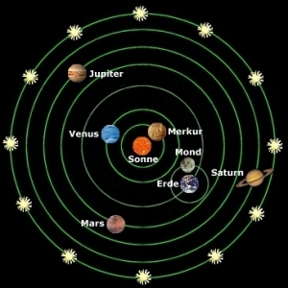
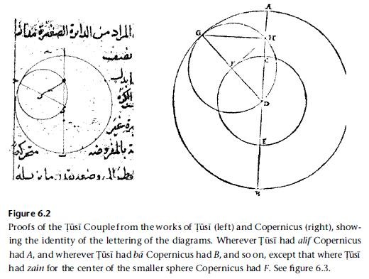
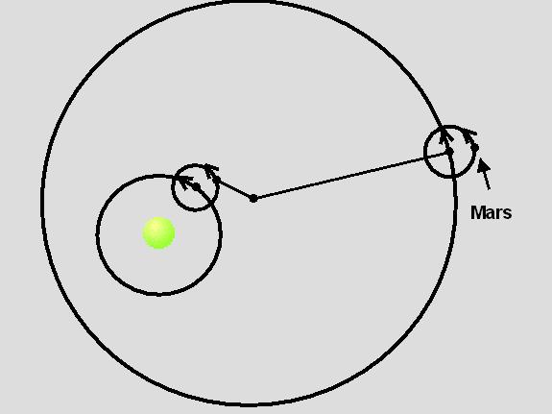
The Copernican Model has Epicycles!
Also, he appears to have borrowed from Al Tusi
Note also that the stars remained fixed to the 8th sphere – Bruno will soon change all of that

Slide 6
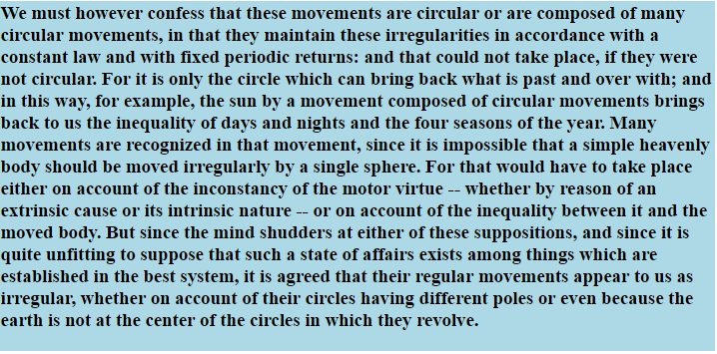

Slide 7
What, the Earth Moves?
The Copernican model places the sun at the center of the solar system and all the planets orbit about it. Most importantly, Copernicus endows movement to the Earth. In fact, three kinds of movement:
  annual motion (orbit about the sun)
  daily rotation (around a tilted axis)
  axial wobble (changes the positions of fixed stars over thousands of years timescale)
Real Orbital Variations

Slide 8
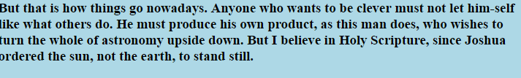
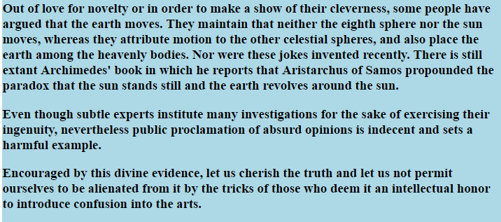
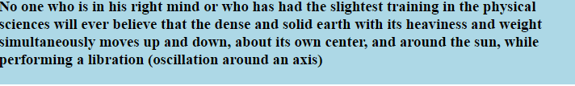
Immediate Criticism
Martin Luther
the 1549 Textbook by Melanchthon:
Jean Bodin a French Philosopher writing in 1596

Slide 9
And none of this is even real!
Andreas Osiander, an ordained Priest, oversaw the publication of De revolutionibus orbium coelestium and added an unsigned preface explaining that the model described in the book was not intended as a description of the way the Universe really is, but as a mathematical device to simplify calculations involving the movement of planets
In fact, it doesn’t really offer a significant improvement on planetary positions since it still keeps the orbits as perfect circles.

Slide 10
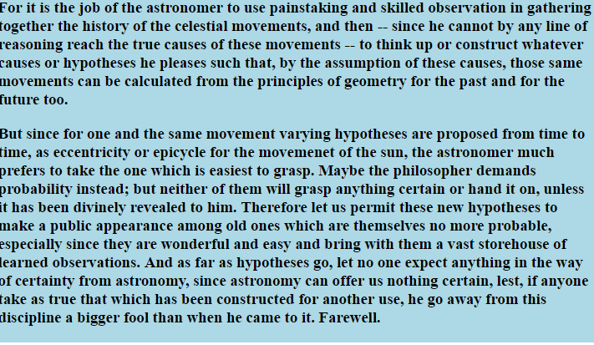
From the preface:

Slide 11
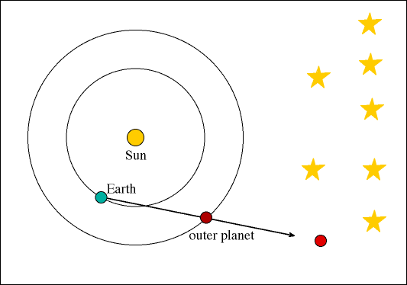
Of course this model gives the natural explanation for retrograde motion. Since the distance between Earth and Mars is continuously varying, this explains the observed brightness variations of Mars.
However, the brightness variation for Mars is about 80 times larger than that observed for Venus even though the distance variations between Earth and Venus would be about the same.
Copernicus does not understand why the brightness of Venus is not observed to highly variable like Mars and this indicates he doesn’t understand his model.

Slide 12
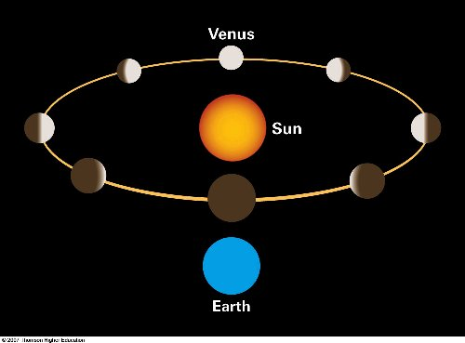
Copernicus does not understand that Venus must have phases
Although he should have understood this explicitly as it just simple geometry.
When we observe Venus at its brightest its not in full phase mode but in 1/2 phase. ESV angle = 90.
When Venus is farthest from the Earth (and hence behind the sun so we can't actually see it) its in full phase. When its closest to the Earth we can’t see it at all.
These phase variations counter the distance variations so that the total brightness variations observed for Venus are only about a factor of 2.5 (barely perceptible to human eye)

Slide 13
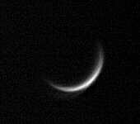
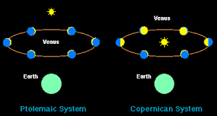
There are no phases in the Ptolemaic System
Galileo first to discover phases of Venus which offers direct proof that the Copernican System must be conceptually correct.

Slide 14
The Cultural Impact of the Copernican Model
What the Standard Lore says:
The most important aspect of Copernicus' work is that it forever changed the place of man in the cosmos; no longer could man legitimately think his significance greater than his fellow creatures; with Copernicus' work, man could now take his place among that which exists all about him, and not of necessity take that premier position which had been assigned immodestly to him by the theologians.

Slide 15
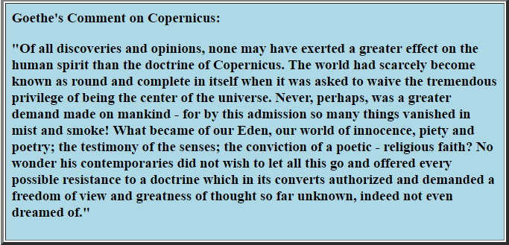
But Really, has anything "vanished in mist and smoke” (1820 Goethe) concerning our collective appraisal of where we stand in the Cosmos ??? Did the Copernican Doctrine have any cultural affect at all - do we behave with more reverence towards nature now that we have been shown that the Earth is not a special place in the Cosmos?

