Slide 1
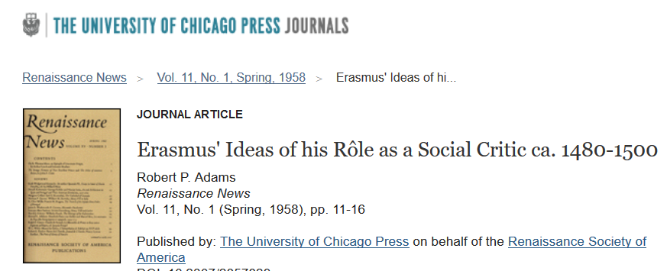
Desiderius Erasmus
Very strong critic of Martin Luther and of the church and society in General
Humility is Truth
Erasmus on Trump:
There are some people who live in a dream world, and there are some who face reality; and then there are those who turn one into the other.

Slide 2
Printing Press Social Criticism

Slide 3
Printing Press Social Criticism

Slide 4
Printing Press Social Criticism

