Slide 1
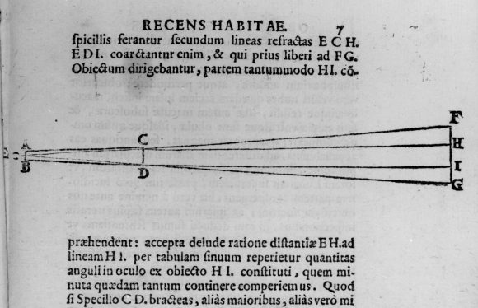
Galileo and The Telescope
Grinding and Polishing Lens to form a focused image through a tube. Need some knowledge of optics – provided by
The Muslim World

Slide 2
The Telescope
His little telescope was poorer than even a cheap modern amateur telescope, but what he observed in the heavens rocked the very foundations of Aristotle's universe and the theological-philosophical worldview that it supported. It is said that what Galileo saw was so disturbing for some officials of the Church that they refused to even look through his telescope; they reasoned that the Devil was capable of making anything appear in the telescope, so it was best not to look through it

Slide 3
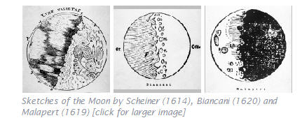
Galileo (and others) Observe Imperfection
For the moon was not perfect, it had blemishes and scars. A year later, when other copies of the telescope were made, many others made sketches of the moon, concerning its imperfect nature → it does not appear that all of the objects in Aristotle's Universe are, in fact, perfect. The moon has defects!

Slide 4
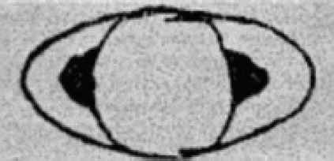
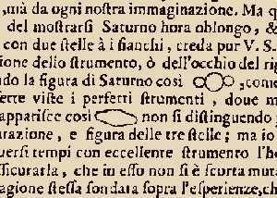
And then there was Saturn
His optics were not good enough to discern the actual rings – instead Saturn appeared to have these strange extensions

Slide 5
Sunspots
Galileo observed the Sun through his telescope and saw that the Sun had dark patches on it that we now call sunspots (he eventually went blind, perhaps from damage suffered by looking at the Sun with his telescope). Furthermore, he observed motion of the sunspots indicating that the Sun was rotating on an axis. These "blemishes" on the Sun were contrary to the doctrine of an unchanging perfect substance in the heavens, and the rotation of the Sun made it less strange that the Earth might rotate on an axis too, as required in the Copernican model. Both represented new facts that were unknown to Aristotle and Ptolemy.

Slide 6
The Moons of Jupiter –observing in real time a changing system
"Accordingly, on the seventh day of January of the present year 1610, at the first hour of the night, when I inspected the celestial constellations through a spyglass, Jupiter presented himself. And since I had prepared for myself a superlative instrument, I saw (which earlier had not happened because of the weakness of the other instruments) that three little stars were positioned near him -- small but yet very bright. Although I believed them to be among the number of fixed stars, they nevertheless intrigued me because they appeared to be arranged exactly along a straight line and parallel to the ecliptic, and to be brighter than others of equal size. And their disposition among themselves and with respect to Jupiter was as follows. That is, two stars were near him on the east and one on the west; the more eastern one and the western one appeared a bit larger than the remaining one. I was not in the least concerned with their distances from Jupiter, for, as we said above, at first I believed them to be fixed stars."

Slide 7
Change on Second Night
"But when, on the eighth, I returned to the same observation, guided by I know not what fate, I found a very different arrangement. For all three little stars were to the west of Jupiter and closer to each other than the previous night, and separated by equal intervals, as shown in the adjoining sketch. Even though at this point I had by no means turned my thought to the mutual motions of these stars, yet I was aroused by the question of how Jupiter could be to the east of all the said fixed stars when the day before he had been to the west of two of them. I was afraid, therefore, that perhaps, contrary to the astronomical computations, his motion was direct and that, by his proper motion, he had bypassed those stars. For this reason I waited eagerly for the next night. But I was disappointed in my hope, for the sky was everywhere covered with clouds."

Slide 8
Ah, this is scientifically interesting!
"Then, on the tenth, the stars appeared in this position with regard to Jupiter. Only two stars were near him, both to the east. The third, as I thought, was hidden behind Jupiter. As before, they were in the same straight line with Jupiter and exactly aligned along the zodiac. When I saw this, and since I knew that such changes could in no way be assigned to Jupiter, and since I knew, moreover, that the observed stars were always the same ones (for no others, either preceding or following Jupiter, were present along the zodiac for a great distance), now moving from doubt to astonishment, I found that the observed change was not in Jupiter but in the said stars. And therefore I decided that henceforth they should be observed more accurately and diligently."

Slide 9
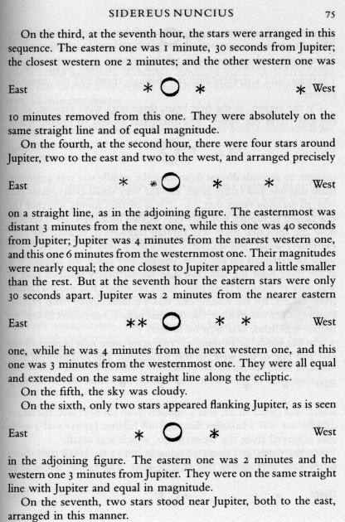
Recording Change

Slide 10
The Phases of Venus

Slide 11
Copernicus is Correct
Galileo used his telescope to show that Venus went through a complete set of phases, just like the Moon. Since The Venus is never very far from the Sun, in terms of angular displacement, in the sky. Thus in the Ptolemaic system Venus should always be in crescent phase as viewed from the Earth because as it moves around its epicycle it can never be far from the direction of the sun (which lies beyond it), but in the Copernican system Venus should exhibit a complete set of phases over time as viewed from the Earth because it is illuminated by the Sun from the center of its planetary orbit about the Sun.

Slide 12
New Phenomena
Planets are seen as disks through the telescope, not points of light like the stars.
Many more stars could now be seen than with the naked eye
The moon and Saturn had “defects”
There is more than one center of rotation in the Universe (e.g. moons of Jupiter)
As each new wonder was observed, increasing doubt was cast on the prevailing notion that there was nothing new to be observed in the heavens because they were made from a perfect, unchanging substance. It also raised the credibility issue: could the authority of Aristotle and Ptolemy be trusted concerning the nature of the Universe if there were so many things in the Universe about which they had been completely unaware?

