Slide 1
most People’s View Of science: Order, Logic, Rationalism all working together to yield the truth
What is Missing?
No room for randomness
This will be strong reinforced in Aristotle’s view of the world. Ultimately this means that all of nature is understandable.
“Nature does all things spontaneously, by herself, without the meddling of the gods.”
Later primarily Descartes and Kant formalize determinism, reductionism and reason as a testimony to the greatness of humanity.

Slide 2
Logic and Order
The backbone of Early Greek Science
Scientific Understanding = a consistent and logical statement.
Oriented towards discovery of patterns, a system, and ordered structure.
Science believes (but can’t prove) that all observable events are rationally explained

Slide 3
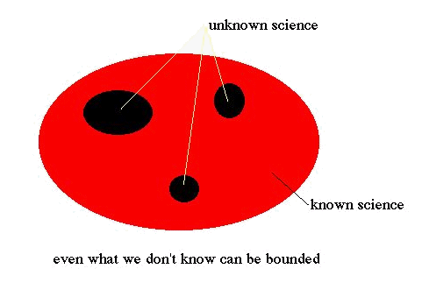
KNOWN vs UNKNOWN
In the rational view, science progresses to reach this state
But perhaps in real life the proportion of areas between red and black are reversed and scientific evolution means the unknown increases

Slide 4
Scientific Method “Steps”
The scientific method or better stated, the scientific process of inquiry, has four principle steps:
observation/experimentation
deduction
hypothesis
Falsification
Note that there is an emphasis on falsification, not verification. If a theory passes any test then our confidence in the theory is reinforced, but it is never proven correct in a mathematically sense. Thus, a powerful hypothesis is one that is highly vulnerable to falsification and that can be tested in many ways. The goal of the scientific method is the construction of models and theories, all with the final goal of understanding. But we should not assume that we have the right to understand.

Slide 5
The Nature of Science
Ideas are supported by testable and verifiable data or observation
Science is a process or way to investigate nature.
Scientific knowledge doesn’t mean possessing the truth.
Science seeks consistency between observations and models – something that congress really doesn’t understand

Slide 6
Quantitative Aspect of Science
Ordinary language is unable to capture scale of precision necessary for scientific discourse
Numbers and math are essential to discussion and understanding.
Consistent Units of measurement are required for knowledge transmission and verification of experiments/observations

Slide 7
The Inevitable Conflict and the relevancy of this class.
Science teaches us that we are in a partnership with nature.
Human institutions often charge that nature is subservient to humans
Our future is determined by which of these two philosophies is practiced – you can not do both
Your evolution on any planet is determined by this choice

