Slide 2
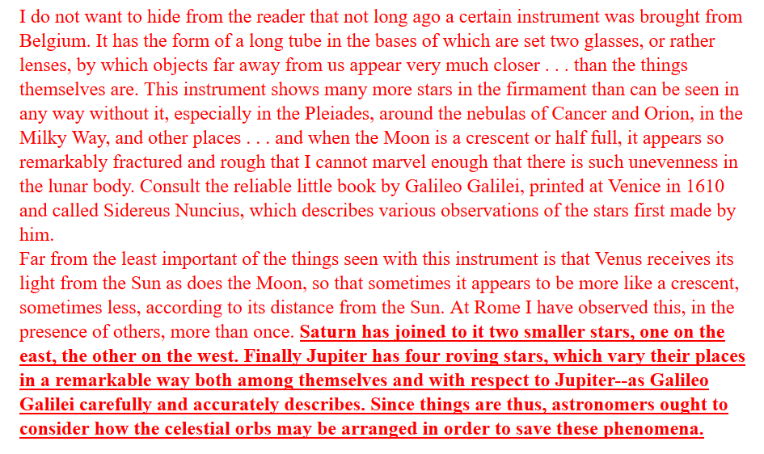
But recall this passage and especially the words in boldface. That is, some were more open-minded, but constrained by cultural bias, among them Christopher Clavius, foremost Jesuit defender of the Ptolemaic system, writing in 1612 and after having a chance to use the telescope.

