Slide 1
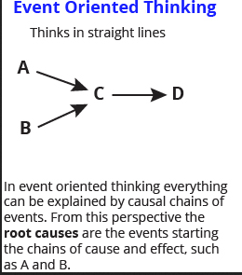
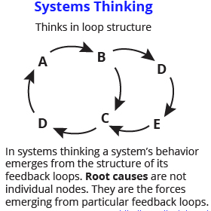
Two approaches
This is Air, Earth, Fire and Water and the Logic and Ordered Universe that leads to the Mechanical Philosophy and a Clockwork Universe
In this view, systems produce emergent behavior and are not well predictable. System behavior can then appear random (tho its not) – this conforms well to the Atomist View

Slide 2
Evaluation
Systems can be evaluated based on their methodologies and operating principles – in this way systems can appear different from one another – e.g. Science vs Religion
Systems can be evaluated in terms of their outcomes or products for society – in this way, many systems might actually be the same. E.g. Science Vs Religion

Slide 3
The Truth System
Questions about the World
Usually Black Box Mechanism available to answer Questions about the world
Multiple pathways
Authoritative Final Anwser = the known TRUTH
Consistent explanation = transient truth
Most Important Feedback Loop – hence Systems Thinking!!

