Slide 1
Systems Thinking
A way to understand the world

Slide 2
This course is actually about systems thinking
This is not emphasized enough to students
Institutions/processes reveal systems thinking
Examples: science, culture, religion, evolution, economics, politics, etc
For example, UO system thinking:
Circle the Wagons and Shoot Inwards but constantly complains about the lack of resources to buy more bullets

Slide 3
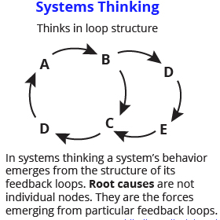
Two approaches
This is Air, Earth, Fire and Water and the Logic and Ordered Universe that leads to the Mechanical Philosophy and a Clockwork Universe
In this view, systems produce emergent behavior and are not well predictable. System behavior can then appear random (tho its not) – this conforms well to the Atomist View

Slide 4
Evaluation
Systems can be evaluated based on their methodologies and operating principles – in this way systems can appear different from one another
Systems can be evaluated in terms of their outcomes or products for society – in this way, many systems might actually be the same.

Slide 5
The Truth System
Questions about the World
Usually Black Box Mechanism available to answer Questions about the world
Multiple pathways
Authoritative Final Anwser = the known TRUTH
Consistent explanation = transient truth
Most Important Feedback Loop – hence Systems Thinking!!

