Slide 1
Various Colonization Wars and Uprisings
Most all of these “problems” were “sorted out” via the application of technology

Slide 2
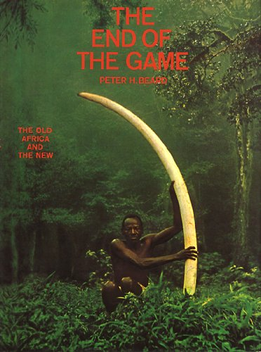
The Inevitable Conflict: Technology vs. The Sacred
As the century turned, Africa began to emerge from a Dark Age stretching as far back as life on earth, into all the years that lay ahead - years of Renaissance, Enlightenment, Industry, and, if you will, Anxiety. It is fitting that Grogan made his symbolic trek (across Africa - 1891-92) as a survey for a railroad, the means through which foreign capital, the paraphernalia of technology, and foreigners themselves would enter. But because an incision is also a wound, the railroad was also the means through which the old life suppurated and poured out of Africa. This, then, is the tragic paradox of the white man's encroachment. The deeper he went into Africa, the faster the life flowed out of it, off the plains and out of the bush and into the cities, vanishing in acres of trophies and hides and carcasses. The coming of the white man, who imposed his steel tracks, his brains and his will, on the great continent was attended by glory and courage, ennobled by sacrifice, enriched by science and medicine and law. But it marked the beginning of the end in a land where nature herself had always been sovereign

Slide 3
The Black War (1824-1831)
After the British defeated Napoleon they turned their attention elsewhere.
Tasmania’s Black War (1824-31) was the most intense frontier conflict in Australia’s history. It was a clash between the most culturally and technologically dissimilar humans to have ever come into contact.
By 1831 the indigenous culture was exterminated. Spears and Clubs vs Bullets …

Slide 4
The American West
By 1875, colonization of the American West as well as the territories of the various European countries was over. The combined effects of the railroad and the introduction of various diseases effectively eliminated indigenous opposition, although there were certainly uprisings.
The railroad could efficiently move massive amounts of soldiers and guns over great distances fast. Just like the British could easily repopulate their forces in Tasmania with Big Ships

Slide 5
Elimination Events
1877: Satsuma Rebellion in the Battle of Shiroyama > Japanese Imperial Army finally extinguishes the Samurai using Gatling guns against swords. (aboriginal vs progress)
1870s "Conquest of the Desert" was a sustained military campaign that established Argentine (e.g. Spanish) dominance over Patagonia through systematic elimination of all indigenous tribes.

Slide 6
Canada
1857 Canadian Law: An Act to Encourage the Gradual Civilization of the Indian Tribes in the Province
Our objective is to continue until there is not a single Indian in Canada that has not been absorbed into the body politic, and there is no Indian question, and no Indian Department -Duncan Campbell Scott 1920

Slide 7
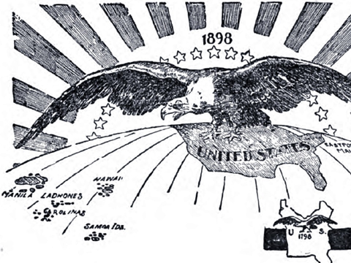
American Progress
1890: Wounded Knee Massacre represents the last major skirmish in the American Indian Wars
1898: America gains control over Puerto Rico, Cuba and the Philippines after the Spanish American War. But, War of the Philippines goes from 1899 - 1902

Slide 8
Other European Conflicts
Sino-French War: 1884-1885 Gives French control of the Red River area and Hanoi; also lead to collapse of the Jules Ferry government (you know, 3 cheers for colonial expansion).
1899 -1902: Start of the Boer ( Dutch and German Farmers ) War in South Africa: The first true guerrilla war where the enemy did not wear uniforms;

Slide 9
Summary
Most of this “imperialism” is being justified as progress.
Obviously this “progress” borders on Genocide.
The more relevant question is where does culture get the notion of moral superiority and how is that used to justify these acts?
Does religion grant moral superiority? Does scientific prowess grant the same?

