Slide 1
Tycho Brahe (1546 – 1601)
Using Observations to detect Stellar Parallax to prove the Earth Orbits the Sun

Slide 2
Tycho realizes this is the correct experiment to perform
Schematic Representation of stellar Parallax. Distant stars act as a fixed reference coordinate system. Nearby stars, when observed 6 months apart, will show a small movement with respect to the background of fixed stars. At position 1, the nearby star would be viewed against a background that contained star B while 6 months later, at position 2, the nearby star would be viewed against a background that contained star A.

Slide 3
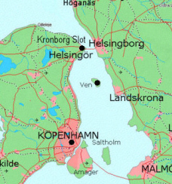
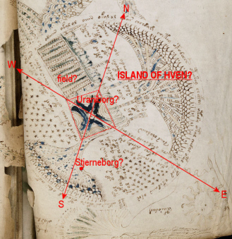
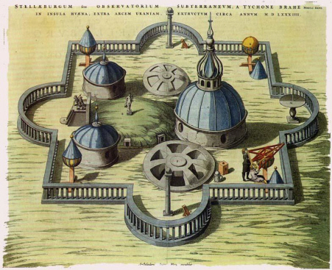
Naked eye Measurements from a built Observatory at Ven
He used a series of long "sextans" that could measure fairly accurately the angle of a star above the horizon. The azimuth was measured in degrees from some starting point in this circular observatory out portals that were equally spaced around the floor.

Slide 4
Measurements
So he measured the positions of many stars to see if he could detect a parallax shift for one set of stars relative to another.
He failed to detect any shift so concluded that the Earth could not go around the sun
Based mostly on internal arrogance, Tyco proposed his own hybrid model for the observed motions where the planets orbit the sun but that whole system orbits the Earth

Slide 5
The Tychonic Model
This hybrid model doesn't work at all with respect to either retrograde motions or predicting planetary positions, but it does explain why Venus and Mercury would always be seen in the sky, relatively near the Sun. The model, however, also allows Mars (as well as Jupiter and Saturn) to come much closer to the Earth than the standard heliocentric model. This means there would be times when Mars should be really bright in the sky.
The Model Visualized

Slide 6
The Detection Problem
He made the best measurements that had yet been made in the search for stellar parallax. Upon finding no parallax for the stars, he (correctly) concluded that either
the earth was motionless at the center of the Universe, or
the stars were so far away that their parallax was too small to measure.
The Detector Issue

Slide 7
Overall Contributions
He made the most precise observations that had yet been made by devising the best instruments available before the invention of the telescope.
His observations of planetary motion, particularly that of Mars, provided the crucial data for later astronomers like Kepler to construct our present model of the solar system.

Slide 8
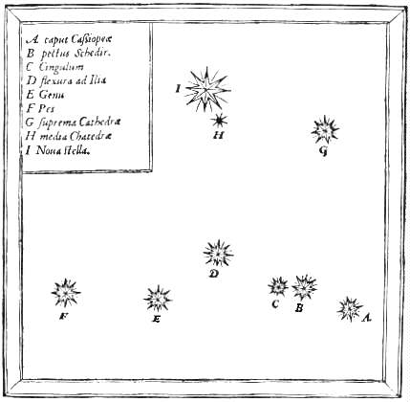
Observed Change in the Universe
In 1572 he made observations of a rare Supernova occurrence in our Galaxy.
This "star" appeared suddenly where none had been seen before, and was visible for about 18 months before fading from view. Since this clearly represented a change in the sky, prevailing opinion held that the supernova was not really a star but some local phenomenon in the atmosphere (remember: the heavens were supposed to be unchanging in the Aristotelian view). Brahe's meticulous observations showed that the supernova did not change positions with respect to the other stars (no parallax). Therefore, it was located like a real star, not a local object. This was evidence against the immutable nature of the heavens.

Slide 9
Lucky Guy sees a Comet in 1577
Brahe made careful observations of a comet in 1577. By measuring the parallax for the comet, he was able to show that the comet was further away than the Moon. This contradicted the teachings of Aristotle, who had held that comets were atmospheric phenomena ("gases burning in the atmosphere" was a common explanation among Aristotelians). As for the case of the supernova, comets represented an obvious change in a celestial sphere that was supposed to be unchanging; furthermore, it was very difficult to ascribe uniform circular motion to a comet.

