Slide 1
Capella’s revision
An obscure figure in history but his work is preserved for Copernicus to “cite”

Slide 2
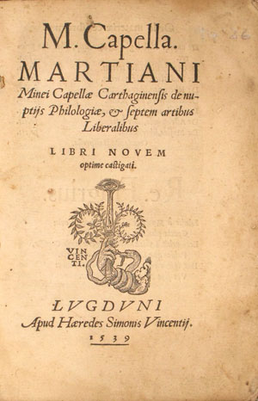
Originally written after the sack of Rome (410 AD) but before the conquest of North Africa by the Vandals in 429.
De nuptiis Philologiae et Mercurii ("On the Marriage of Philology and Mercury“) is an 8 Volume work.
The title refers to the allegorical union of the intellectually profitable pursuit (Mercury) of learning by way of the art of letters (Philology).
Reprinted in 1539 through the printing press and thus available to Copernicus

Slide 3
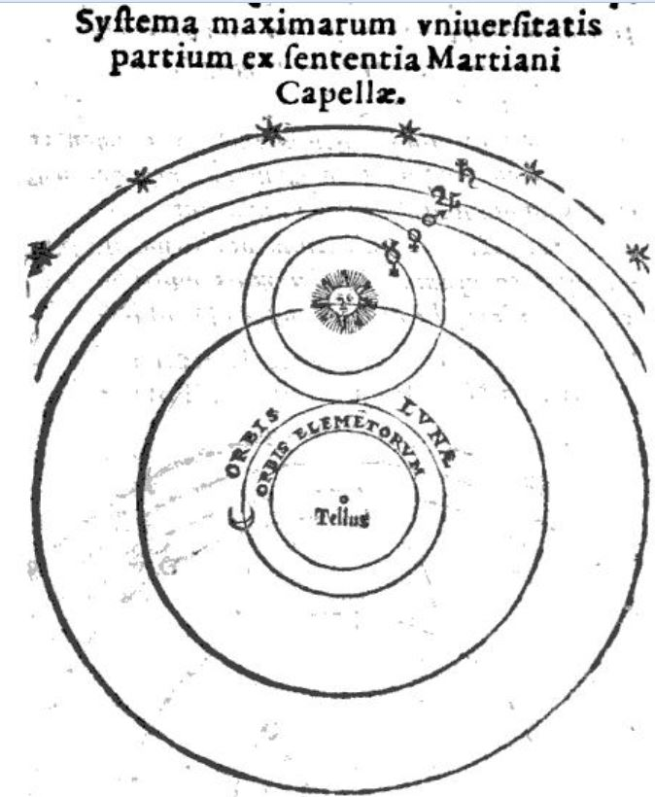
what do you notice?
Mercury and Venus now orbit directly around the SUN and that SYSTEM orbits around the Earth.

