Slide 1
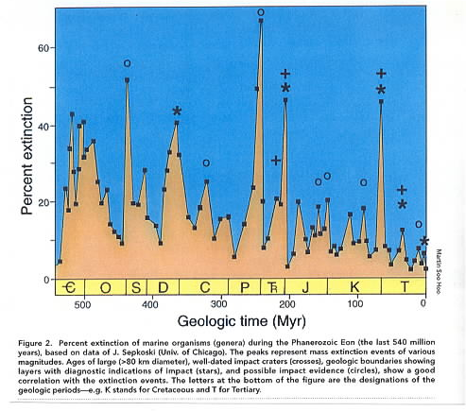
Periodic Extinctions of Varying Amplitude (percent extincted)

Slide 2
Mass Extinctions and Evolution
½ to 2/3 of all species are eliminated during big events
Plankton in the ocean is nuked
So both the land and water are effected
Encephelization Levels (EL) in organisms measure the amount of brain tissue in excess of that needed for basic metabolism maintenance

Slide 3
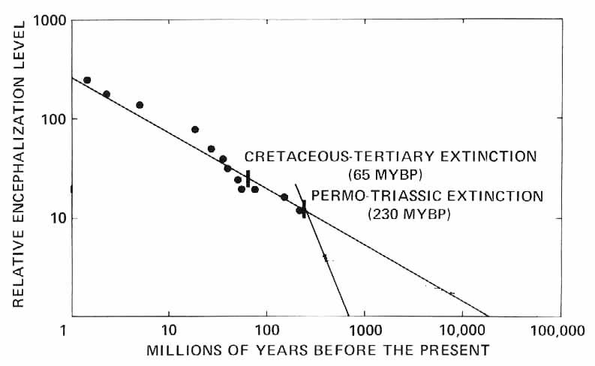
Evolution of Intelligence?
This diagram has many features:
EL Doubling time About 2 MY
Unaltered EL Evolution would have produced “humans” 60 MYA
Last 200 million years has constant slope
Fastest Growth: 600-250 MYA; beginning of sea to land migration

