Slide 1
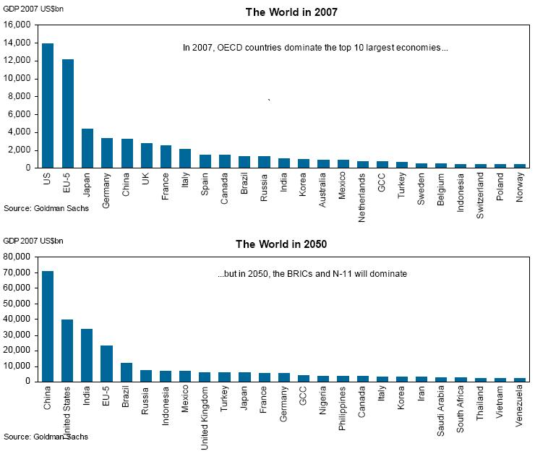
Globalization and Change
Big E or Little e →
US = 5* (China+India)
Post WW II
Japan + Germany = 0.5*US
New Players = Indonesia, Mexico, Turkey
(China + India) = 3* US
Japan + Germany = 0.2*US

Slide 2
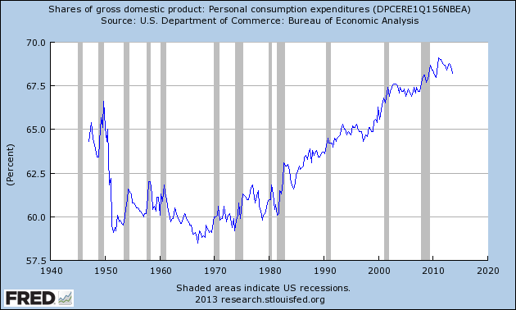
The Consumptive Mandate Waveform: if you got more, consume even more: Maintain BAU
Greed
sustainability

Slide 3
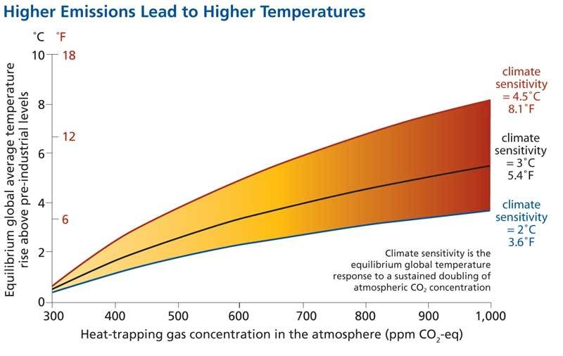
Accelerated Climate Change
CONSUMPTION →

Slide 4
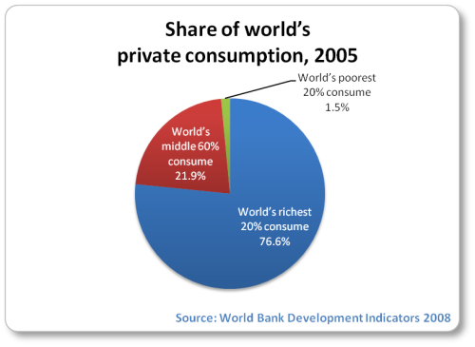
Correct this →
Our view of the world as a resource to use up must change!
Profit vs Equity: Surplus → Growth or Equity? Growth or Prosperity?
This is your generations challenge:

Slide 5
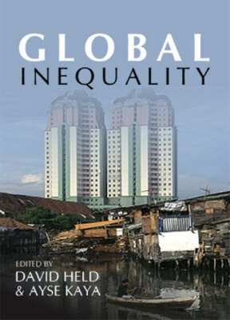
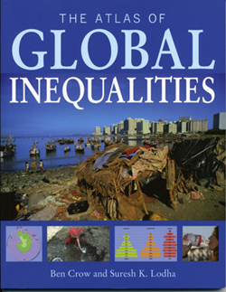
What Inequity Looks Like

Slide 6
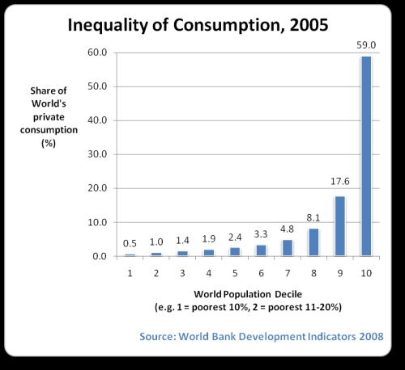
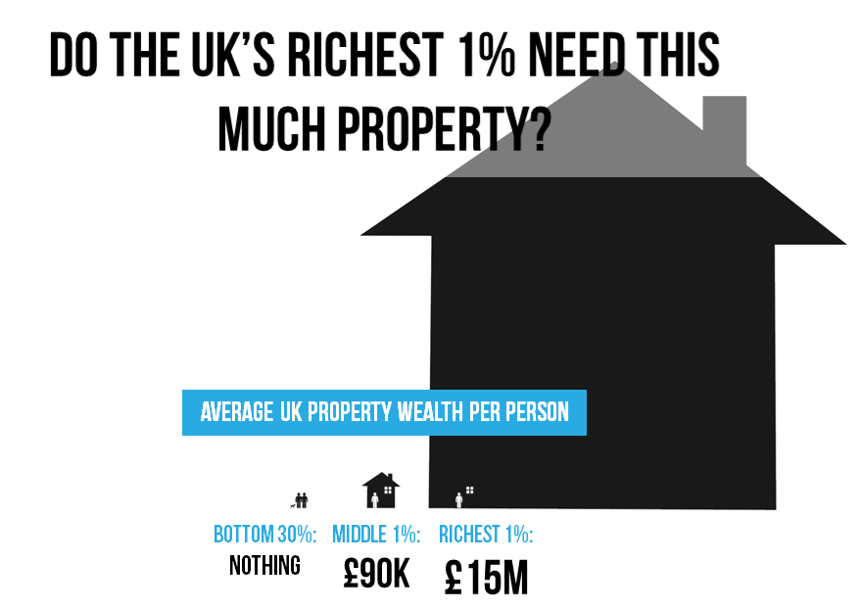
There is some indication that this is starting to change slowly

Slide 7
Summary
Once again, the issue is not that inequity exists but rather that the amplitude of the inequity is enormous (and getting larger)
The bias of GDB is that this situation is the end result of e continually trying to implement E in a social Darwinist manner
However, bubble collapse now gives us a second chance to behave differently → which do we value more – personal wealth or global equity?

