Slide 1
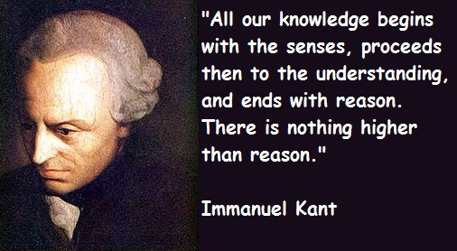
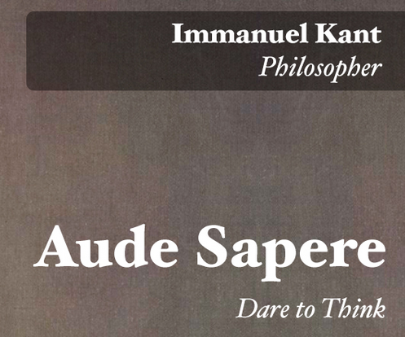
1724-1804: He made a very influential synthesis of rationalism and empiricism. Empiricists, such as Locke and Hume, argued that all our knowledge comes from experience, or from reflection on experience. Rationalists argued that empirical knowledge is uncertain and only reason can lead us to truth.

Slide 2
Rationalists vs Empiricists
There is a very big difference in which of these two approaches is adopted
Empiricism: encourages collective humility (gee, I don't understand a damn thing!)
Rationalism: encourages collective arrogance (we can understand everything; hell we do understand everything)
Its quite clear that we have collectively chosen rationality as our means for certifying and ascertaining the Truth. The Truth is NOT unimportant.

Slide 3
Kant Reinforces Rationality
All our knowledge begins with the senses, proceeds then to the understanding, and ends with reason. There is nothing higher than reason.
But although all our knowledge begins with experience, it does not follow that it arises from experience.
If man makes himself a worm he must not complain when he is trodden on.
Seek not the favor of the multitude; it is seldom got by honest and lawful means. But seek the testimony of few; and number not voices, but weigh them.

Slide 4
Some Context
After the Death of Newton, the scientific revolution continued to accelerate with more and more sophisticated experiments being done and methods of inquiry developed. With the development of Calculus, statistical methods could now also be developed. The roots of most modern scientific disciplines can therefore be found in this period. Moreover, philosophy at this time was moving hand in hand with this Scientific Revolution:

Slide 5
The Influence of Hume
Response to Hume
Given his temperament, Kant was not the sort of man who could abide Hume’s suggestion that humans are emotional, not rational, beings.
Nor could Kant abide Hume’s claim that, at best, science and philosophy are games people play to have fun, rather than ways of attaining truth.

Slide 6
Kant’s Analysis of Perception
Every perception is a two-fold reality: i.) raw sense data and ii.) the organizing and structuring of that data by the mind.
Sense data, by itself, is a meaningless jumble.
Sense data makes sense only after it has been organized and structured by the mind’s categories.
A perception there occurs when the mind’s categories organize and structure this raw data

Slide 7
Kant’s Required Ordered Mind
Humans can have no knowledge of “things in themselves”
Order and structure do not exist “out there” in the noumenal world (the world of things)
Order and structure only exist in the phenomenal world of the human mind.

Slide 8
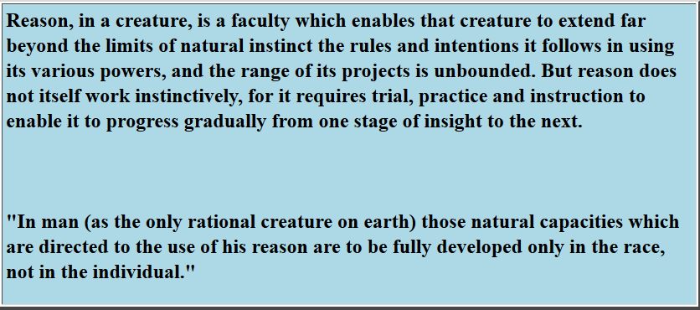
Kant’s Mechanistic Pathway
What does this mean and why is it dangerous?

