Slide 1
The Problem With Mercury
And an anomaly that can not be reconciled with Newton

Slide 2
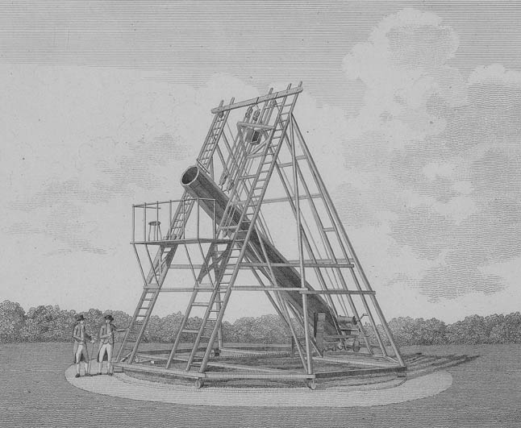
Say it ain’t So
Herschel in the 1780s studied the motions of double stars and showed that they obeyed Kepler’s Laws
Why is this important?

Slide 3
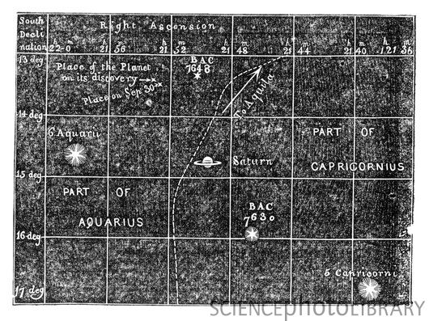
A motion anomaly – fully resolved
Next, comes the triumph of mathematics and the validation of precision The 1846 Discovery of Neptune:

Slide 4
The Problem With Mercury.
Precision measurements in the 1840's and 1850's showed that the orbit of Mercury did not conform to Newtonian Mechanics. As in the case of Uranus, a suspected perturbing body was the likely explanation.
However, in 1859, Levierre (the same guy involved in the discovery of Neptune) showed, using precision calculations, that this could not be the source of the observed anomaly in the orbit of Mercury.
So what to do Dismiss the Anamoly or Dismiss Newton?
What would Newton Say if presented these data?

