Slide 1
Resistance to Cultural Change
Is Profound!
Remember the bias of Bothun: Inequity and climate change in the world are driven by increasing per capita consumption because that is how prosperity and progress are defined and that has determined out value system. We are driven to that value system due to little e coercion combined with the Social Darwin Mantra of penalizing the UNFIT. Three Cheers for Trump!

Slide 2
One Earth Resources Equal For All
The Moral Perspective of Planetary Management

Slide 3
Business world analogy
The 7 reasons that (business) culture resists change
There isn't any real need for the change
The change is going to make it harder for them to meet their needs
The risks seem to outweigh the benefits
They don't think they have the ability to make the change
They believe the change will fail
Change process is being handled improperly by management
The change is inconsistent with their values

Slide 4
Mapping on to changing our cultural consumption habits
1. There isn’t any real need for change
There is no evidence that suggests our current consumption habits are damaging in any way; consumption produces a better standard of living – why change that?

Slide 5
2. The change is going to make it harder for them to meet their needs
Reducing consumption and consumption fossil fuel based energy is too hard to do and will significantly compromise my current lifestyle. Furthermore, since there is not evidence that compels me to make such a change, Fuck it …

Slide 6
3. The risks seem to outweigh the benefits
My short term economic security is far more important than long term benefit for the planetary ecosystem

Slide 7
4. They don't think they have the ability to make the change
I am an individual, what can I do that will actually make any impact? (see last slide for your impact!)

Slide 8
5. They believe the change will fail
Since there is no evidence that changing our consumption habits will have any positive effect then any such mandate to change will surely fail and have significant negative consequences.

Slide 9
6. Change process is being handled improperly by management
We don't trust our government to make a fair set of regulations. We don’t trust scientific advisors to the government to be unbiased. All policy recommendations serve only self-interests. Little e will continue to screw us worms and passing shadows, just like it has always been.

Slide 10
7. The change is inconsistent with their values
Of course it is!
We are not part of nature; we control nature; nature does not control us. We are not in partnership with nature. The Aboriginal world view is bullshit. The perfect, precise, logical, and ordered view of the Universe is correct and Humans are Special.

Slide 11
Consumption Driven Increased inequity since we are all so fucking special
Business as Usual
Is our GOD

Slide 12
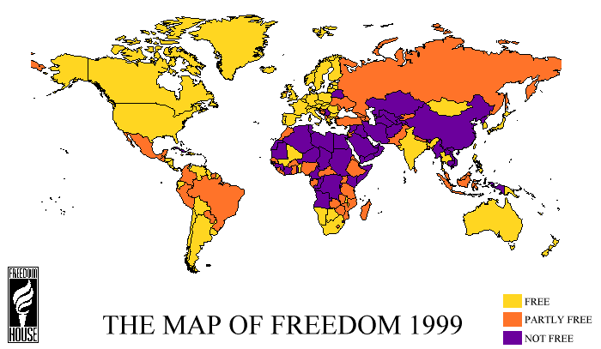
When the world has gotten to the point where access to freshwater is not equitably distributed – well then, the elite have WON!
Physical, economic water scarcity..& freedom

Slide 13
Your BAU Future

Slide 14
What can you do as an individual: Be Optimistic and Proactive
Change can occur when consumers are properly informed.
Technological solutions exist to make significant impact if deployed now
Consume Less
Technology is rapidly improving
We are probably NOT Terminally Stupid

Slide 15
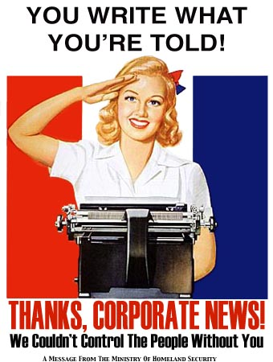
You have three choices:
Make the Wise Choice
Practice BAU
Give UP
Proactive: Educate your Peers

