Slide 1
Images for Symbols
You have 10 Runes – no rules, drag and drop them in some order to describe the following images

Slide 2
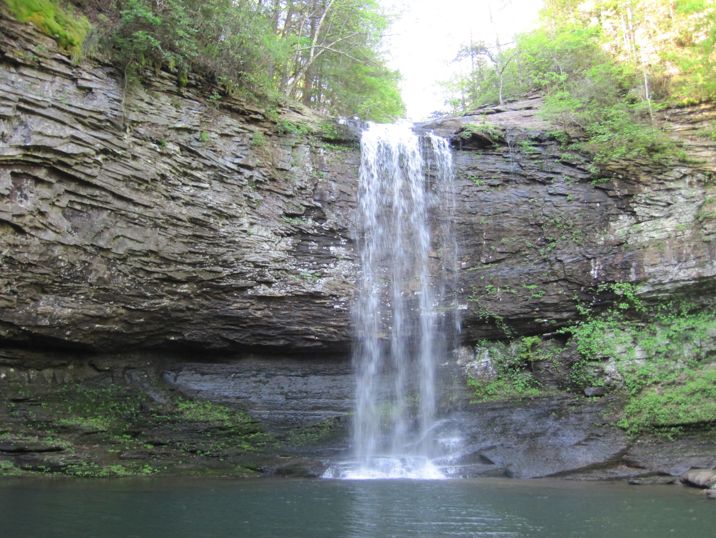

Slide 3
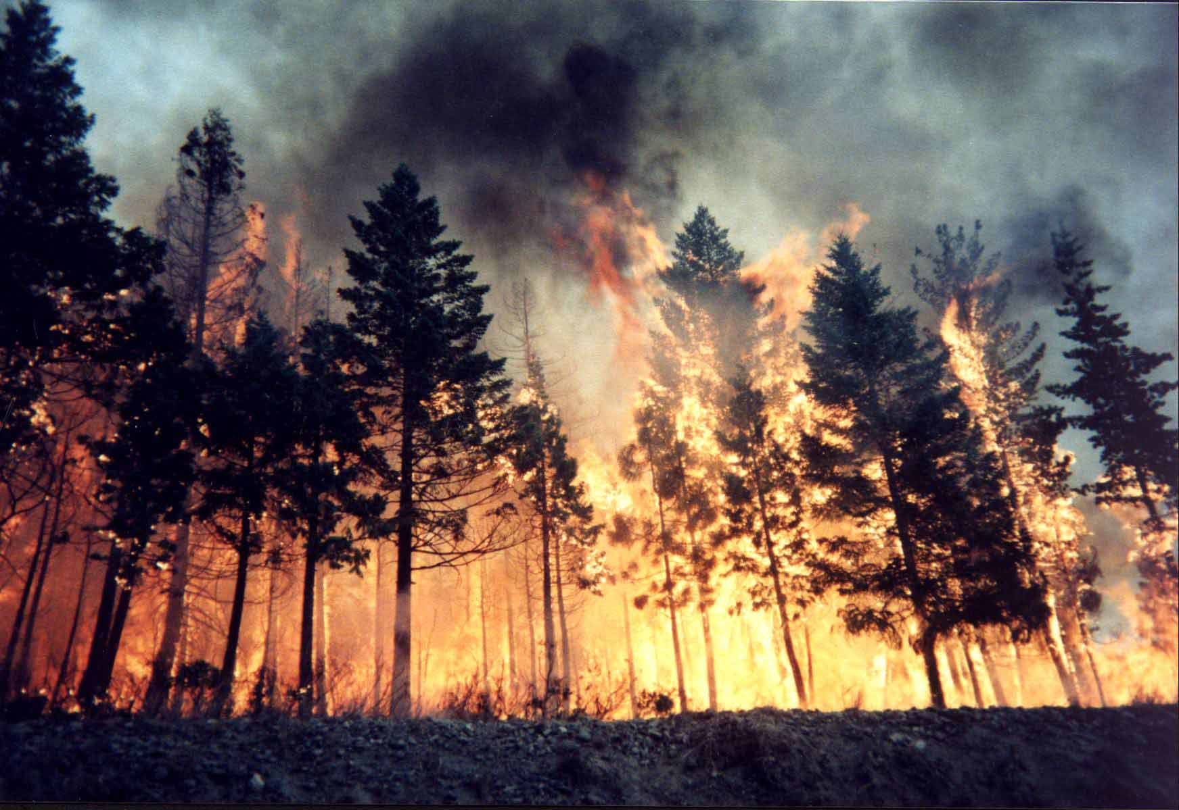

Slide 4


Slide 5
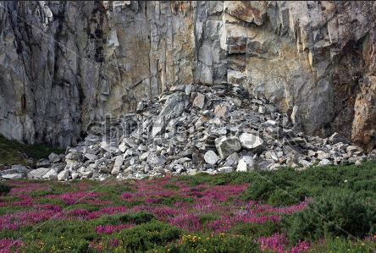

Slide 6
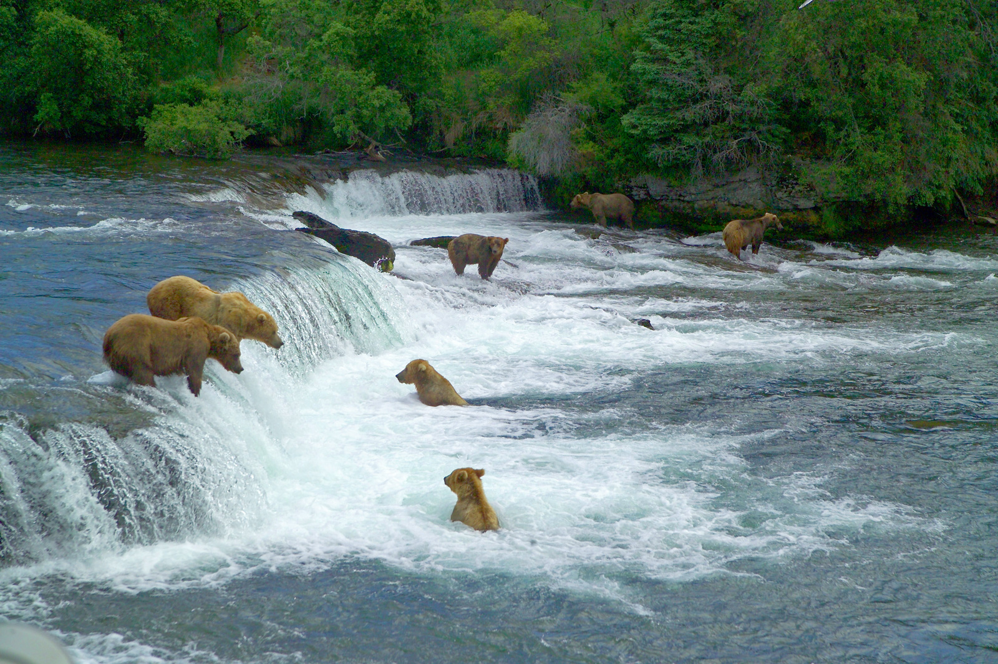

Slide 7
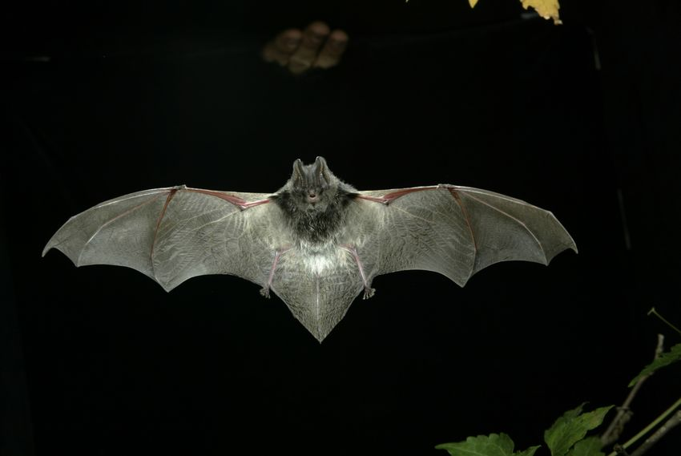

Slide 8
