Slide 1
Differential Adaptation to Climate Change Events is our future
Basically, a climate change event now is one that moves tremendous amounts of ocean water to places its not supposed to be:
More intense (but not more frequent) Hurricanes and Typhoons
Intense 2-3 week long rainstorms (mostly in Europe)
Significant higher storm surges (sea level rise)
Main effects:
Loss of soil nutrients to sustain agriculture
Salt water intrusion that destroys agriculture
Land alteration and deprecation that impacts livestock and breeding
Leakage of water into mining facilities
Complete disruption of coastal fisheries

Slide 2
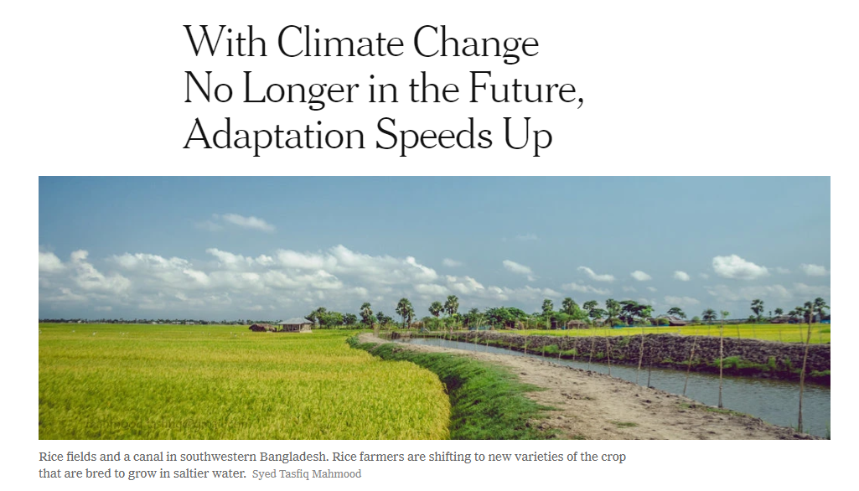
But that Future is NOW; From NYT Sept 2018

Slide 3
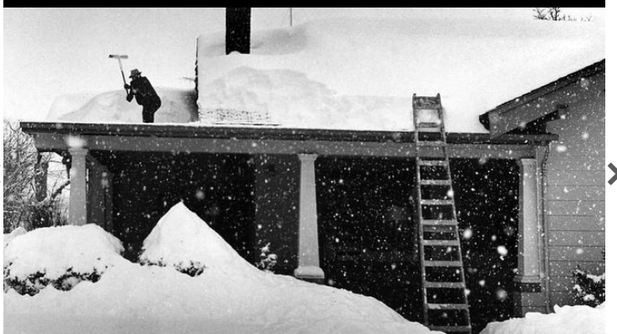
Climate change is Extreme Weather Volatility a lot more than it is systematic warming.

Slide 4
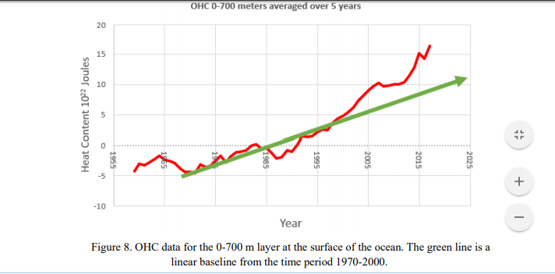
All rates are accelerating; The Result; more catastrophic weather systems

Slide 5
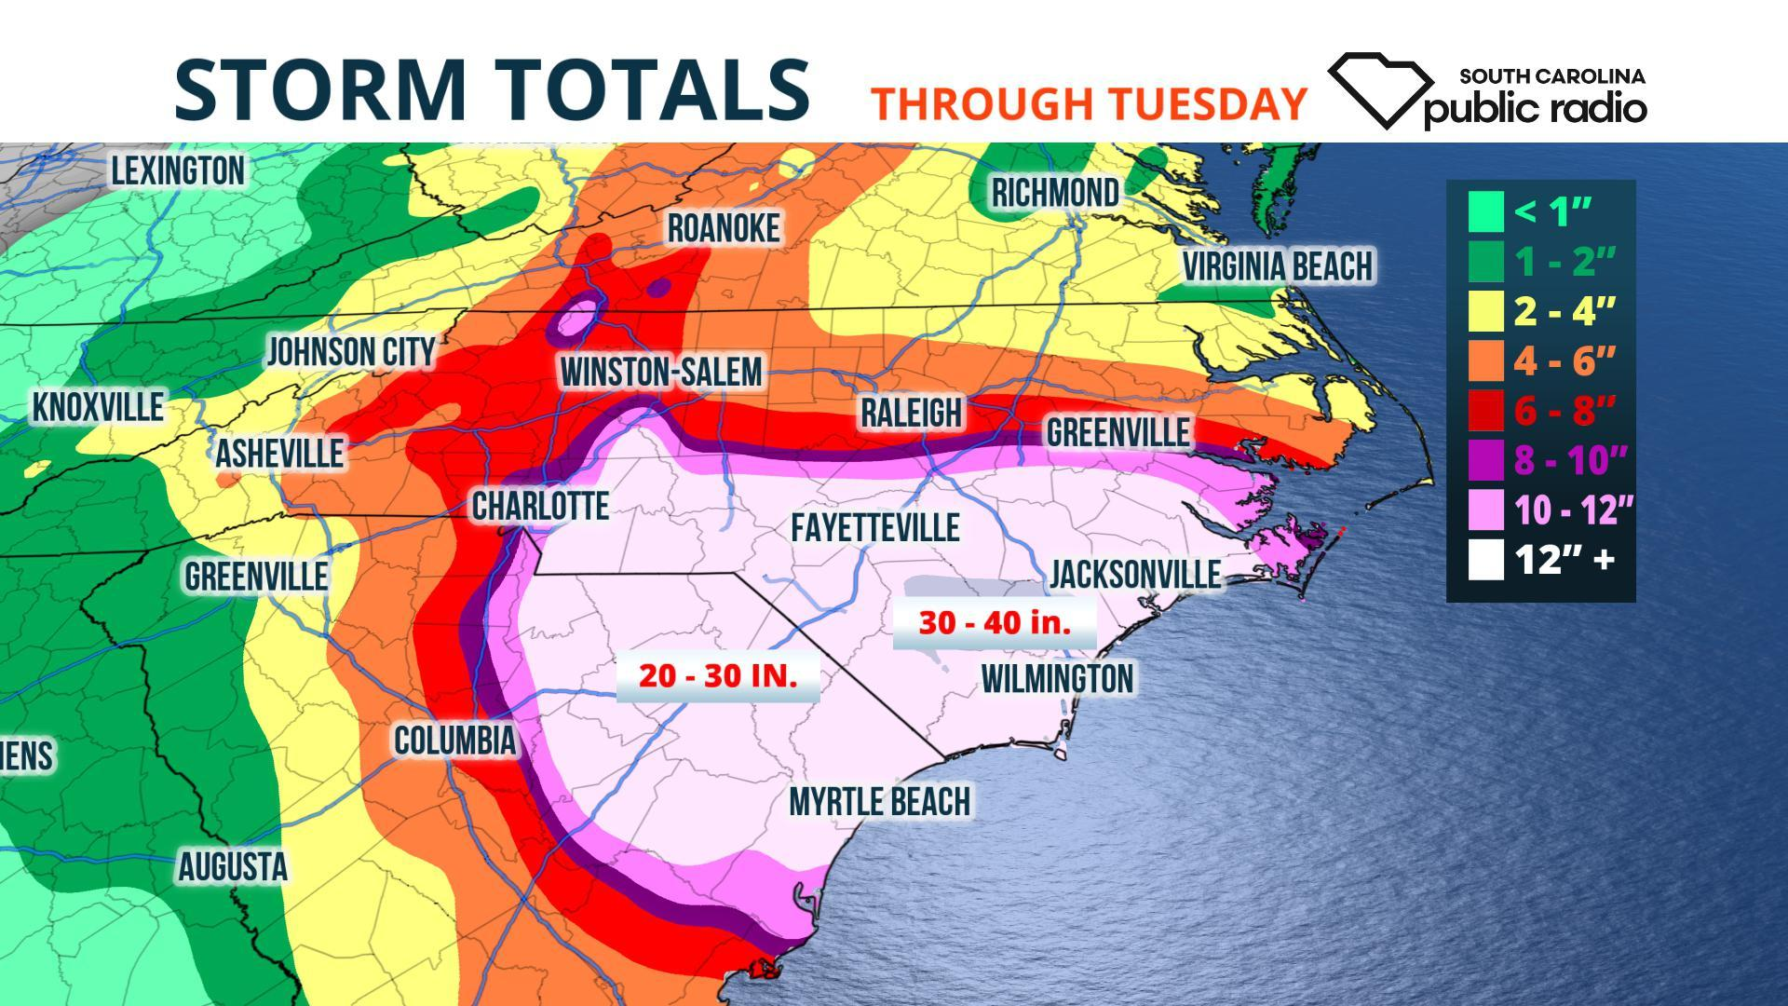

Slide 6
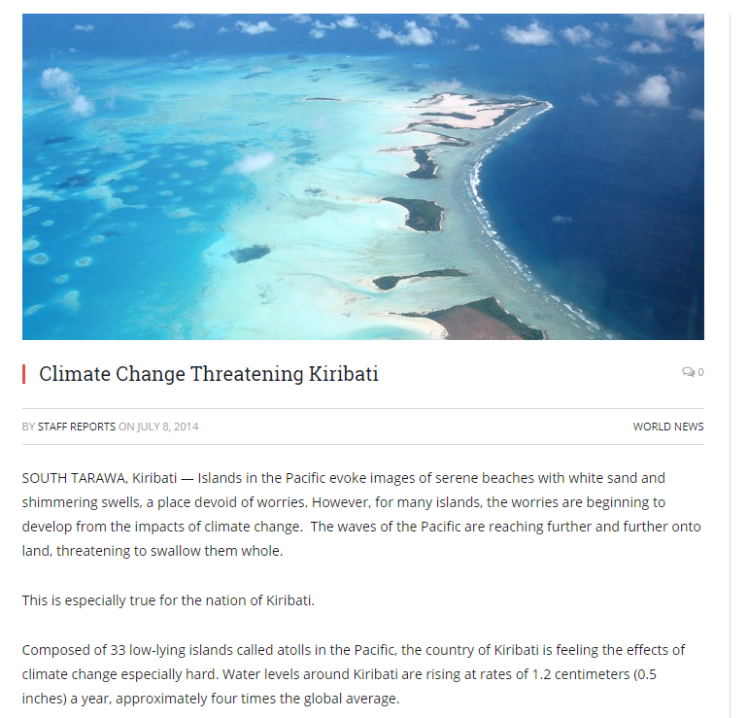
The only thing which really is systematic is the relentless rise of sea level – that can not be stopped. In the case of Kiribati its not adaptation its abandonment

Slide 7
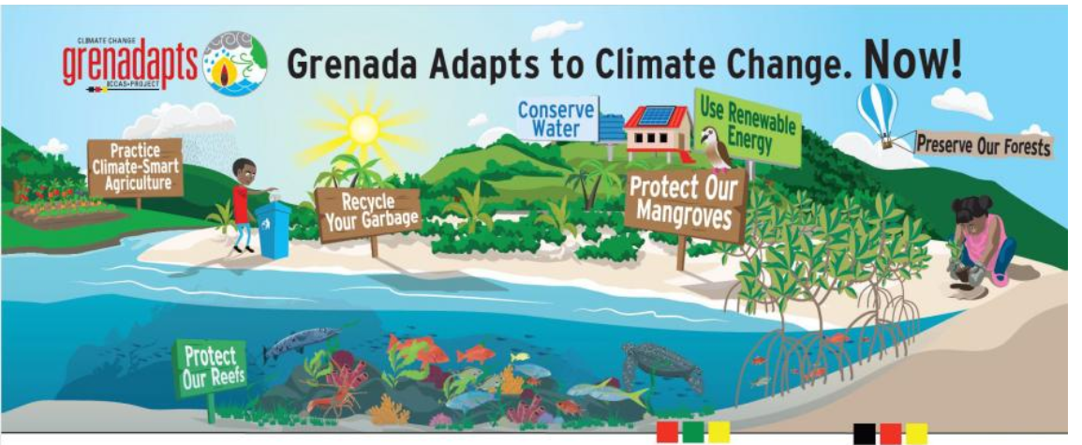
For islands with mountains, adaptation remains possible

Slide 8
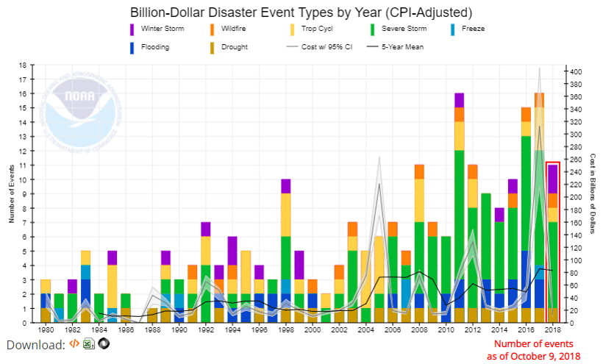
But events are increasing in frequency and the size of the event dictates longer recovery times

Slide 9
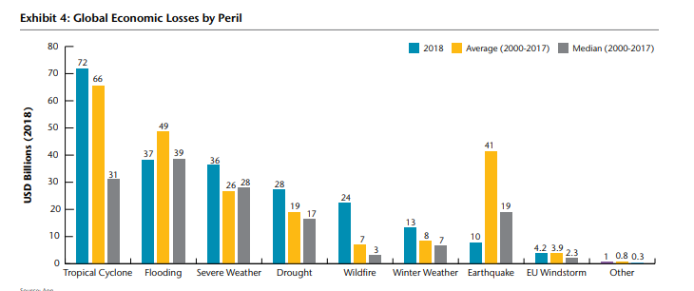
Most events are Flooding Related

Slide 10
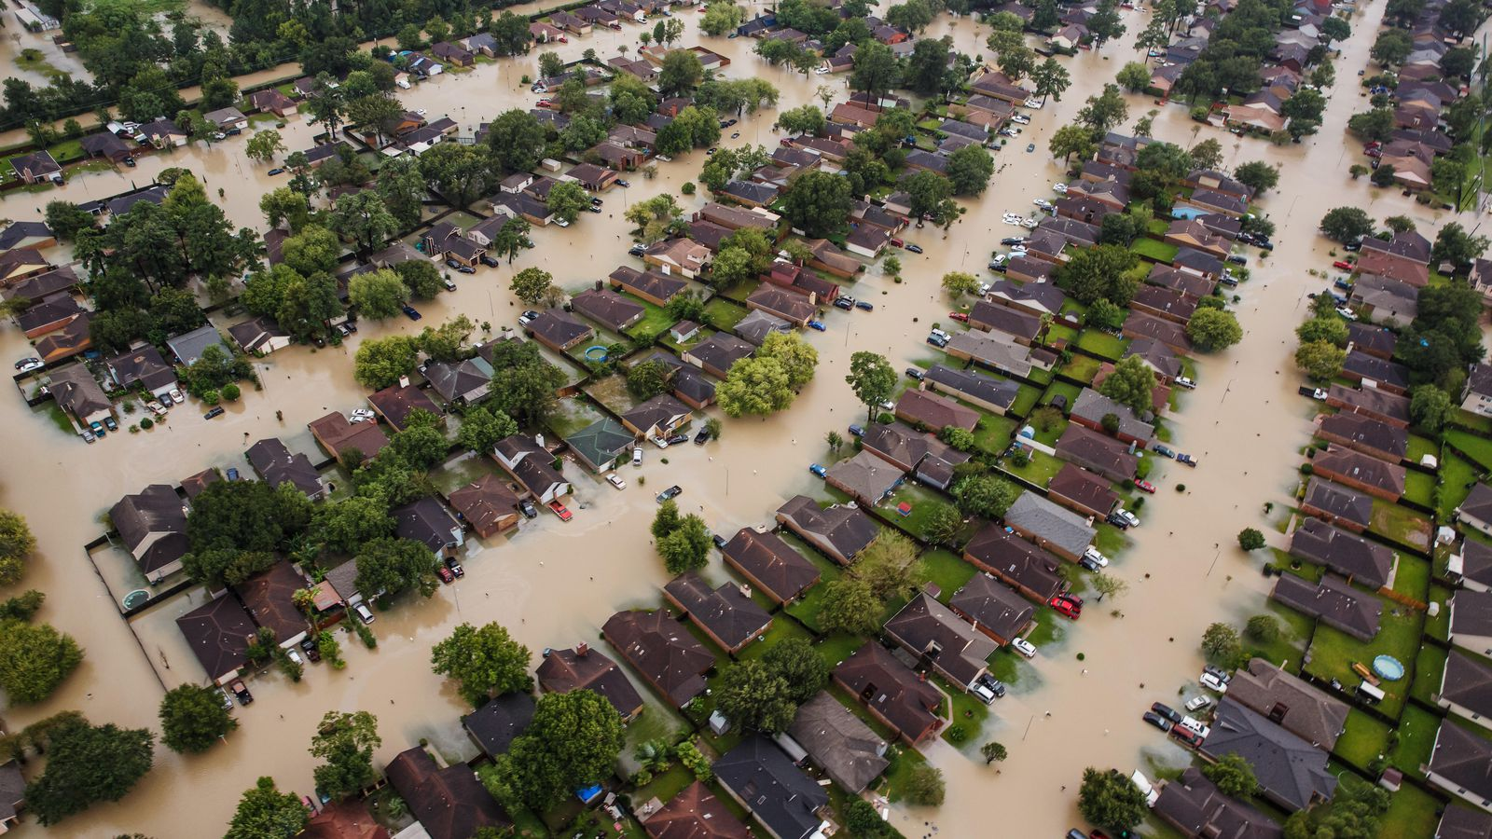

Slide 11
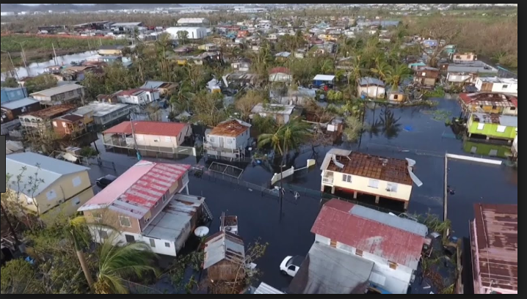
drones

Slide 12
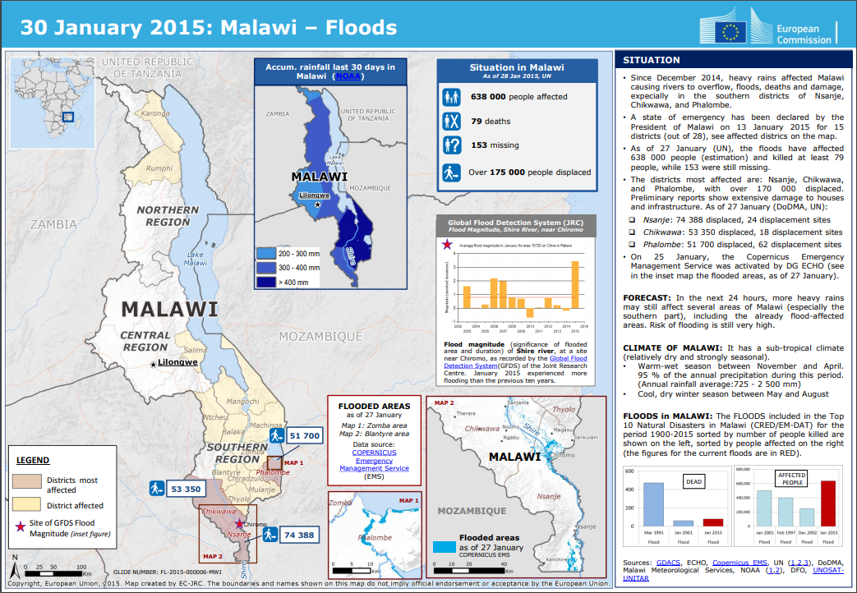
The 2015 Malawi Floods – 22% of the country under Water

Slide 13
But its not just Large Scale and unprecedented Flooding; 2018 California wildfires are another example of scale that overwhelms the support system

Slide 14
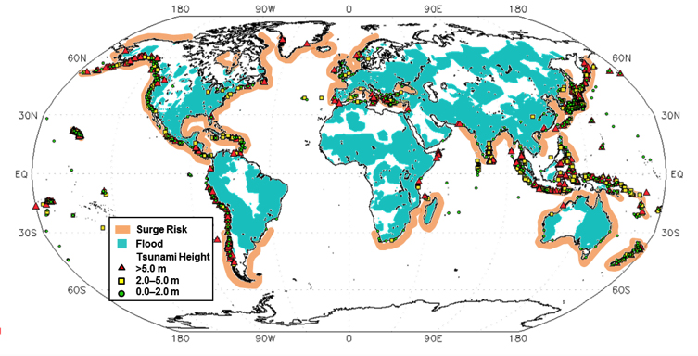
The Scale of the Surge Problem is Large and is amplified by coastal topology

Slide 15
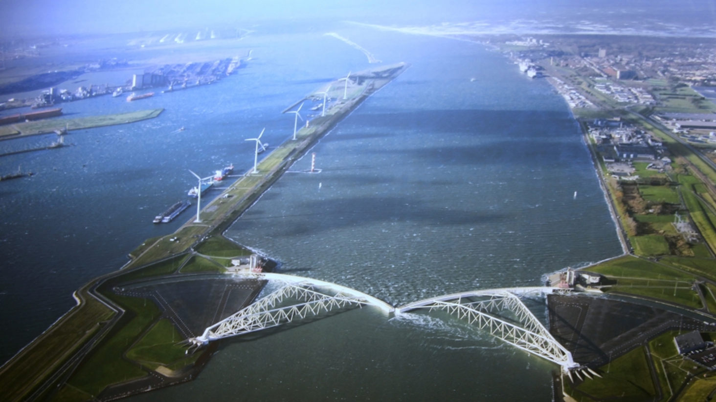
Need to build infrastructure which has high capital cost

Slide 16
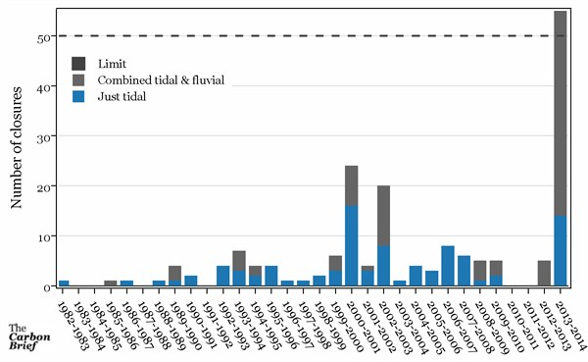

Slide 17
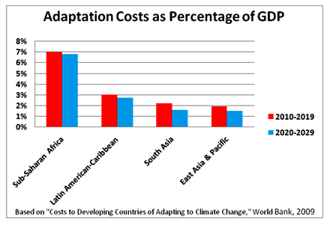
Adaptation costs rise non-linearly (accelerate) with each year that we delay. Cost relative to gDP highly regional
In 2018: Current leaders in spending were EU at 1.8% and India at 2.6% of GDP

Slide 18
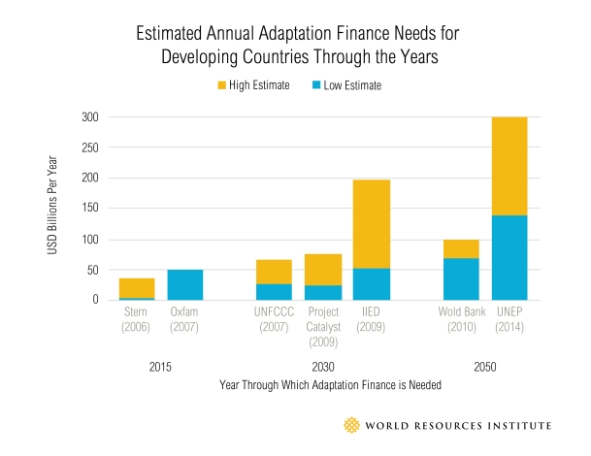
Costs continued

Slide 19
As measured by adaptation costs and 2016 gdp Per capita the illustrated countries below have zero ability to bear climate change costs

