Slide 1
Policy One Comparison and Debrief Discussion
Remember, all is an Illusion:

Slide 2
Overall
Most language that was used was too scientific, this was expected, you need to think about other ways to say the same material that the lay person might better related to. More importantly, the lay person likely has pre conceived ideas that you need to get around (e.g. global warming vs climate change).
“If you can get an endorsement from an athlete that everybody recognizes, then who needs science?” and "Scientific facts don’t sell products; stories do."

Slide 3
What might the problems be here?

Slide 4
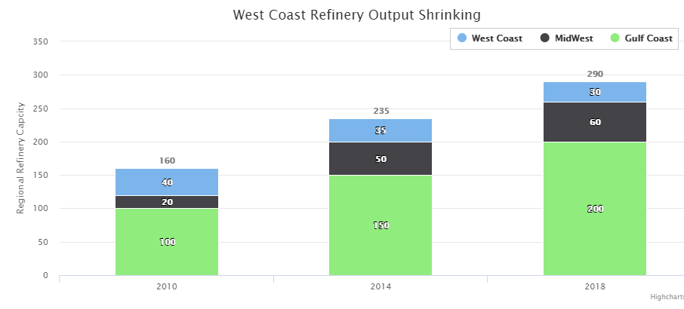
IS there a better way to show this?

Slide 5
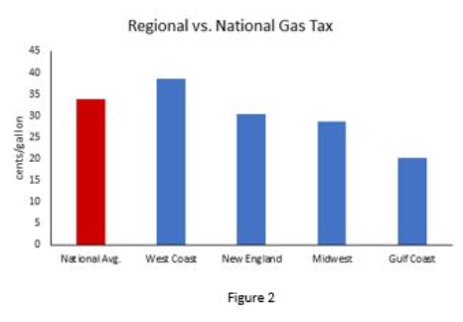
West coast clear here

Slide 6
Effects of west coast oil refinery explosion and extensive down time

Slide 7
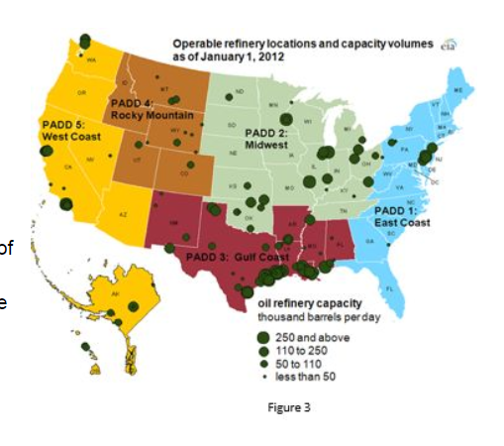
This is better (but show over time)

Slide 8
This Makes my Policy Head hurt

Slide 9
Whoops – west coast capacity goes Down

Slide 10
This is good but very hard to process; what is a negative ratio? So many digits confuses the reader → this could be presented better in some visual way
Agreed that is hard to draw any conclusions for what price of gas is needed for conservation – clearly we haven’t tested this yet

Slide 11
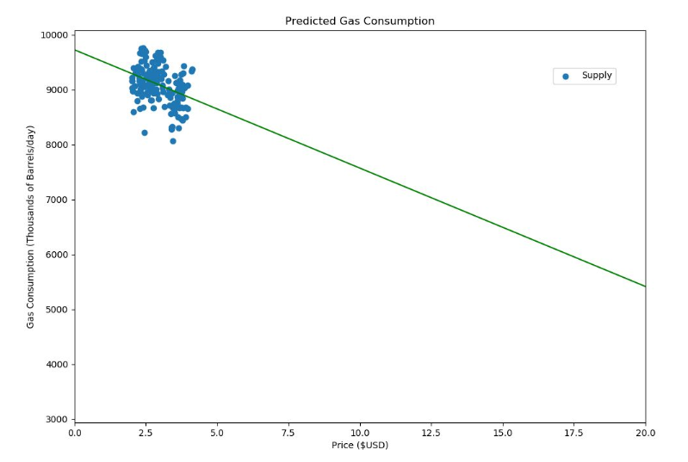
Global
Cooling?

Slide 12
But this is unamerican !!

Slide 13
Why is read “Constant” and Blue “way wigglier” ???

Slide 14
You have to use average annual miles driven to make this kind of graph

Slide 15
Shade areas of “good” and “bad” – why the big drop around 2012 – summarize that on graph

Slide 16
Show this with a figure so I know your not making this up
Boring, - I don’t know what 0.00423 % even means … let alone a percentile

Slide 17
This is Good

Slide 18
Policy
$3.3 per gallon → 3.9% reduction ; 50 billion raised → scaling the flat rate by population density (but nowhere is it shown how 50 billion comes from this and what the scaling is)
“It does not seem possible to determine a baseline …” that’s a complete punt – there are lots of ways to do this
15% of all driving is recreational → proposed $2.40 tax on that which ramps up to 17.70$ (this approach might actually work since drivers would be trained to seek alternatives in certain cases)

Slide 19
Show me a picture …

Slide 20
This is Good: Need a visual to show pipeline to 50 Billion

Slide 21
We currently use 21 MBD → this is drastic

Slide 22
Good approach but tax commodity miles more than the others – note this is independent of the actual gas price – its all taxes

Slide 23
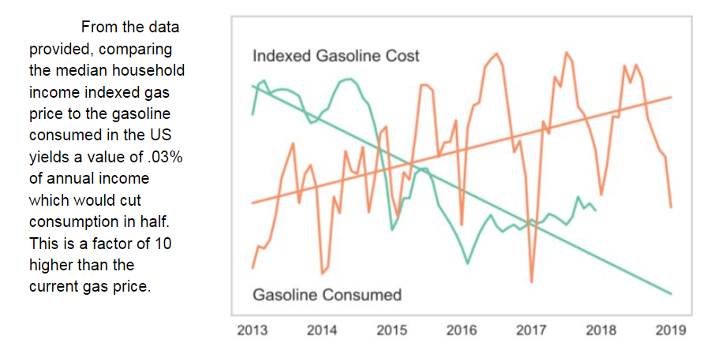

Slide 24
This approach also fixes the social security problem

