Slide 1
Second Policy Assignment Debrief

Slide 2
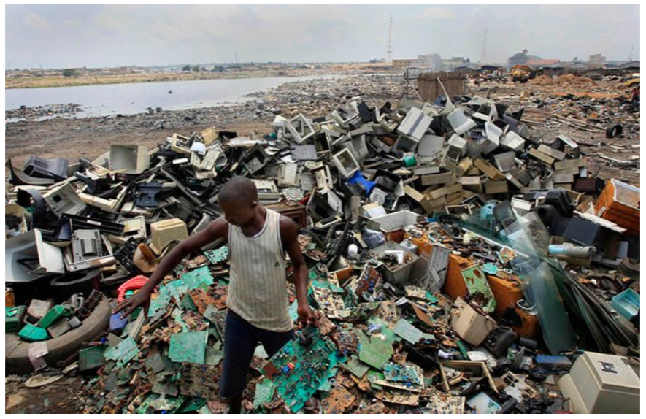
Excellent, start with humanizing the problem!

Slide 3
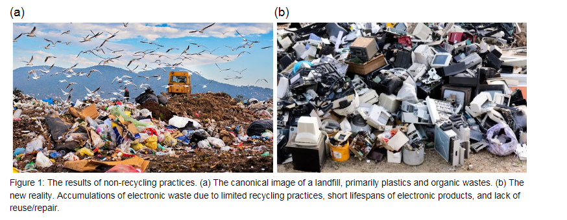

Slide 4
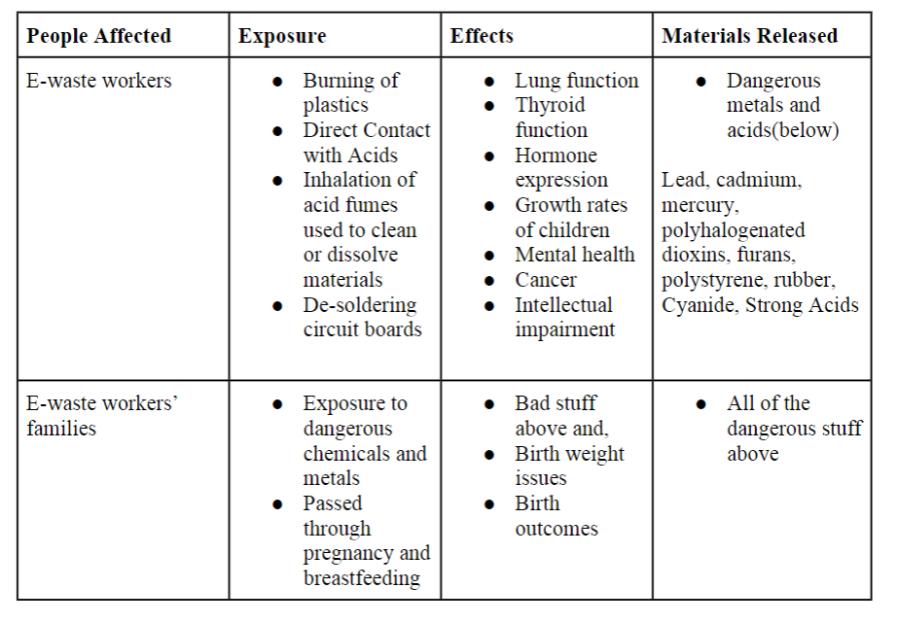

Slide 5
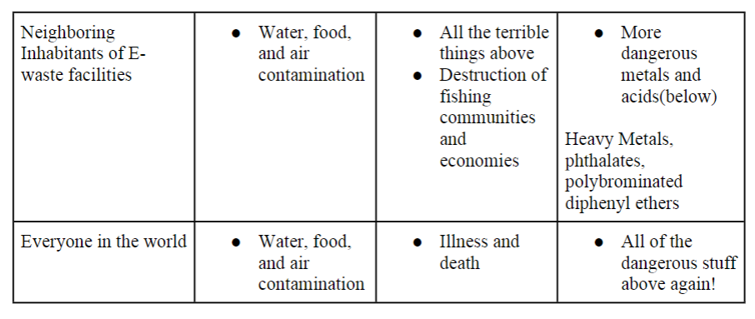
Note: E-waste interacts with its environmental surroundings via diffusion from precipitation – hence rainy sites are more vulnerable

Slide 6
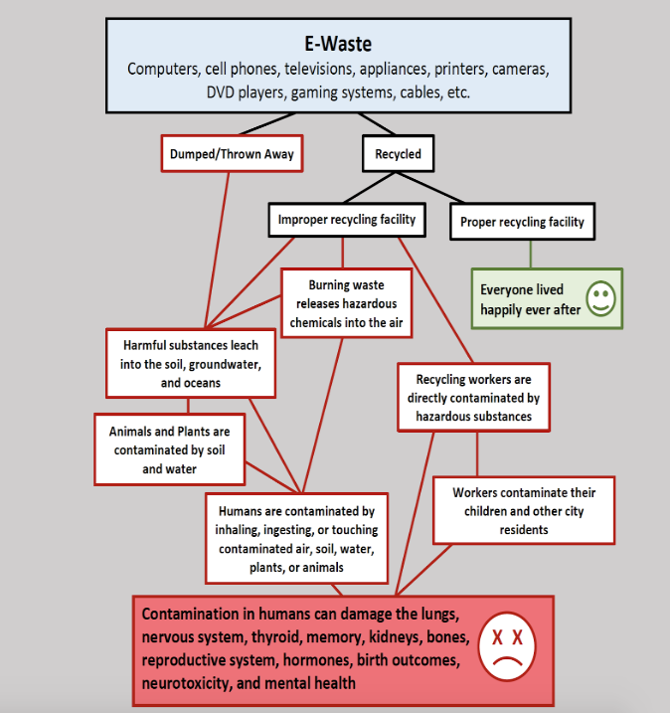
Which can you process faster, the table of a bulleted list or this figure?

Slide 8
Size of the Problem?

Slide 9
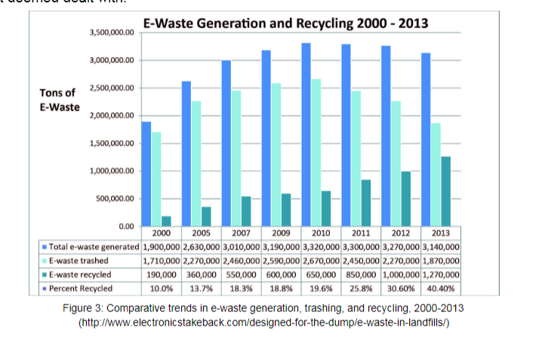

Slide 10
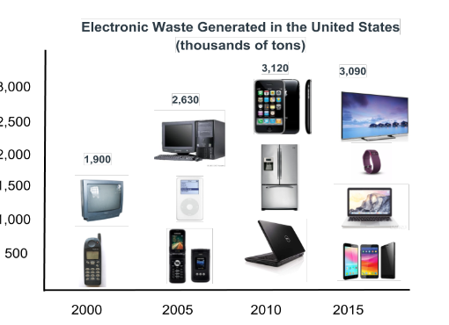
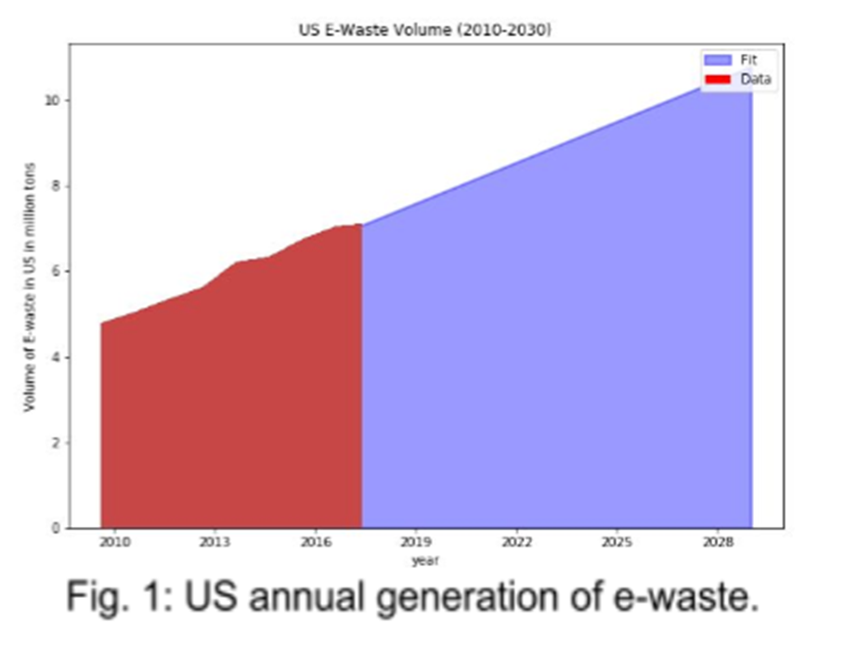

Slide 11
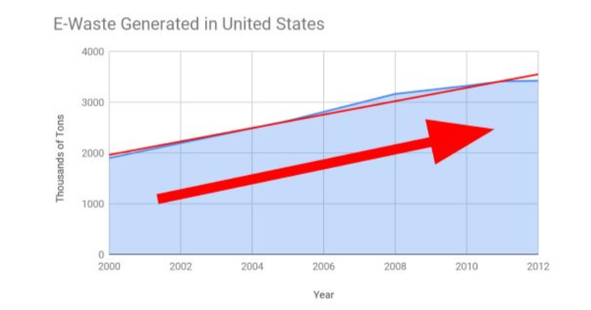
Big Arrows help Policy Readers

Slide 12
Evidence that Blue Team Learned …

Slide 13
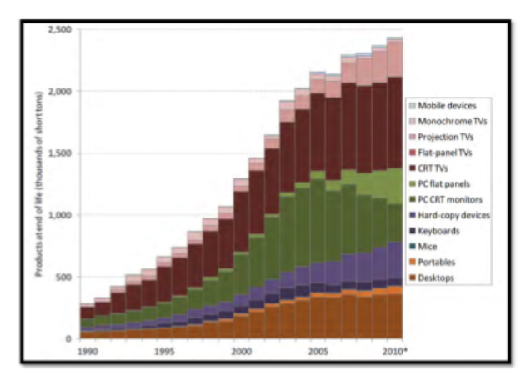
Good vs Not Good

Slide 14
Good – but then compare 2000 cubic meters to the size of a house or something – again policy makers need a context for anything quantitative

Slide 15
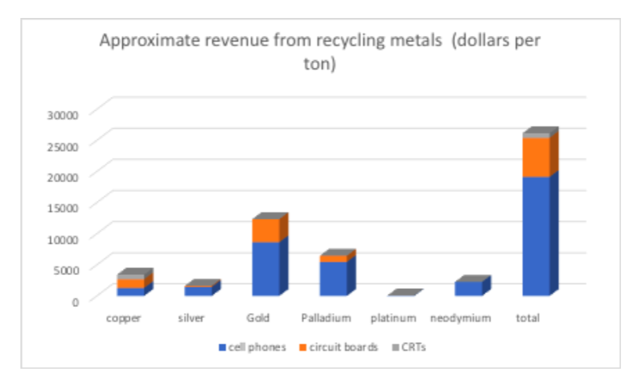
Good

Slide 16
Better … directly sells profitability but the text needs to be more exciting

Slide 17
After the plant is built, annual operating costs are estimated to be 6 million dollars; annual revenue from recycle metals are estimated to be 90 million dollar. This profit margin is likely the highest in the history of capitalistic endeavors which makes this program a complete no brainer.

Slide 18
Not sure if this is effective

Slide 19
More effective

Slide 20
And this is useful

Slide 21
Policy Bullets
The collection will occur on the local level once a month (but average lifetime of electronics is 5 years – so why not quarterly? Annually?)
75% by 2030 will create 1.1 million new jobs
If they have failed to recycle the item and instead sent it to a landfill, a fine will be sent to the household, normalized as 20% of the item’s original cost.
For precious metals (gold, silver, palladium, copper), a ton of E-waste (mostly cell phones) can produce $15 K → 1 worker can deal with 33 tons of E-waste → So then say that this is $450,000 per worker!

Slide 22
Good – visualize the formula

Slide 23
But use consistent units: 2.8 billion not 2812.5 million …

Slide 24
Good – a real summary

