Slide 1
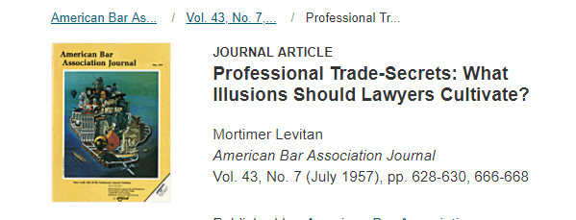
As you all determined, mathematically it is not hard to determine different kinds of tax rates to satisfy the goals. The question is, how many of these would represent a feasible or implementable policy. That is why the lawyers are here today to help discuss this.

Slide 2
In a room of ten children and ten toys, one child would be in control of 8 of the toys! This is
wrong and leads to a situation where the remaining nine children are vastly disadvantaged
compared to the one.

Slide 3
Nice
10% in Gaussian = 120K
10% in Skewed = 160 K
Most Importantly – US Censes Bureau Poverty line is 17K; Skewed shows that 10% statistically live in Poverty

Slide 4
Cross over at 137K = 83% of all households.
Median Household 15.2 % lowers to 8.9%
200-300K 30 to 40%
1.6 Trillion raised

Slide 5
Wealth
Fairly modest
Household wealth between 1 and 10 million → 1%
Household wealth greater than 10 million → 3%
Total revenue generated is 1.4 Trillion
Selling this: Historical return of stock market is 7% (but averaged over what time scale); so household wealth still accumulates

Slide 6
The No Brainer Way
Top 10% of American Households own 77% of the total wealth or 82% Trillion. So tax that at 5% for those 10% and your done! (done = 4T) But of course, if the stock market rises historically at 7% then these household now have a barrier to accumulating wealth. Will that matter in this policy?
Cut revenue income Tax by 50% across all brackets to raise 1T instead of 2T; 1.25 million households (1%) have wealth more than 10 million; tax that wealth at 11% to get the additional 3T. Households now lose wealth statistically.
Which of the above might work better?

Slide 7
Another Approach – works mathematically but no likely in the policy world

Slide 8
1.7 Trillion in New Tax Revenue

Slide 9
Tax Wealth

Slide 10
Social Security

Slide 11
Good Summary for Policy Makers

Slide 12
10% Tax on NFL,NHL, NBA, MLB = 700 Million
10% Tax on Concerts in the US with attendance above 10,000 = 800 Million

Slide 13
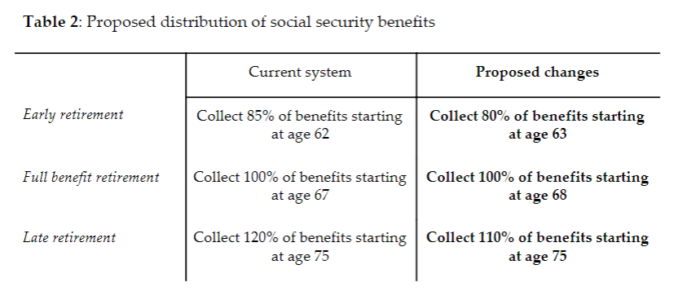
For people born after 1975

Slide 14
Finally a somewhat radical approach
But its likely the same thing can happen by taxing the top 1% at 6-7% rate → again, this is a policy issue

Slide 15
They must have consulted with Blue Team: not a good visual representation of this policy (and why does everything have to be linear?)

Slide 16
Good but …

