Slide 1
Homework 2 Responses
This was meant to assess backgrounds and extant skill sets more than anything else

Slide 3
Methods used
Most everyone used either Mathematica or Matlab and called various stdev routines to do the calculations.
Some people used a form of python
One person did this in Java
One person tried to do this in R
The Principle difference in approach is whether or not you actually code the standard deviation function yourself, or called a pre-compiled package that returns a result via that black box. The former approach is always preferred. The less black box, the more your control and understand.

Slide 4
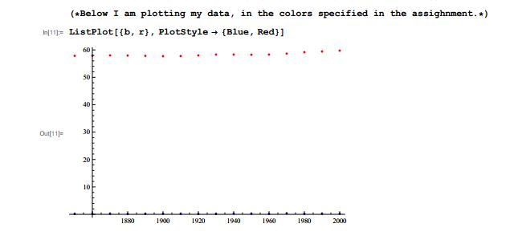
Plotting Examples
One Immediate problem: Producing both variables on one axis so both can be seen:

Slide 5
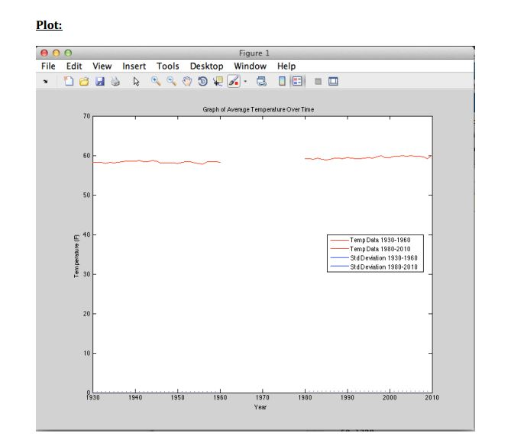
Wrong procedure

Slide 6
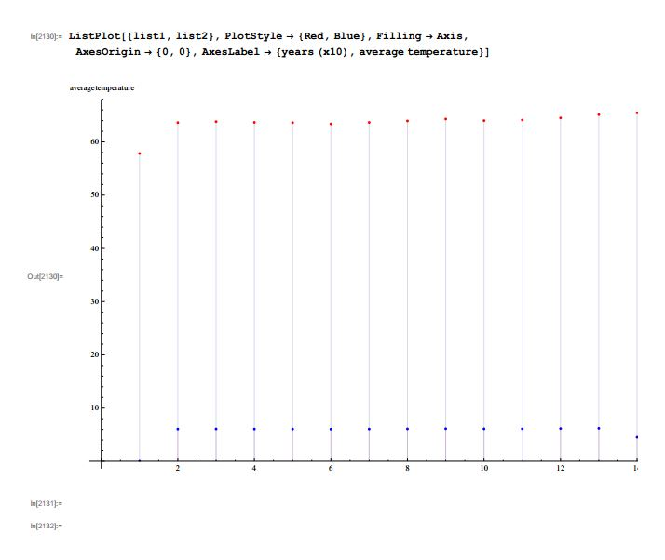

Slide 7
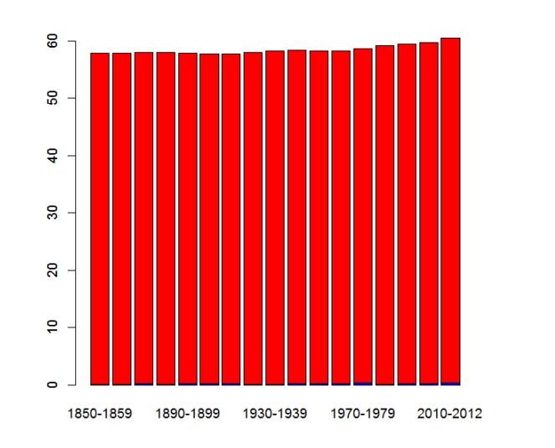

Slide 8
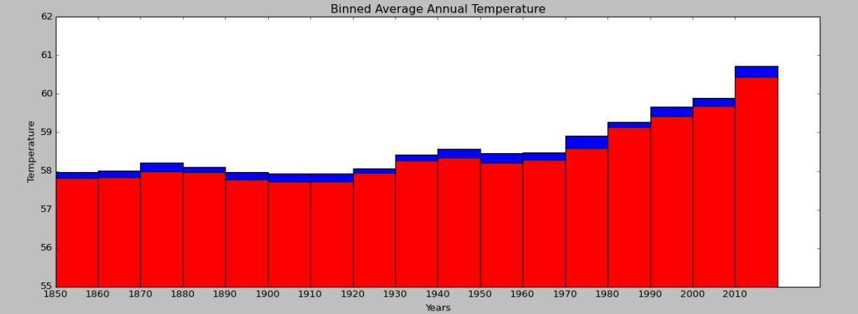
Alternative Plots

Slide 9
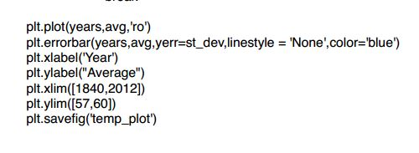
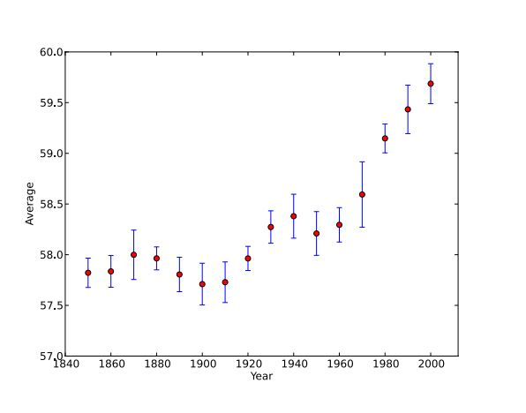

Slide 10
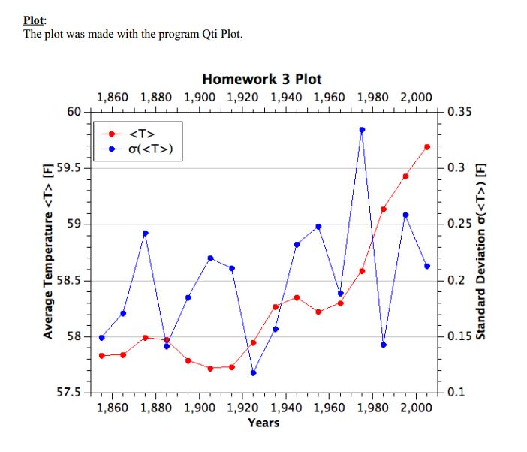

Slide 11
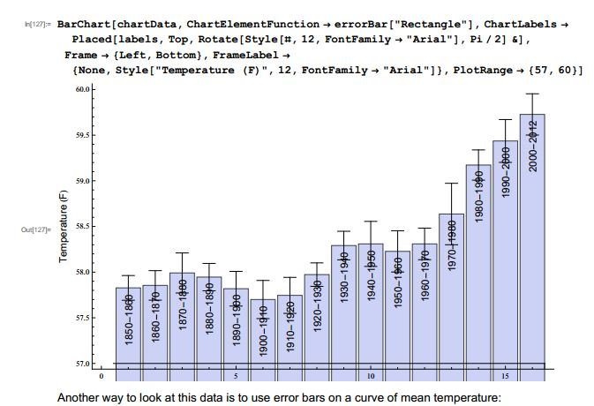

Slide 12
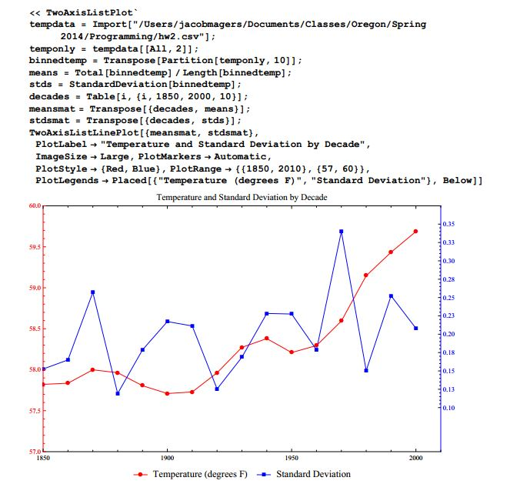

Slide 13
Example of least number of characters required using Command Line Bash Script.
Example shows calculation for 10 years

Slide 14
Fortran
real x(1000)
do 10 j = 1,200
read(unit=19, fmt=*, end=11) v
n = n + 1
x(n) = v
10 continue
11 nmax = n
do 30 k=1,17
istart = k*10 -9
iend = istart+9
sx = 0
sx2 = 0
do 20 j = istart, iend
sx = sx + x(j)
sx2 = sx2 + (x(j) * x(j))
20 continue
iyr= 1850 +0.5*(istart+iend)
if (iyr .gt. 2013) go to 99
xcent = sx /10
sdx = sqrt((sx2 / 10) - (xcent ** 2))
xcent=xcent-57.8
x2=xcent-sdx
x3=xcent+sdx
xcent1 = xcent - .03
xcent 2 = xcent + .03
write(2,302)iyr, x2, xcent1, xcent2, x3
30 continue
302 format(5x,'['"'",i4,"'",1x,4(","F5.3),"],")
99 stop
end
['1855' ,-.112,0.000,0.060,0.172],
['1865' ,-.122,0.010,0.070,0.202],
['1875' ,-.040,0.160,0.220,0.420],
['1885' ,0.036,0.140,0.200,0.304],
['1895' ,-.186,-.040,0.020,0.166],
['1905' ,-.289,-.110,-.050,0.129],
['1915' ,-.270,-.100,-.040,0.130],
['1925' ,0.038,0.120,0.180,0.262],
['1935' ,0.322,0.440,0.500,0.618],
['1945' ,0.330,0.520,0.580,0.770],
['1955' ,0.184,0.390,0.450,0.656],
['1965' ,0.321,0.470,0.530,0.679],
['1975' ,0.472,0.760,0.820,1.108],
['1985' ,1.204,1.310,1.370,1.476],
['1995' ,1.385,1.600,1.660,1.875],
['2005' ,1.688,1.860,1.920,2.092],

Slide 15
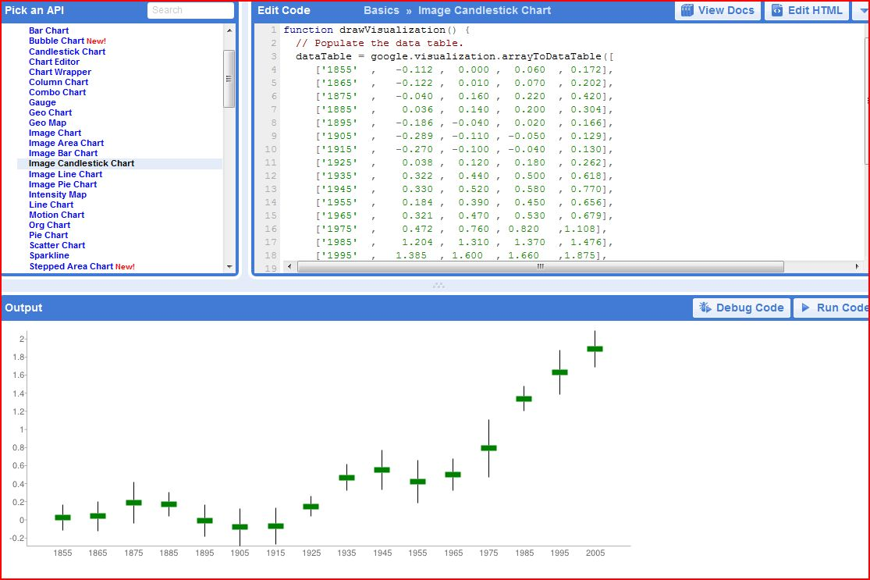
Feed output to Google Plot Library (demonstrate in real time)

Slide 16
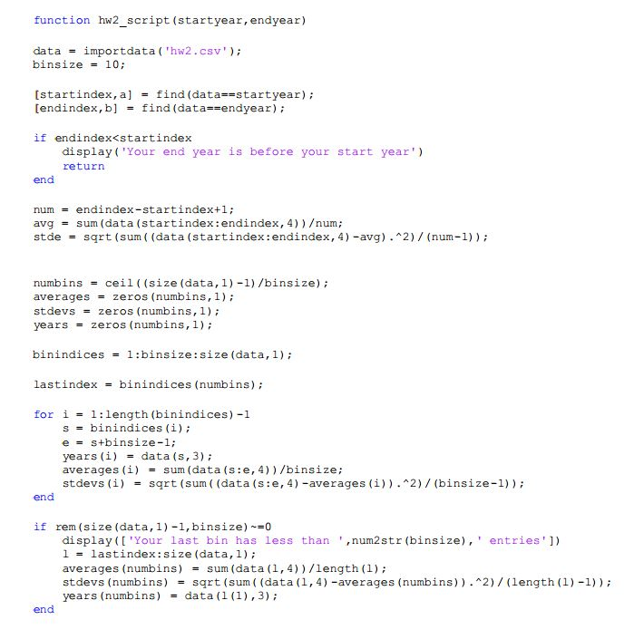
One actual submission with real calculations using Matlab

