Slide 1
Homework 3 Responses
This was meant to give you practice with data management/mining given a non ideally formatted input data structure

Slide 2
Sorting and List Management
The strategy I'm testing on these shorter lists is to try and wind up with a list containing only ['year','storm id','min nonzero pressure'] - so I want to try and do it by sorting through the lists, for a given year and storm id finding the min pressure and adding to a new list... so far my attempts have been fruitless
This was the typical problem encountered by some of you

Slide 3
Some Success

Slide 5
Many Counting Problems

Slide 6
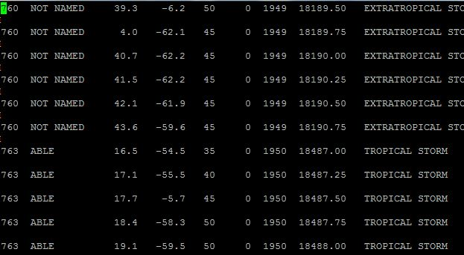
Producing the right file to “count”
What is the “problem” here with the raw data file?

Slide 7
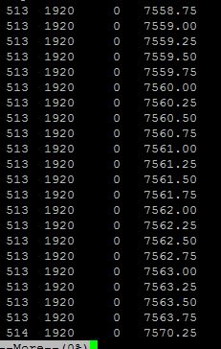
Code to Produce a new data file
I could have filtered on “0” pressure but that would have reduced the actual number of Hurricanes carried forward

Slide 8
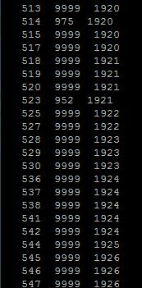
Next Pass produces inital “counting” file

Slide 9
Producing same counting file using csh scripts – practice this in csh!
1. grep –i “HURR” master1.txt > new.txt
2. sed s/NAMED//g new.txt > new1.txt
3. **awk ‘{print $1 FS $6 FS $7}’ new1.txt > new2.txt
4. sort –n –k 2 new2.txt > new3.txt
New3.txt is then a file with 3 columns in which the FIRST occurrence
of unique storm ID Is the lowest central pressure
Actual files on following slides.
** could use cut –d” “ –f1 –f6 –f7 new1.txt > new2.txt but I always screw up CUT

Slide 10
New.txt

Slide 11
New1.txt

Slide 12
New2.txt

Slide 13
New3.txt
Count this file anyway you like;
Conditional IF statements are useful
For counting.

Slide 14
Science
An example of science that is enabled by doing list management operations on data bases
Current project, track analysis of Atlantic Basic Hurricanes – all previous analysis is only for LANDFALL events.

Slide 16
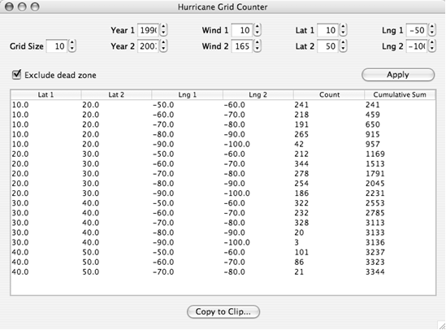

Slide 17
Frequency:
What detection efficiency improvement happened in 1950 relative to 1940?

Slide 18
Lots of Information!

Slide 19
Pressure analysis for strong storms < 965 mb; 2005 is dramatic!

Slide 20
New Important Result: Dynamics are changing; evolution is faster

