Slide 1
Homework 4
Responses
There was no expectation of completeness assignment – this was meant to give you the opportunities to a) start and manage a github collaboration, b) practice with visualization library code examples

Slide 2
Event Counter
Straightforward – if conditions with grids or thresholds
The Six Seattle Events
56.8103 1949 6.50000
34.3604 1965 6.50000
147.875 1980 5.50000
48.8908 1996 5.80000
95.9339 1999 5.60000
70.2530 2001 6.80000

Slide 3
Clustering
This is hard for events clustered in space and time.
Need to utilize a couple of passes first in space then in time. Combining space and time together for automatic pattern recognition is hard and usually unrealiable

Slide 4
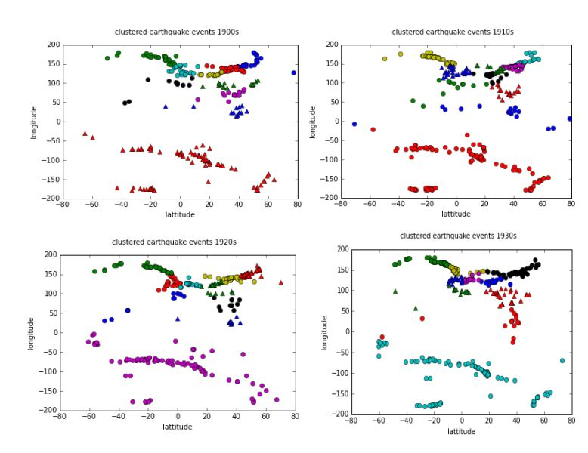
One Attempt

Slide 5
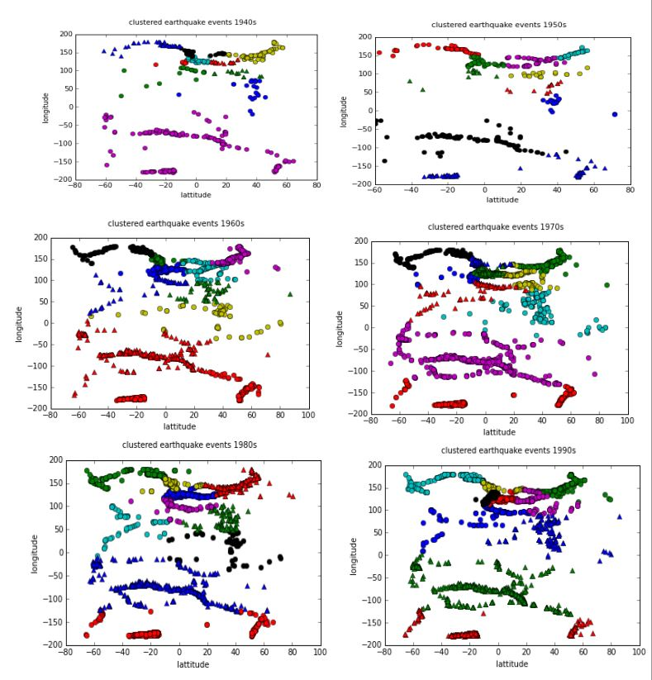

Slide 6
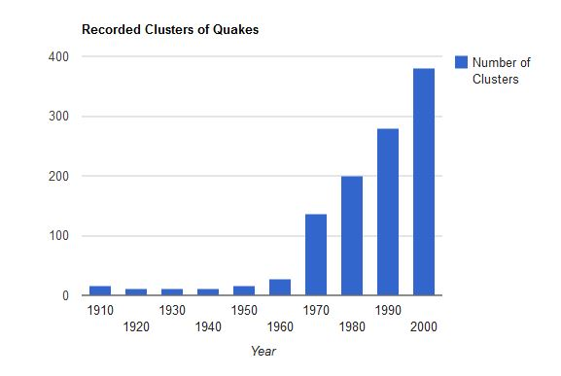
My Clustering Output

Slide 7
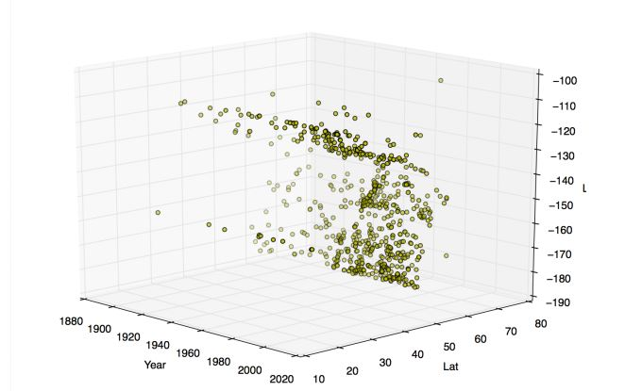
Location Plotting Examples
Maybe “cool” but doesn’t convey much information

Slide 8
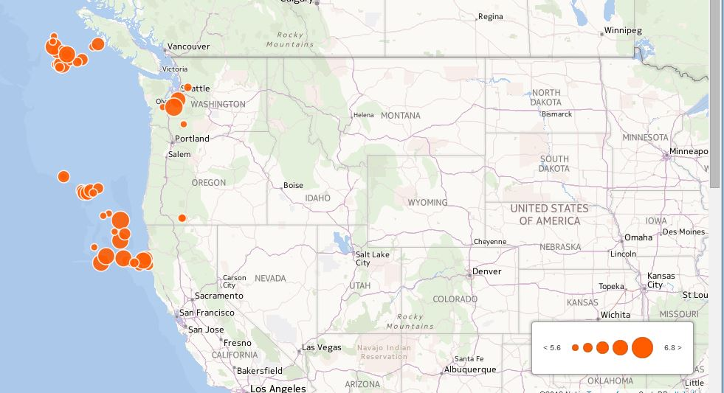
Again, not much info

Slide 9
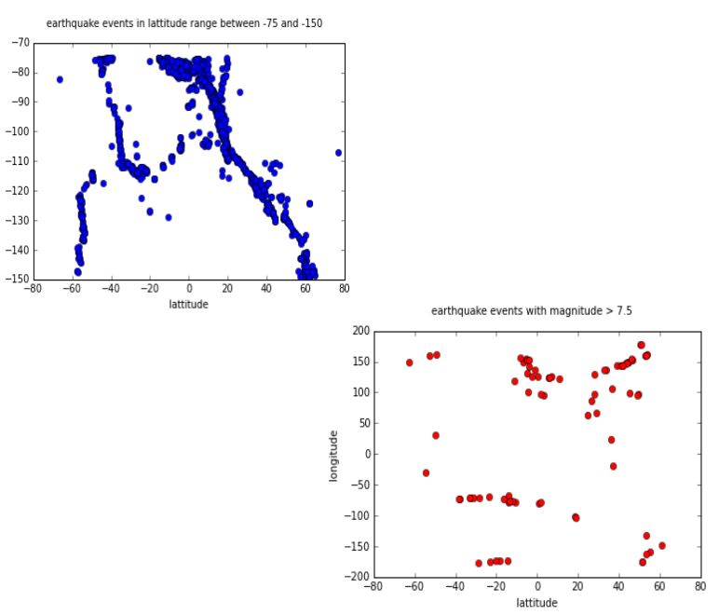

Slide 10
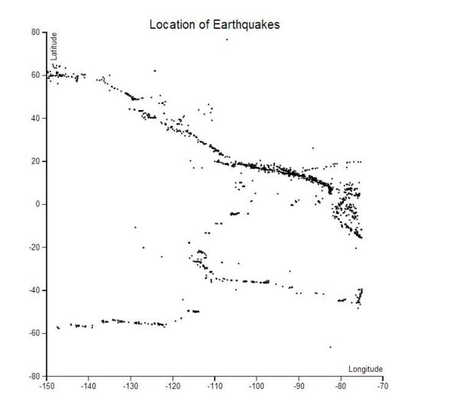

Slide 11
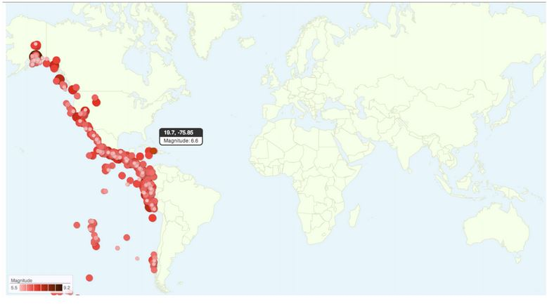

Slide 12
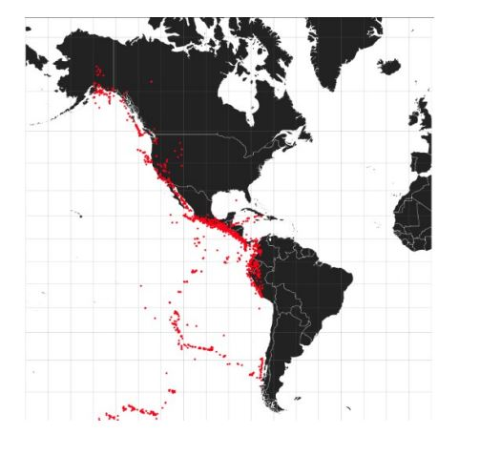
Using D3

Slide 13
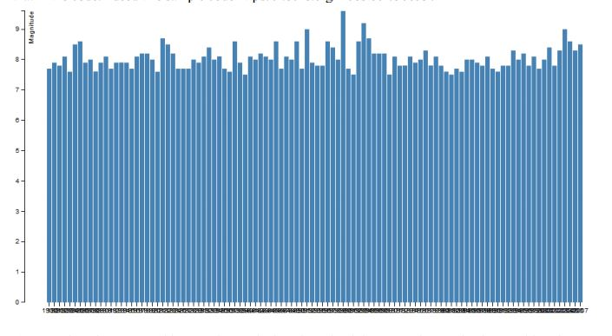
Time Line Representations

Slide 14
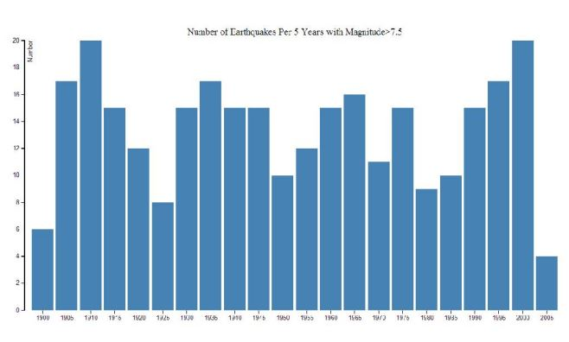
Better with Averaging

Slide 15
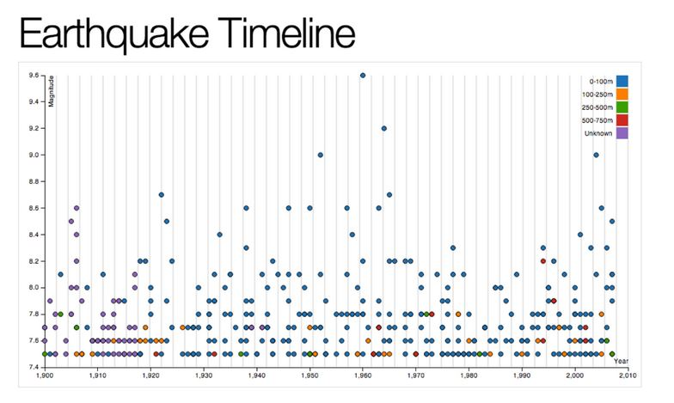
Does highlight extremes; attempted color for depth

Slide 16
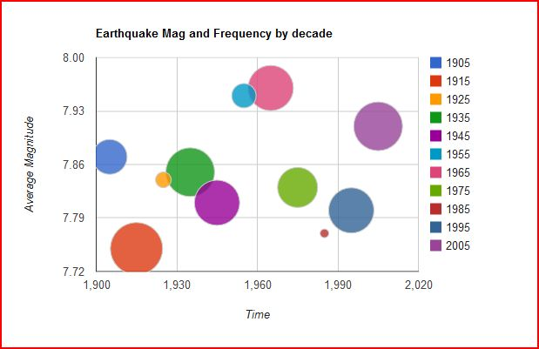
My try – different way a) tries to convey frequency and average together – what does it show?

Slide 17
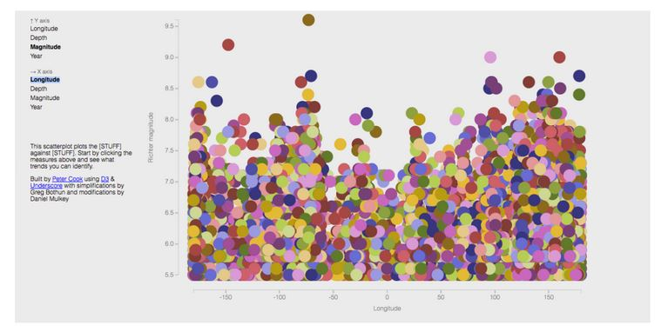
Be Happy

Slide 18
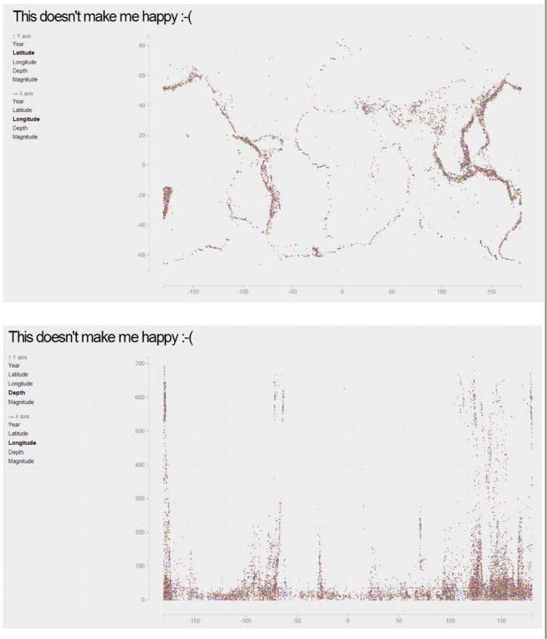
Be Not Happy

Slide 19
The Real world by Josh
Yep! I used bootstrap because it looks pretty and I'm not a designer.
It does seem as more data is available that programming is becoming increasingly essential for STEM fields. And someone who wields both scientific knowledge and programming ability would be really powerful.
I do wish my math was better. The brick walls I tend to hit usually have to do with not understanding math.

Slide 20
From a guy named harvey
Nice! I would have killed to take a class like this.
And there are so many great OSS tools out there, both to get things computed and make them pretty, it's a pretty ideal time to do it.
Here's some more stuff students might find helpful to get started, depending how techie they want to get:
pandas / numpy / scipy (you probably know these already)
iPython Notebook (good tool for taking input data and transforming it to meaningful results)
Foundation (alternative to bootstrap)
flotcharts (probably easier than D3 for newbies)
charts.js (another charting alternative)
Flask (simple but powerful web framework to serve up the web stuff)
Just blathering. Need caffeine. Well done!

Slide 21
And now the “cool “way to do it but in reality this is a felixible and efficient kind of interface for dealing with multidimensional analysis of complex data sets.
bootstrap

