Slide 1
Homework 5
All about noisy time series analysis in which features exist and long term behavior is present; finite boundary conditions are always an issue

Slide 2
Always plot the data first
For any time series problem, plot the data first at some sensible scale and do simple smoothing to see if there is underlying structure vs just all random noise.
Do a simple preliminary VISUAL analysis – fit a line to all or parts of the data, just so you get some better understanding
EXCEL is actually convenient for this

Slide 3
Raw data scaled to ymin=0

Slide 4
Fool the Public Scale as the public assumes bottom = 0

Slide 5
Get Rid of Pre Satellite Data

Slide 6
Maybe a small linear decline but this “fit” includes features in it

Slide 7
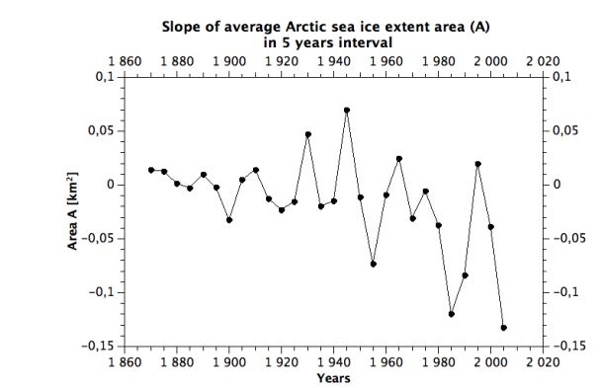
Derivative of Curve can identify when changes occur – many ways to do this
Small differences in approaches produce slightly different results:

Slide 8
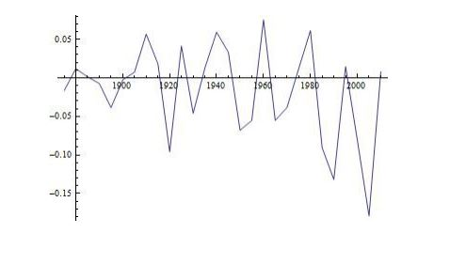
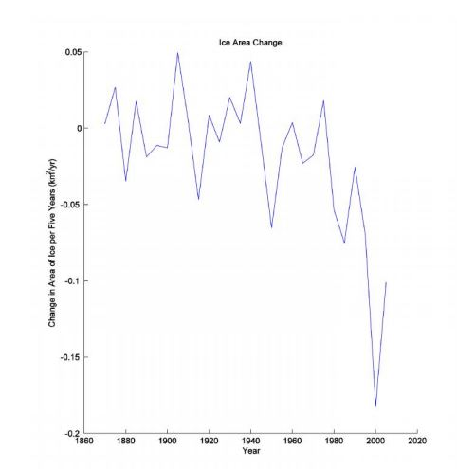

Slide 9
Derivative and Integral
Area ratio = 1.37 (721/525)
No Need to do “fancy” interpolation for numerical integration for this data given the intrinsic noise – why do extra calculations if you don’t need to → spare machine resource

Slide 10
Derivative Clearly revels when systematic change starts

Slide 11
Smoothing the Data
There are many techniques for smoothing
There is always a trade off between smoothing width and data resolution. There is no formula to optimally determine this – you have to experiment with different procedures.
Exponential smoothing often looks “weird” as both the weights and the smoothing changes with smoothing parameter

Slide 12
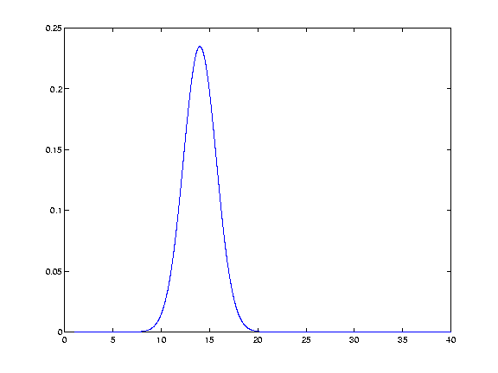
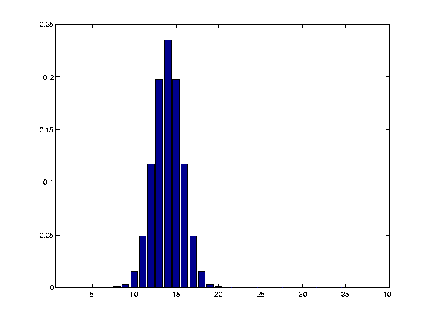
Gaussian Kernel → need to normalize correctly
Area under curve = 1;
11 points are shown here; use 7 points for each data point; 96% of wt.
Area under curve = 1

Slide 13
Note phase “error” – this is common because of a finite data end so best build in an offset that you can change

Slide 14
Most of your Gaussian Kernel Smoothing looks too noisy

Slide 15
Should look like this since the technique is meant to show wave form features by essentially median filtering the noise (this is how A/D works as well)

Slide 16
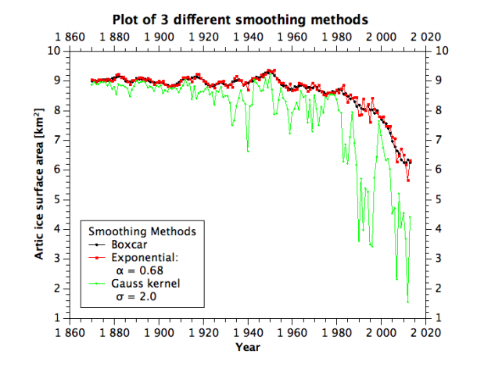
Normalization issues look like this

Slide 17
For this data set, choice of smoothing technique doesn’t much matter

Slide 18
Exp. Smoothing Weighting the Past (K=0.1)
Blue = exponential

Slide 19
But equally weighted (K=0.5) gives same result is brute boxcar

Slide 20
Exponential (Blue) (recent year weighted; k =.9) vs Gaussian (Green)

Slide 21
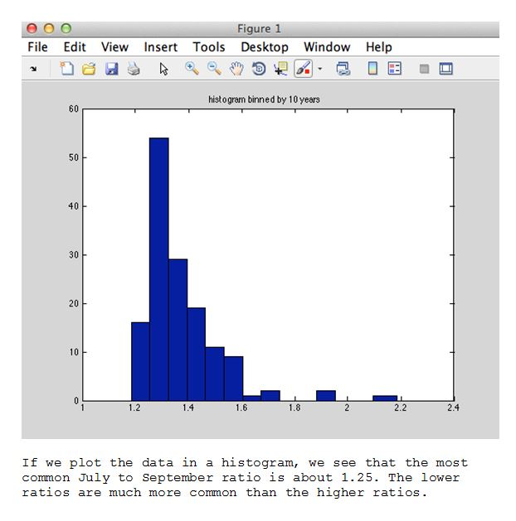
Histogram Exercise
Easy and the point was that this is not a randomly distributed variable; distribution is skewed (third moment; kurtosis = 4th moment

Slide 22
Feature Extraction
As expected this gave everyone the most trouble; its not hard but you do have to pay attention to the your process.
First produce a sensible plot so you get a feel for the amplitude of the feature

Slide 23
Again make the Scale reasonable
See the Noise! Now do Feature Extraction – want to fit a “continuum” that doesn’t include features. This simple linear fit does include features so is wrong but it serves as an initial guide.. What you notice is that the peak is about .4 units above the “baseline”. Window out features and continue.
0.4

Slide 24
So clearly something is wrong here

Slide 25
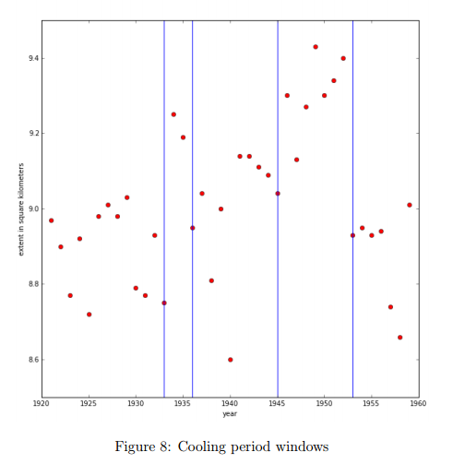
Way too big of amplitude and poor data representation for windows

Slide 26
And you can’t subtract with the features in your baseline!

Slide 27
Define windows and fit polynomial outside of window and then subtract that at every point (flatten the spectra) → are these features statistically significant or just noise?

Slide 28
With features (NO – just and illustration)

Slide 29
Now subtract polynomial from every f(x)=y point

Slide 30
Flattened Spectra

Slide 31
Smoothing Helps
Maybe 3 events; 1 for sure; note amplitude is correct compared to the first pass (i.e. ~0.4)
Constant = 9.1
Area under the curve for biggest feature is about a 3% excess over baseline – not very high amplitude but not a NOISE FEATURE either;
0=9 sq. km; feature is 20 years; 9x20 =180; area of feature is triangle: ½ *20*(.5) = 5; 5/180 = 3% (good enough for estimate)

Slide 32
Numpy procedure
>>> import numpy
>>> x,y = numpy.loadtxt(“xy.txt”, unpack=True)
>>>p = numpy.polyfit(x, y, deg=3)
>>>print p
>>>-7e-07 1e-04 -0.0072 +9.108
Excel = -5e-07 8e-05 -.0063 9.105

Slide 33
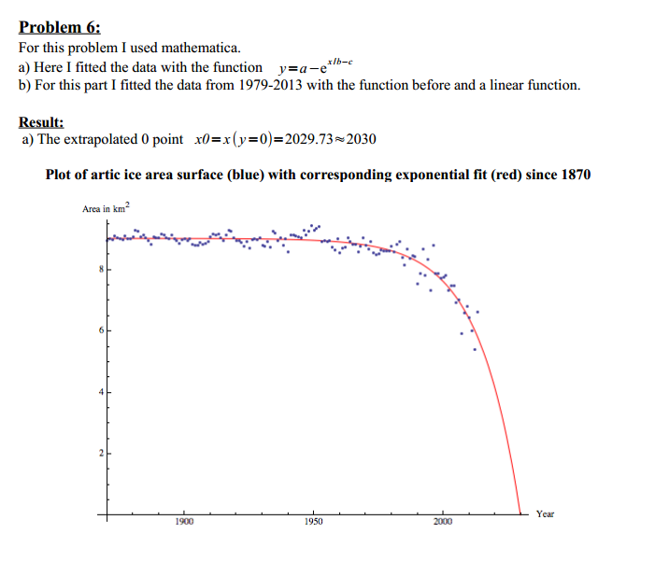
Fitting the whole thing
Yes there is a family of functions that work for this kind of “sharp cutoff wave form”

Slide 34
Sigmoidal Distribution
$$y=a−be^{{(−cx}^{d})}$$
A = 10.35
B = 17.46
C = 2.2E10
D =-4.69
The zunzun.com site is magic!

Slide 35
Science/Policy Issue; 2095 vs 2030

