Slide 1
Clustering and randomness

Slide 2
Is this random?

Slide 4
Which side is randomly generated?
People Perceive Patterns easily in randomly generated data

Slide 5
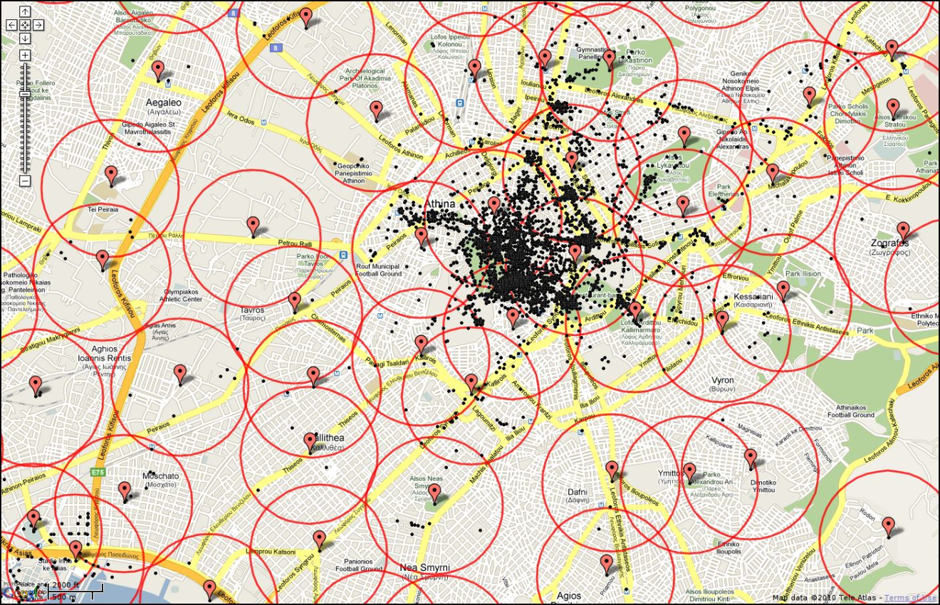
Clustering
Event density that occurs on different spatial scales.
Is there a characteristic scale?

Slide 7
K-Means clustering (data mining)
Code Example
Game of Life Example

