Slide 1
Some Science
Related to your Sea Ice Assignment
National Climate Assessment Report released May 6, 2014

Slide 2
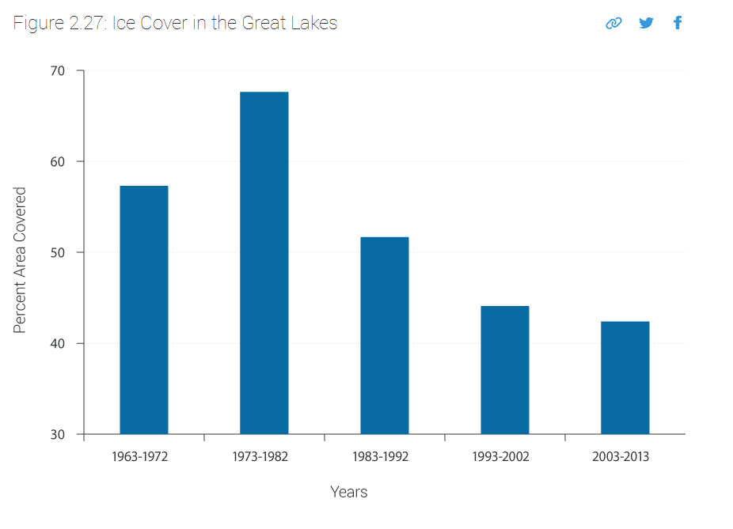

Slide 3
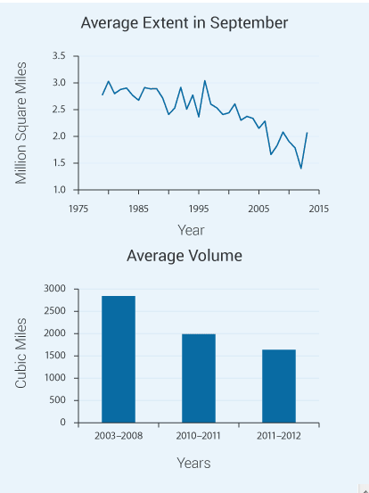
Extent is a reasonable proxy to volume because Ice thickness is generally uniform

Slide 4
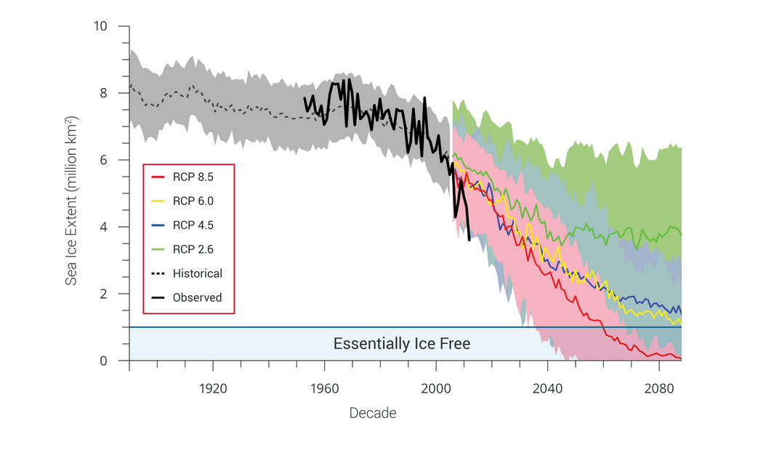
Should look Familiar –note that data is accelerated relative to all models

Slide 5
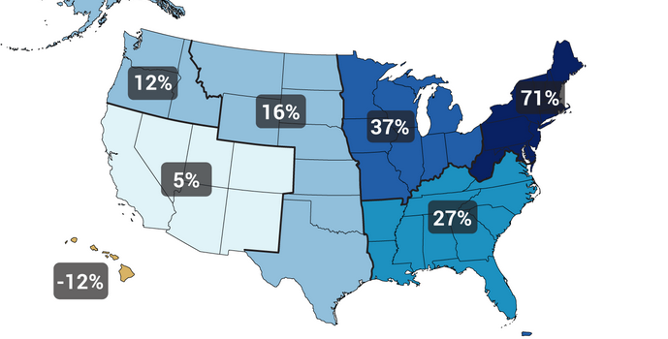
Hair/NO Hair Mesh Code Project → increasing Deep Tropical Convection –see movie

