Slide 1
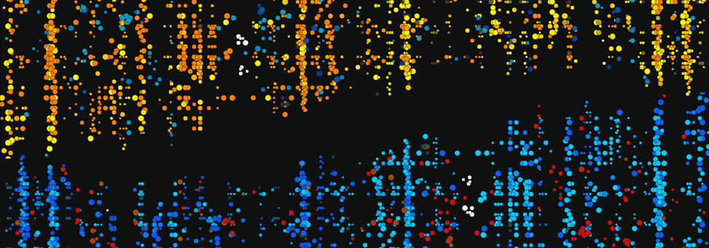
BIGDATA AND VISUALIZATION: What IS IT?
Accelerated Understanding

Slide 2
The Science World is Changing
Traditional fields of physics are morphing to more cross-disciplinary areas. This means new skill sets are needed.
Informatics and data base mining is becoming particularly important.
Computational Techniques are evolving rapidly due to OpenSource development.
The science/public policy interface offers new opportunities
Data visualization is rapidly accelerating

Slide 3
COUNT the V’S
CGHJKIRTUYFDSCBNMKLWQADFYUIVPOLKDFUZXMJYTDERTYOPIKLSWEAWDGHJERYIOKJTVNMWERTYSWYPEADSGBVMUYTREDSWCVNHJKLP

Slide 5
BIgDATA
This is not merely a tool, it is a RESEARCH THEME
BIGDATA: “The next frontier for innovation, competition and productivity.”
BIGDATA: A collection of data sets so large and complex that they can’t be handled by traditional algorithms and applications

Slide 6
BIGDATA OPPORTUNITIES
It rests on a computational core supported by professionals
Simulation is as important as Data Analysis – opens up new areas of research and design.
Visualized END products are essential; VIZ Facility Required. Center for synthesis.
BIGDATA: combinations of data sets, strongly promotes interdisciplinary analysis
Should be used for any kind of data driven public policy
Very challenging problems can be undertaken → New Proposals in New Areas

Slide 7
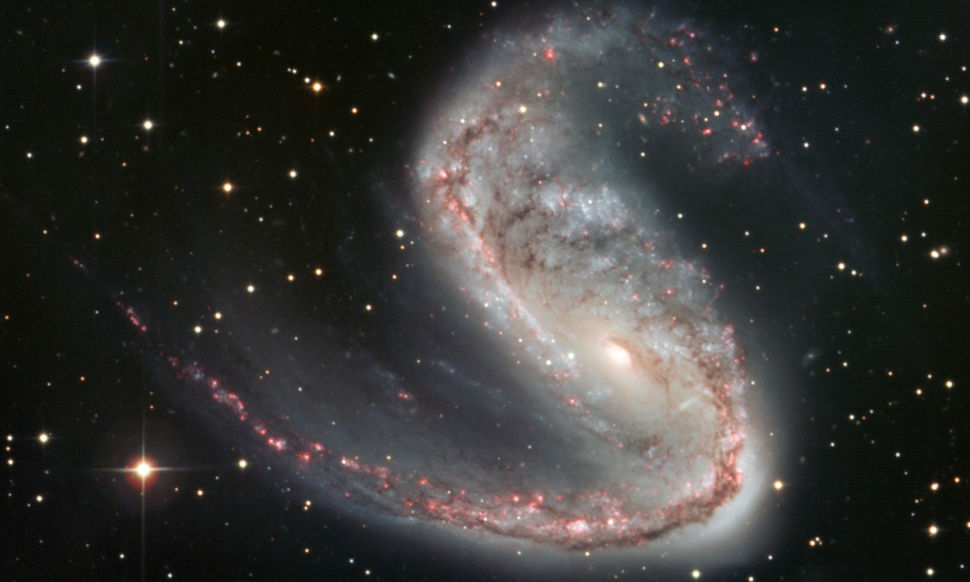
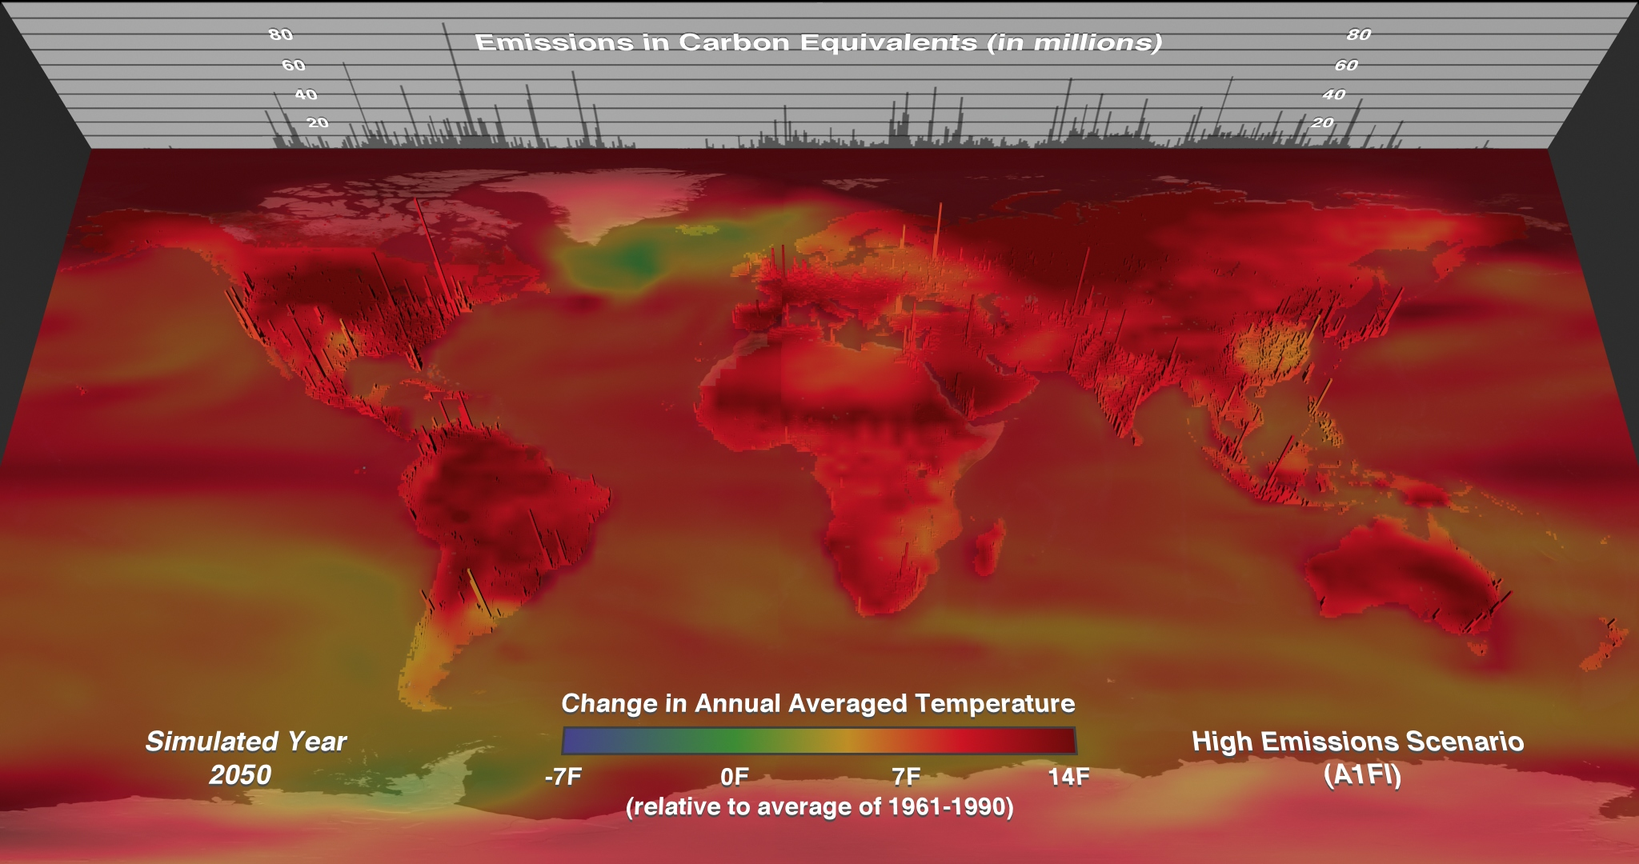
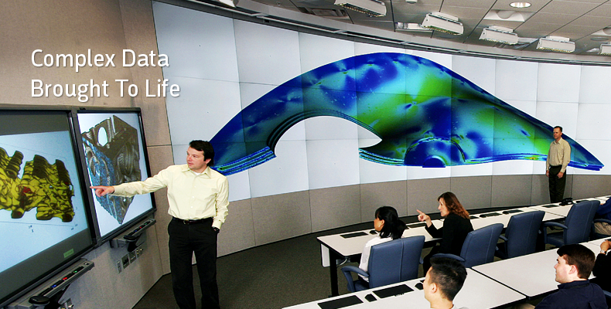
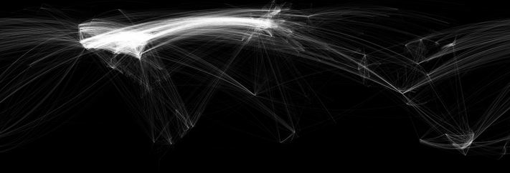
Examples

Slide 8
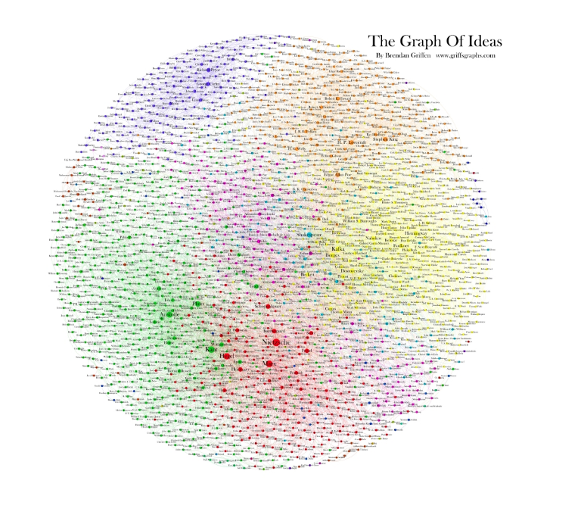
4000 pixel radius sphere

Slide 9
Deep Tropical Convection/Atmospheric Rivers

Slide 10
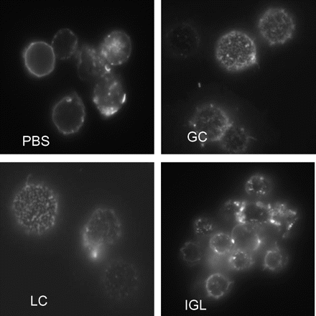
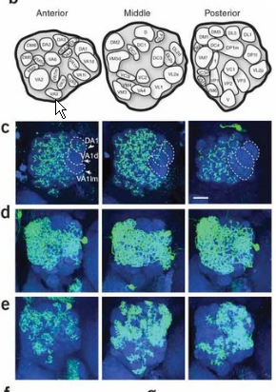
Clustering Patterns – relevant to materials characterization; biophysical imaging; galaxy distribution; regional climate changes; env. Science spatial patterns

Slide 11
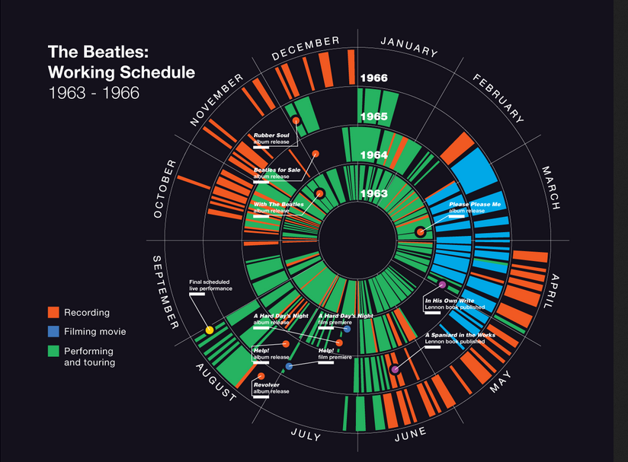
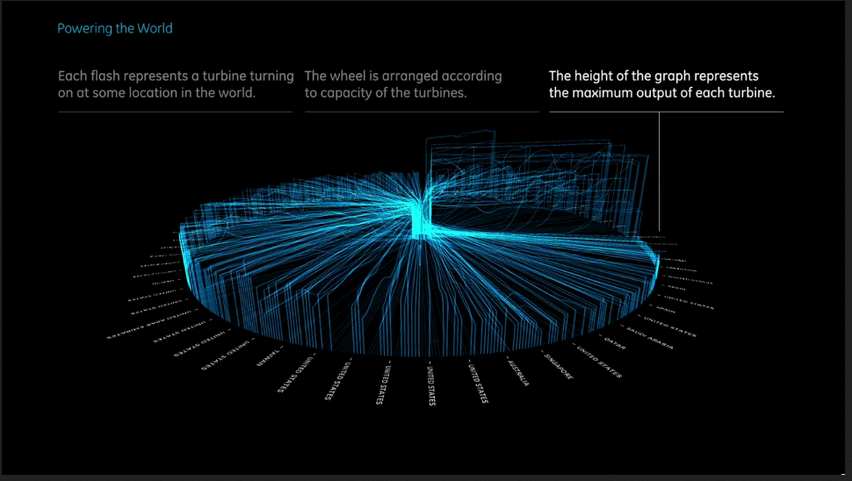
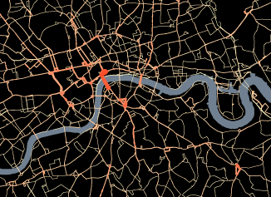
More Examples

Slide 12
Current Scale Mismatch
${10}^{15}$ = FLOPS (Exxa Power Limited)
${10}^{12}$ = LAN Speed
${10}^{9}$ = Broad Band Speed
${10}^{6}$ = Display Pixels
REAL TIME data analysis requires all these scales to be similar

Slide 13
Zoom in View

Slide 14
Motion Pathways

Slide 15
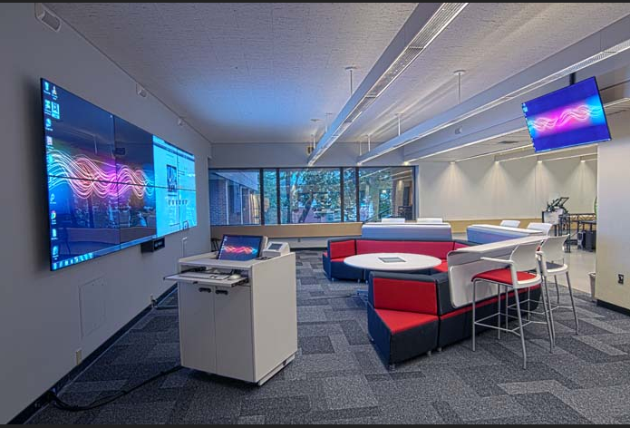
Proposed UO VIZ Lounge

Slide 16
Summary
State of the art facilities (viz) and support (BigData) is the catalyst for new areas of inquiry into new problems that have become possible to attack
“Without an interdisciplinary conceptual framework and without interdisciplinary researchers to work with disciplinary researchers to integrate the contributions from different disciplines to focus on solutions to the problems at hand, progress is likely to be slow.”
Investment depends on how much of the above statement you believe.

