Slide 1
Blind Random Search
A much More useful approach now that computation is fast

Slide 2
Simple Example
Refer to Excel Demo in Class
Example blind random parameter search code

Slide 3
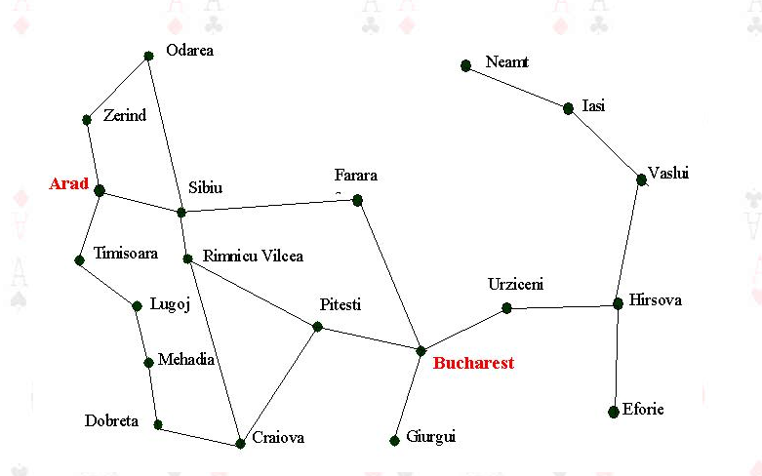
Conceptual Example: Want to go from Arad to Bucharest = many ways to go

Slide 4
Level 1 choice is Zerind, Sibiu, Timisoara

Slide 5
If you went to Zerind, then next blind choice would be Odarea or back to Arad – inefficient you started over – could use this to eliminate that choice – say minimize total path length choice

Slide 6
But this is stupid, there are intelligent choices to be made → but how to you code a machine to do this? Also, in some cases there may not be any information that can be used and you won’t know the “answer” until you found it.

Slide 7
Kinds of blind search strageties
Breadth-First-Search: always returns a solution or failure (this is brute force)
Systematic approach that considers all nodes at level 1, level 2, etc
Has branching factor complexity every state creates b new states. So level 1 produces b states, and the next level produces b^2 states.
Order is O(b^d) where d is the number of states to search

Slide 8
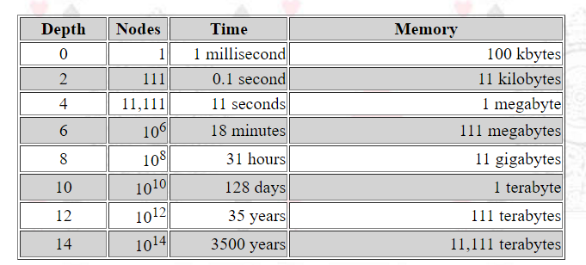
Resource Issue – needs to be convolved with human timescales

Slide 9
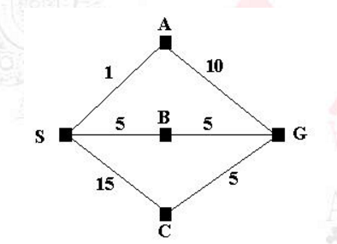
Uniform Cost Search
Like the travelling salesman problem
We want to go from S to G – so, duh, SBG. But in the previous approach, if A is the first node randomly chosen then SAG results – not optimal.

Slide 10
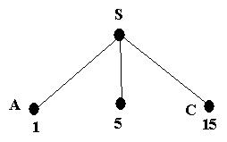
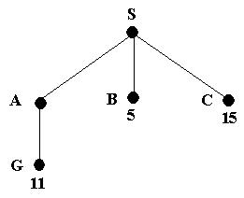
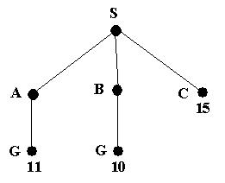
Do Cheapest First
Well that cost of SAG is now 11 but S to B to C is 10 which is less than 11

Slide 11
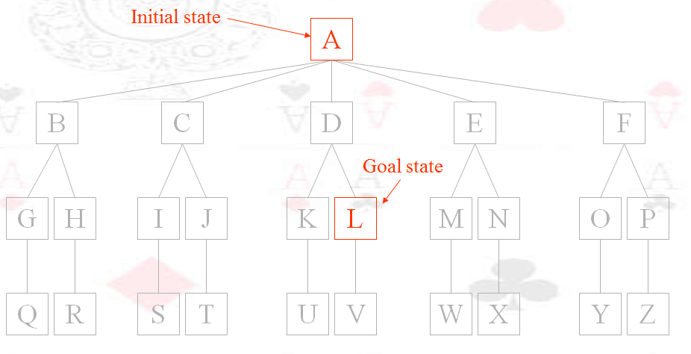
Want to get to State L from State A

Slide 12
How to Get there? Blind initial choice of B,C,D,E or F

Slide 13
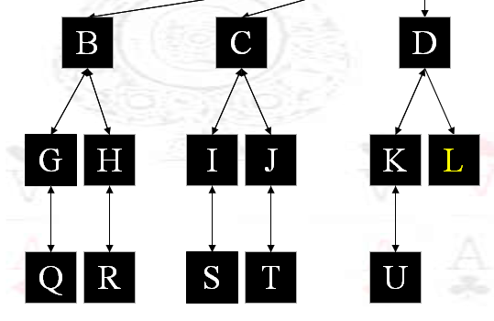
Depth First Choice

Slide 14
Depth Limited – stop the search after going down X number of depths per node

Slide 15
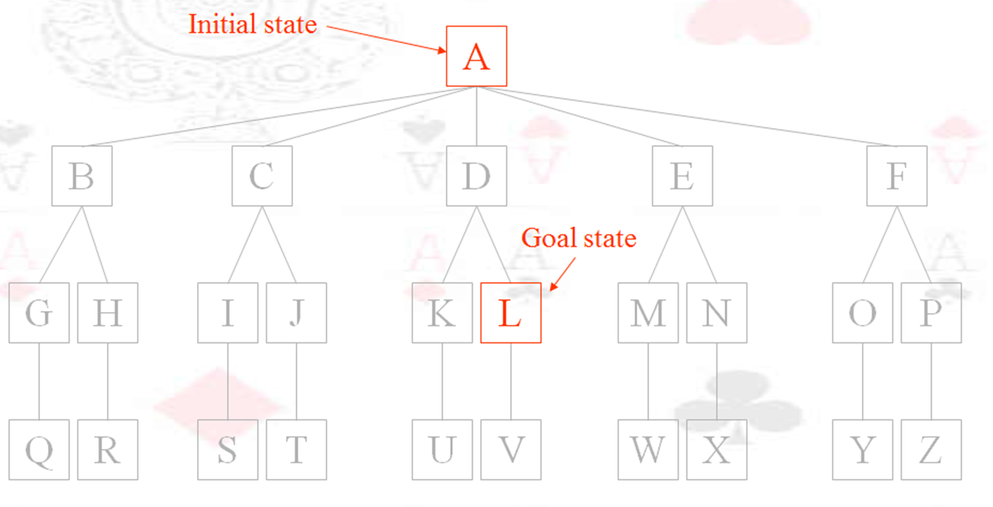
Iterative Deep Searching

Slide 16
But if d is not known then don’t do a depth limited search – could go down an infinite branch

Slide 17
In all blind searches
You might create the same pathway or choice more than once.
Yet its computationally expensive to store each choice and check if it has already been made.

Slide 18
