Slide 1
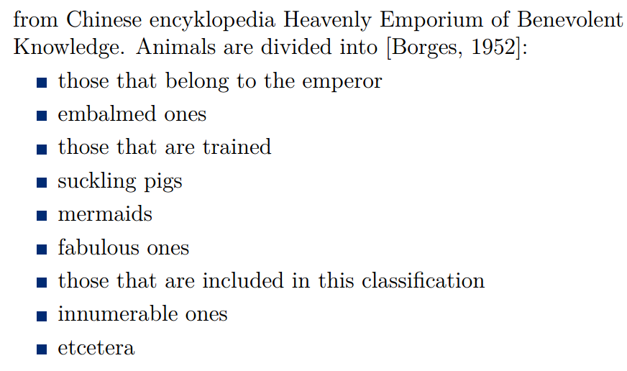

Slide 2
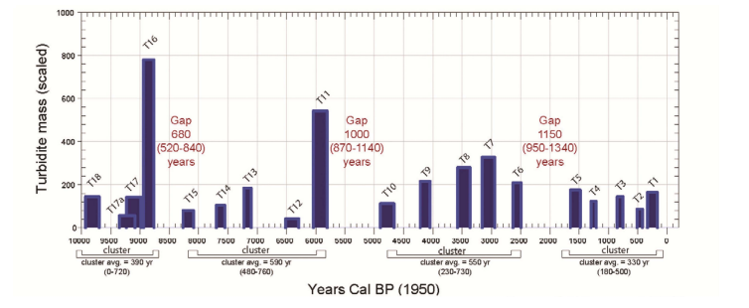
“Gap Analysis”
Cascadia Earthquakes

Slide 3
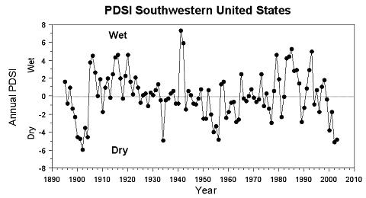
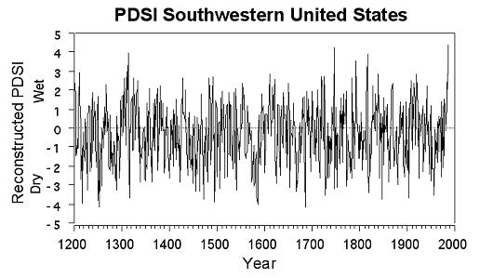
Count “Power” in time boxes

Slide 6
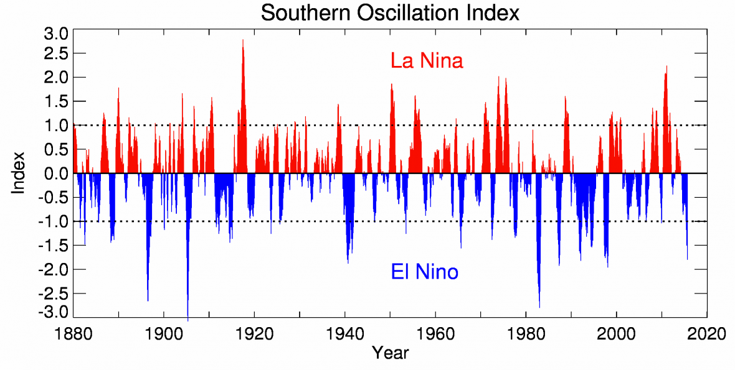

Slide 7
Power Spectral Density? Wavelets? – are their characteristic features?

Slide 8
Clearly Clustering is present but how to characterize it?

Slide 9
References
http://www.cs.ucr.edu/~eamonn/meaningless.pdf
http://alexminnaar.com/time-series-classification-and-clustering-with-python.html
https://umexpert.um.edu.my/file/publication/00005678_120457.pdf

