Slide 1
Data and Data Science
Some Final Thoughts

Slide 3
Scientific Programming
This Class was designed for you to practice in these areas
Basically always follows the same structure:
Formatted reading in of the data and convert to arrays (data initially is probably in an array)
Data sorting and possible reformat/transform
Looping through the data
Conditional If statements everywhere
Mathematical operations on pieces of the data – often calls to library subroutines
Output for analysis
Visualized Representation of Output

Slide 4
Things you should now recognize after experiencing this “class”
Preparing raw data for analysis is a lot more time consuming than you think
Preparation is best done via formatted read and formatted write operations. Prepare subsets of data to operate on.
Always try to array the data
Attempt to write your own mathematical operation filters and not use “libraries”
Always keep track of local minimization when fitting data;

Slide 5
More things
Plot the data early and often – get a feeling for the noise.
Use powerful command line procedures for certain data sorts or global edits.
Build command line pipeline that produces a graphical output whenever you re-run code on data
Search for existing tools to adapt – especially for visualization needs –highcharts.com is your friend
Practice, practice, practice; mistakes, mistakes, mistakes is the best way to learn. BE RESIALANT

Slide 7
All Best Done Via Exercises

Slide 8
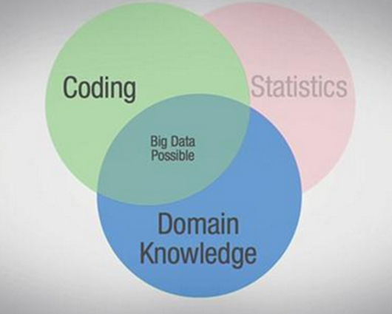
What is Data Science?

Slide 10
Books To Read

Slide 11
This is your motto

