Slide 1
Python vs Fortran
As a general rule you should be using multiple languages these days (except for Java)

Slide 2
Fortran vs Python
The principle advantages of Fortran are
Faster array operations with less memory problems (e.g. np.loadtxt(‘file’) will bomb due to memory problems if file has too many lines
Best formatted read and write operations and file saving to local directory.

Slide 3
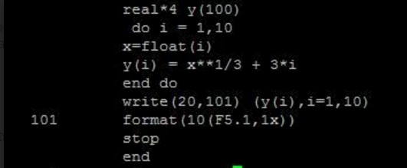
I have to compile and run this program and that produces a file named fort.20 in the directory in which I ran the program
It is somewhat more tedious to do this kind of operation in python especially if you want to produce a lot of temporary data files

