Slide 1
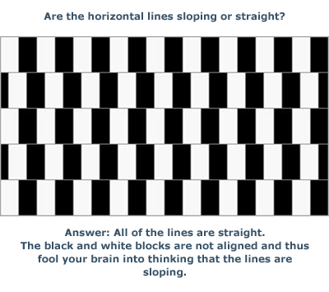
Homework 1 Responses and Issues
This assignment was meant to give you practice with data management/mining given a non ideally formatted input data structure and to prove that data exploration is TIME CONSUMING if you can’t do it efficiently – this class is about given you practice on real data sets

Slide 2
Someone did a nice visualization of all the track data to serve as a reference
This is always useful to do – visualize the entire data set

Slide 3
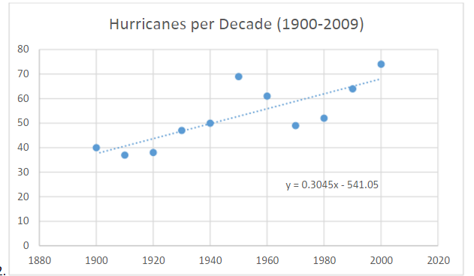
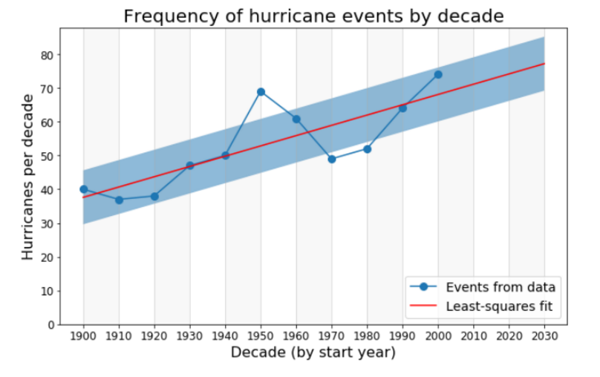
Hurricane Frequency – shit we should be worried!

Slide 4
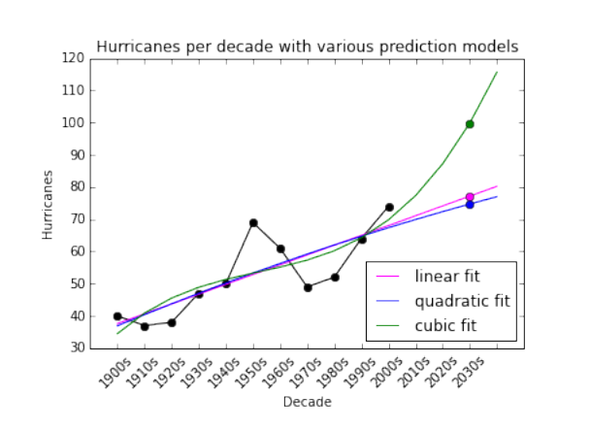
Multiple Fits – more or less worried now?

Slide 5
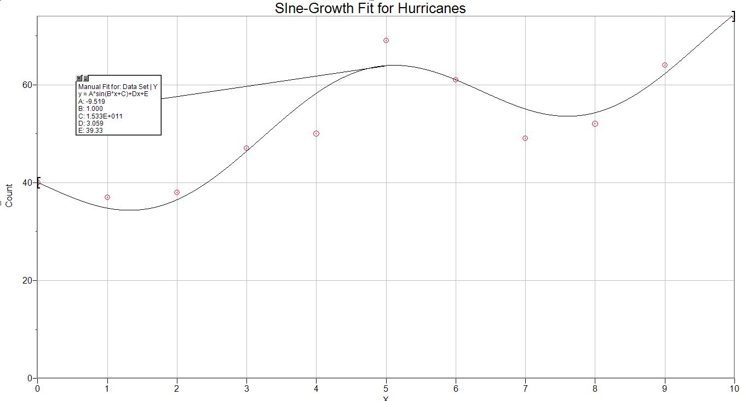
Future Hurricanes Sine Wave Fit

Slide 6
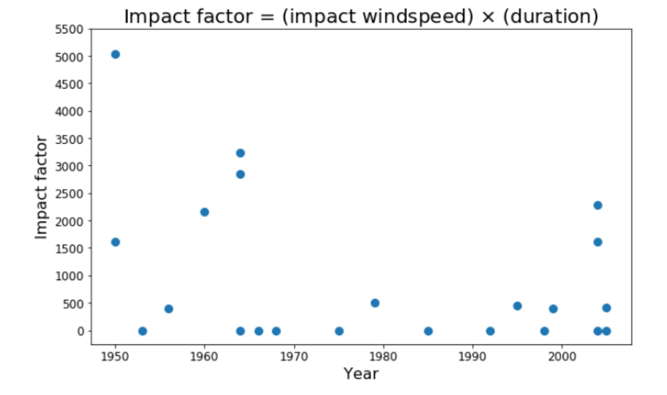
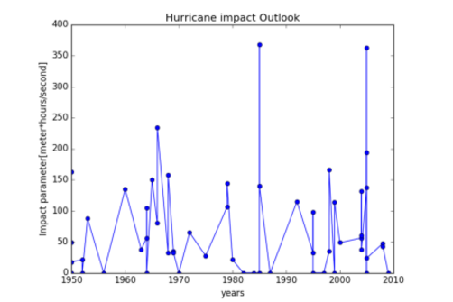
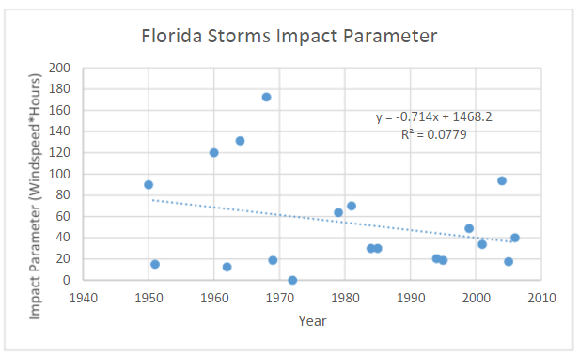
Impact Representation

Slide 7
Impact Representation

Slide 8
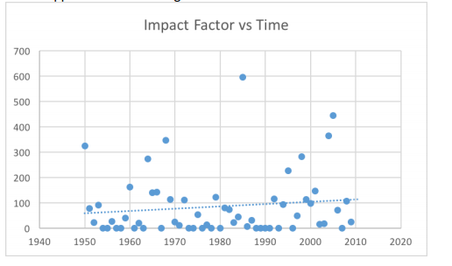
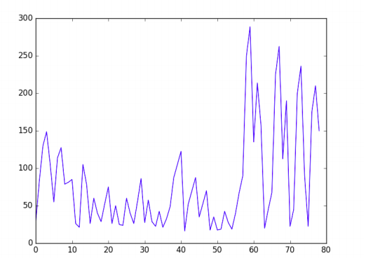

Slide 9
Plot using open source geomaps

Slide 10
Modelling the Impact

Slide 11
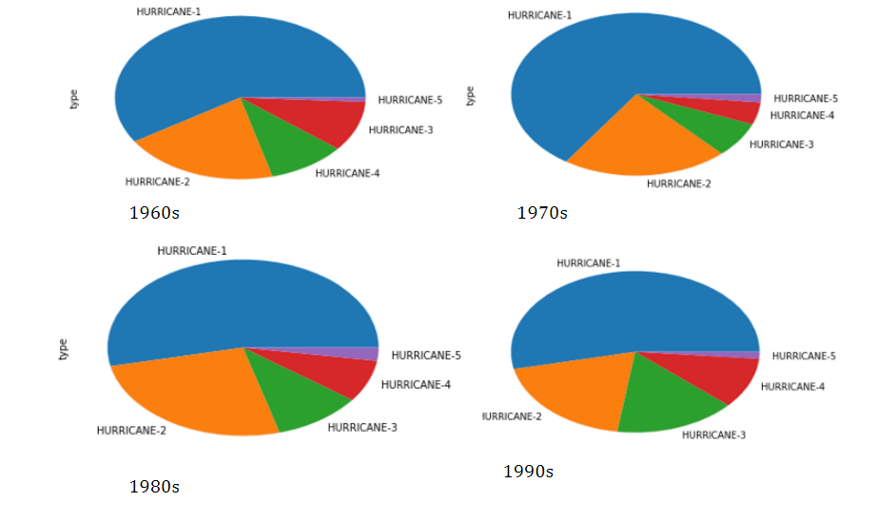
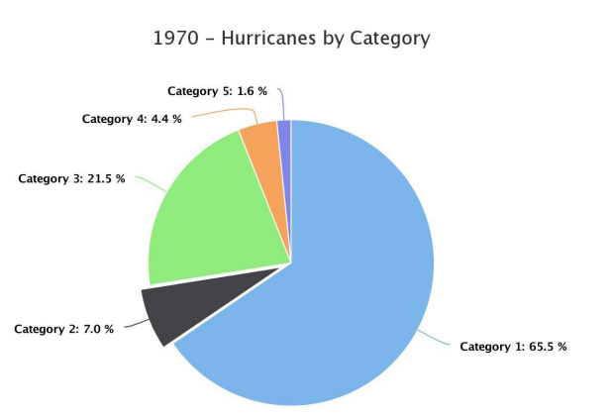
Pie Charts

Slide 12
More Pies

Slide 13
Another way (from highcharts)

Slide 14
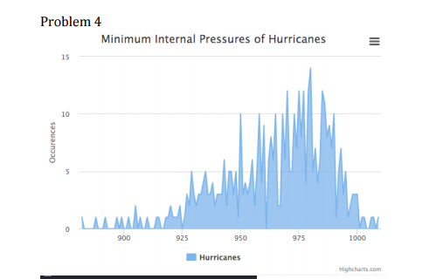
Minimum pressures – over resolution – histograms should be smooth

Slide 15
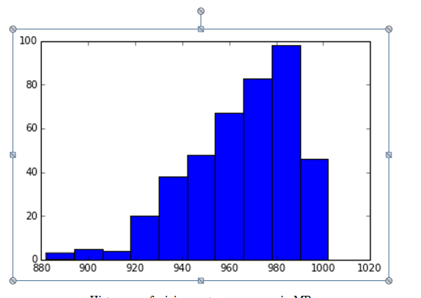
Maybe over-smoothed?

Slide 16
Better
Mean and 3σ lines shown

Slide 17
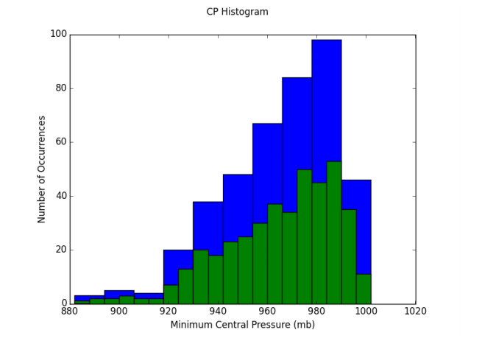
Nice – showing two bins together
Why is an average and standard deviation for this distribution not meaningful?
How would you define a strong vs weak hurricane from this distribution?

Slide 18
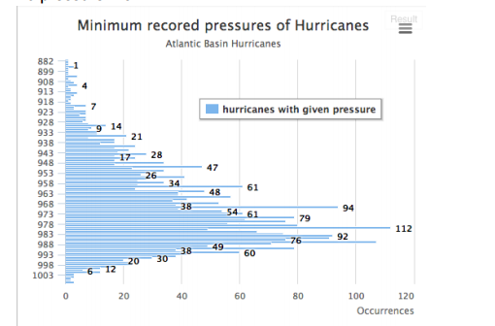
An Alternative View

Slide 19
Spin Up times
Let's define a standard of 1000 MB and a "hurricane threat" level of 970 mb. Calculate the "spin up time" (the time it takes to go from 1000 MB to 970 MB) for each storm ID.
These directions sometimes were not followed – what is this asking you to do with the data?
Some systems are probably not even named Hurricanes at the 1000 MB level –so you need a new data file – system ID, time-field, central pressure

Slide 20
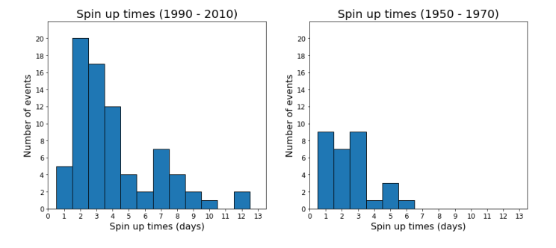
In general, make a new data set to deal exclusively with this part

Slide 21
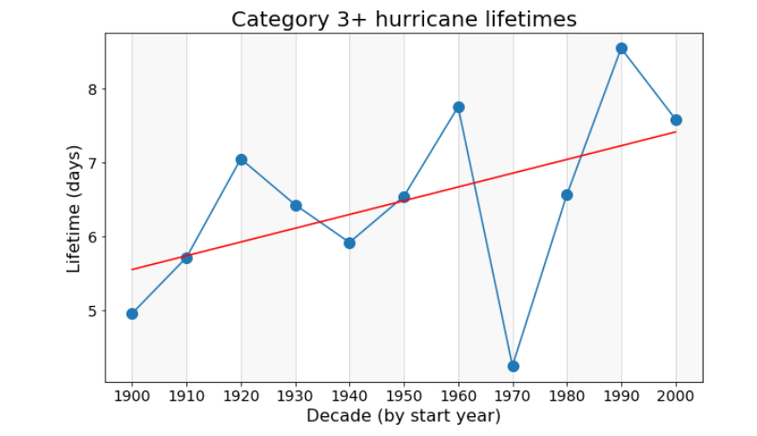
Cat 3+ (wrong Y-axis label)

Slide 22
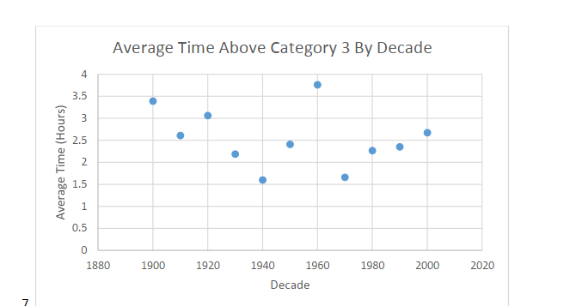

Slide 23
Something not right here

Slide 24
Don’t have plot origins where there is no data

Slide 25
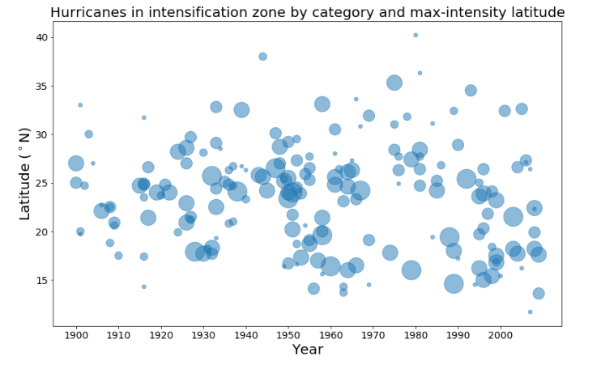
More Correct

Slide 26
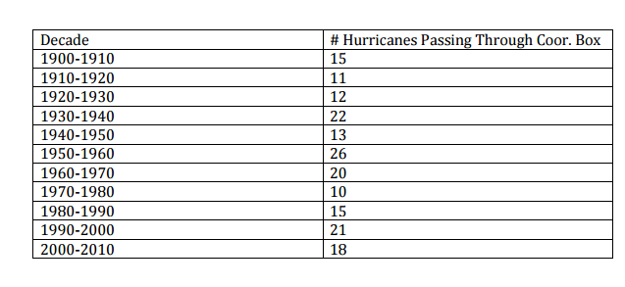
South
Atlantic
Hurricane Box
Notice the Feature that appears in the Plot

Slide 27
My Analysis snippets
There is nothing elegant in what I do – this is all brute force but it works.

Slide 28
Google Chart Library

Slide 29
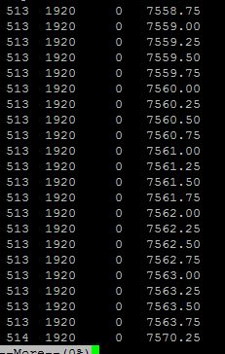
Example Code to Produce a new data file

Slide 30
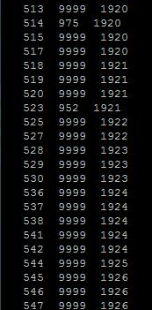
Next Pass produces initial “counting” file

Slide 31
Science
An example of science that is enabled by doing list management operations on data bases
Current project, track analysis of Atlantic Basic Hurricanes – all previous analysis is only for LANDFALL events.

Slide 33
Frequency Analysis:
What detection efficiency improvement happened in 1950 relative to 1940?

Slide 34
Lots of Information!

Slide 35
Pressure analysis for strong storms < 965 mb; 2005 is dramatic!

Slide 36
New Important Result: Dynamics are changing; evolution is faster; KS TEST and CFDs!!

