Slide 1
This assignment is all about flow control prediction from a network of sensors. This is a ubiquitous data science issue.
In this case your are analyzing a river network and eventually making a prediction for an outcome.
In most all cases, flow control predictions are subject to burst behavior and non-linear responses. That’s why good prediction is hard.
I bet you can’t read this slide easily while that rotating thing is screwing with your head

Slide 4
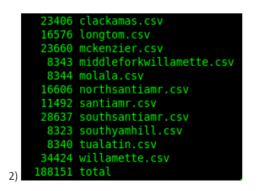
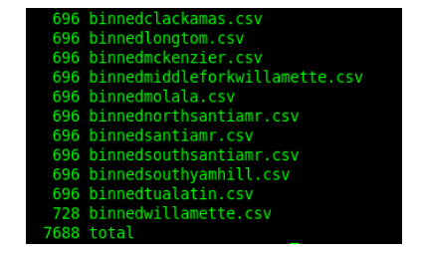

Slide 5
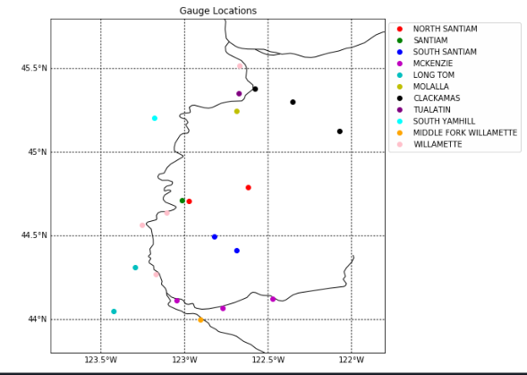

Slide 6
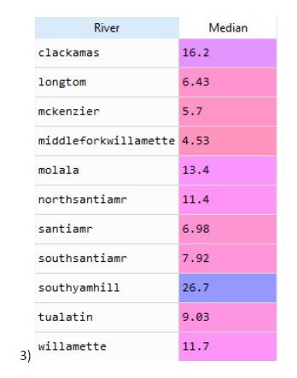

Slide 7
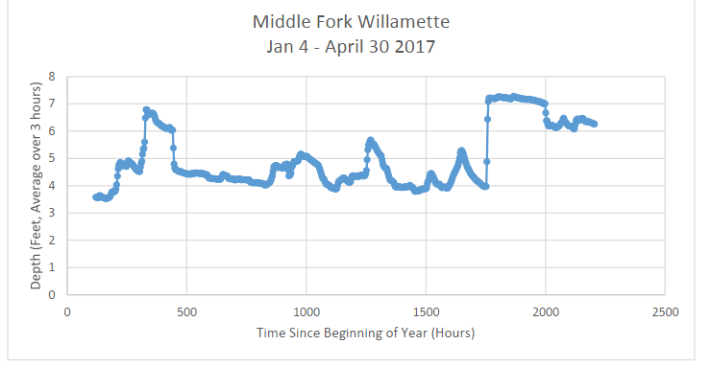
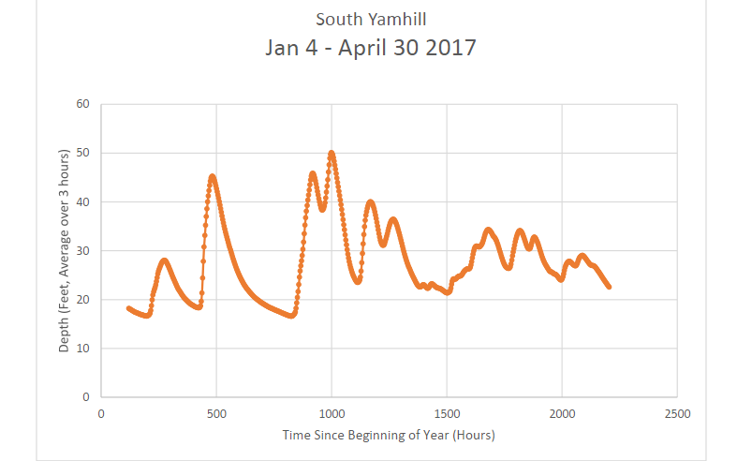
.52 feet per hour
1.14 feet per hour

Slide 8
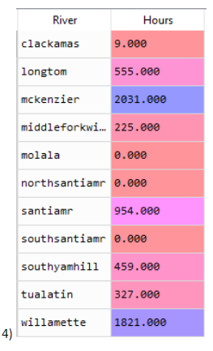
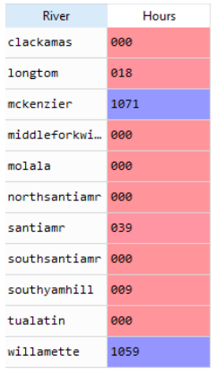
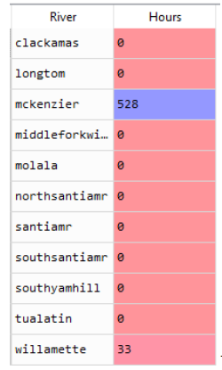
Alarm Levels

Slide 9
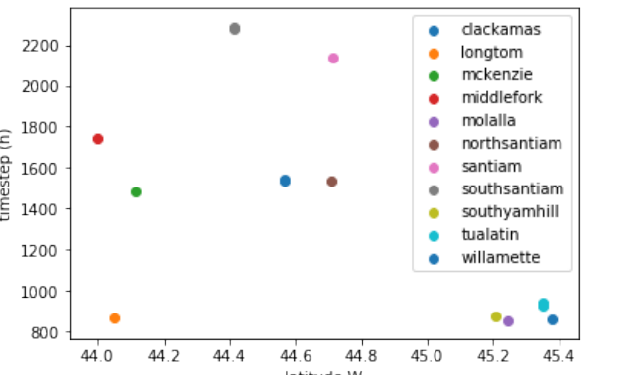
Burst Behavior
In general, you always want time on the X-axis

Slide 10
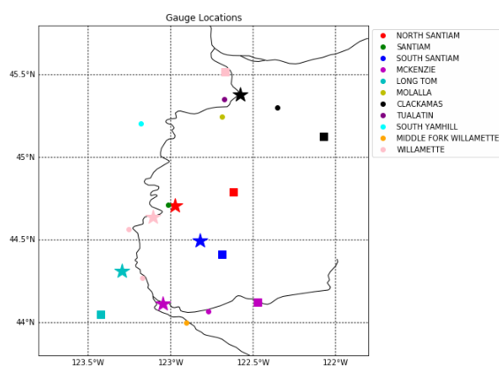
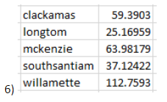
Data Management Foresight!

Slide 11
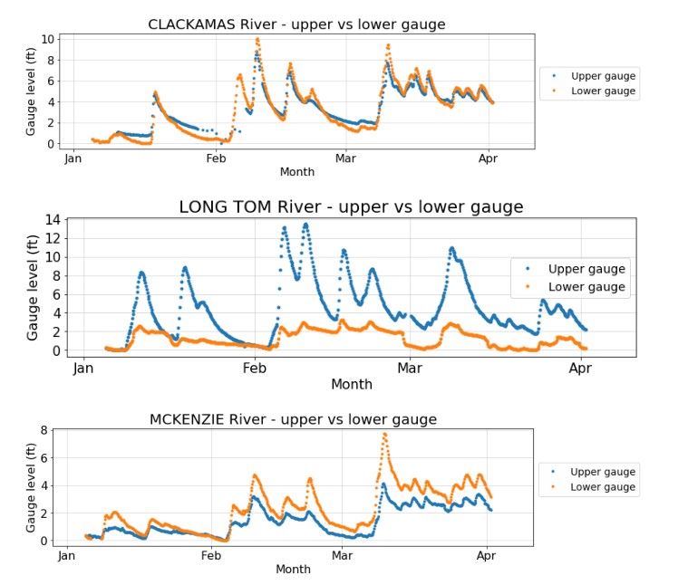

Slide 12
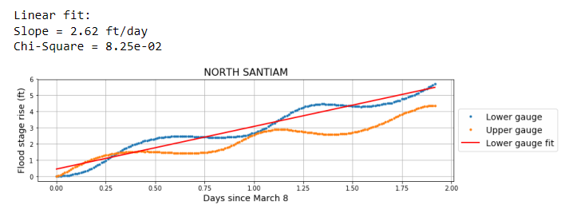

Slide 13
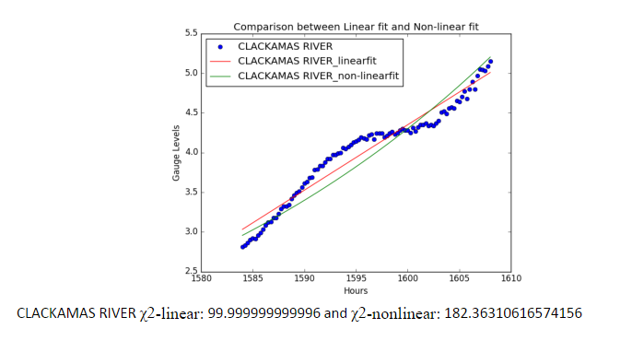

Slide 14
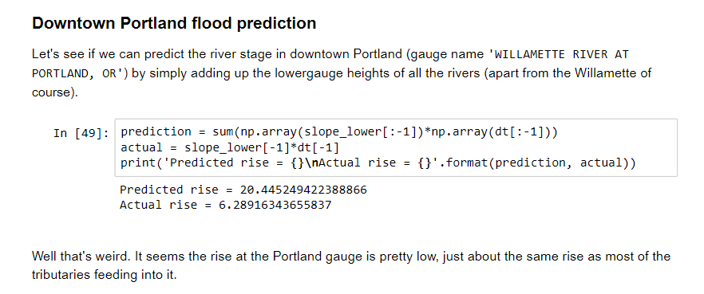
FLOOD CONTROL!

