Slide 1
Linear Regression
Everyone thinks they know this stuff

Slide 2
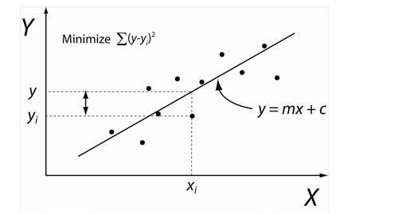
For example, the above is a data set in X and Y. We are interested in finding the line which slope and intercept such that the square of the residuals (the deviations from the actual Y-values compared to the line at a given value of X) is minimized. The line above is adjusted so that a minimum value is achieved. This is easily proved using a bit of calculus which seems unnecessary. In producing a linear regression, one uses this method of “least squares” to determine the parameters. The important parameters which are determined are the following:
    The slope of the line (denoted as a)
    The intercept of the line (the value of Y at X=0) – denoted as b
    The scatter of dispersion around the fitted line – denoted as s (this is also referred to as the standard error of the estimate)
    The error in the slope of the line – denoted as s_{a}
    The correlation coefficient – denoted as r
The accuracy of any prediction of Y for some future value of X depends on s and s_{a}

Slide 3
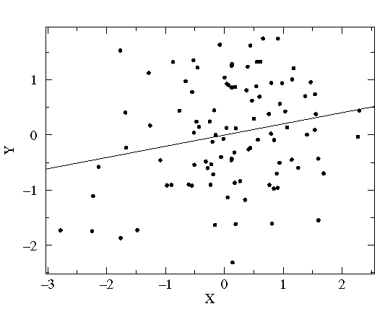
Who gives a shit about r
r² is called the coefficient of determination. Thus if r = 0.9 then r² = 0.81. This is taken to mean that 81% of the value of Y is determined by X, on average. For us physical scientists, this a meaningless statement and hence we will not make use of these parameters for this course. An example is provided below.
Please guard against the not uncommon situation of "statistically significant" correlations (i.e., small p values) that explain miniscule variations in the data (i.e., small r² values). For example, with 100 data points a correlation that explains just 4% of the variation in y (i.e., r=.2) would be considered statistically significant (i.e., p<.05). Here is what such data looks like in a scatter plot:
The correlation may be statistically significant, but it is probably not important in understanding the variation in y.

Slide 4
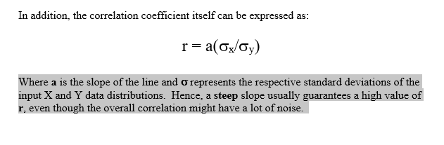
σ_{x} and σ_{y} Matter

Slide 5
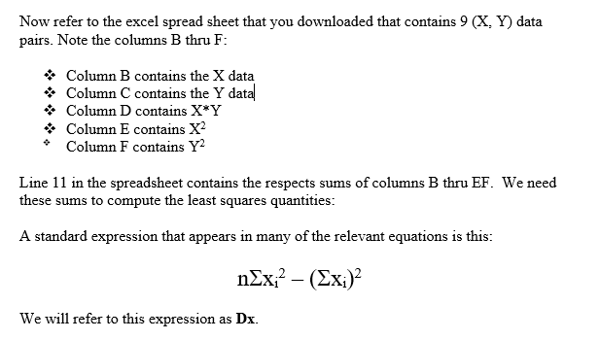
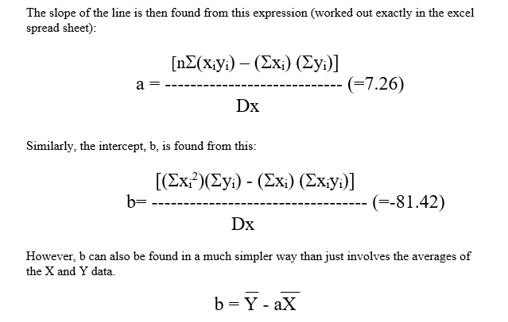
Refer to the Excel Spread sheet

Slide 6
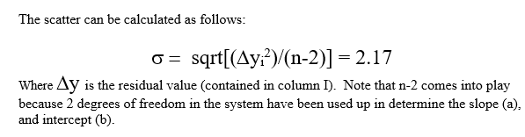


The things that matter:
If you want to minimize the error in the slope what do you want in your data set?

Slide 7
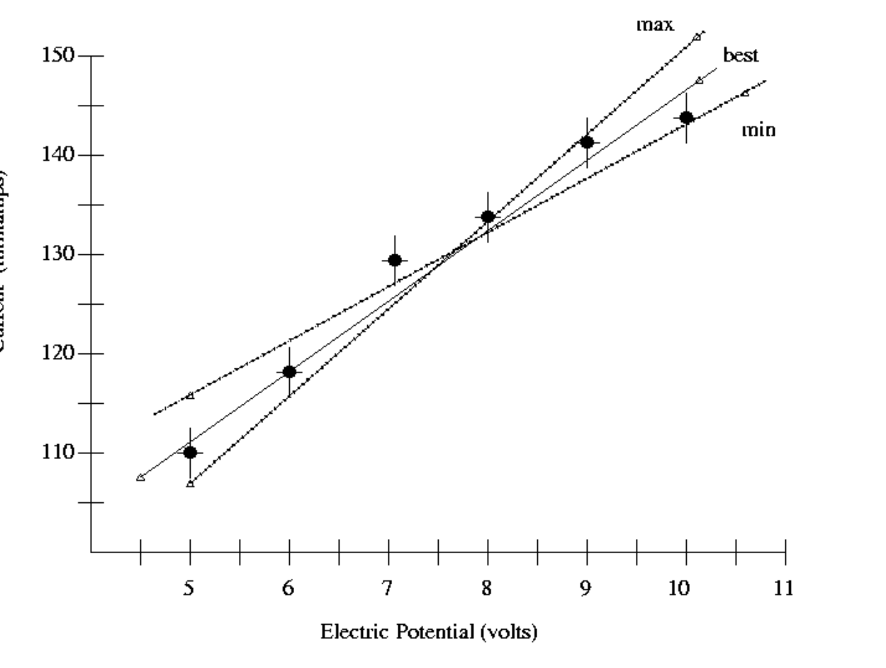
The slope error lines

Slide 8


2
This is a very simple and useful statistic for all kinds of curve fitting
The chi-square distribution can be used to see whether or not the observed counts (data) agree with the predicted counts (data) from your functional fit
  O = observed count and
  E = Expected count
We only care about MINIMIZING this number, never about its actual statistical p-value or degrees of freedom.
We use this just to determine a best fit from available alternatives.

Slide 9
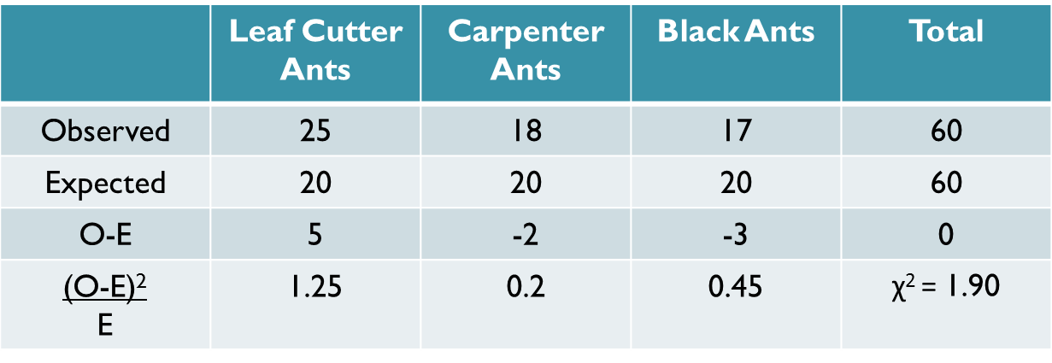
Example
The quality of the fit is totally determined by the Leaf Cutter Ants

Slide 10
Maybe there is a bad data point in the Leaf Cutter Ants
Extremely useful to therefore do 1 cycle of sigma-clipping.
In science we often use 2.5σ as the one cycle threshold (this corresponds to p = .01 – well use 2.35σ if you want to be exact). – all points that deviate more than +/- 2.5σ from the initial fit, can be rejected to produce another fit.
You only get to do this clipping one time.
This is used quite a bit, for instance, in climate analysis where often times the data is just bad.
Unless you have some a priori way of insuring that you have no bad data, you an always use this approach.

Slide 11
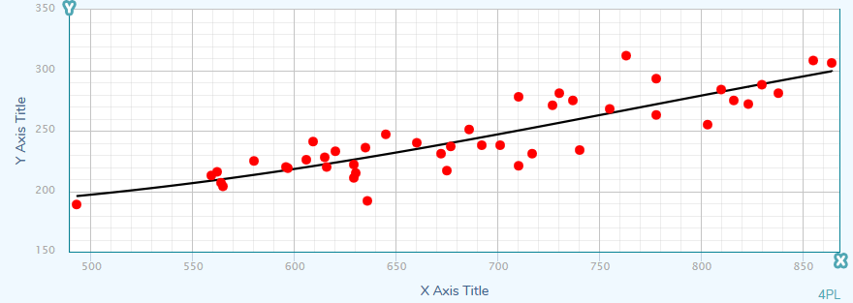
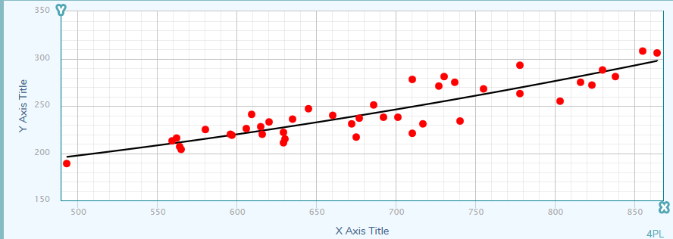
Example:
Sigma = 16.3
Sigma = 14.4
The accuracy of my prediction has now been improved!

