Slide 1
Some Machine Learning Basics
There is lots of confusing and overly sophisticated and technical material on this which greatly aids in making machine learning appear to be hard and to readily obfuscate actual implementation

Slide 2
Machine Learning Defined
“[Machine Learning is the] field of study that gives computers the ability to learn without being explicitly programmed.”
--Samuel 1959
“A computer program is said to learn from experience E with respect to some task T and some performance measure P, if its performance on T, as measured by P, improves with experience E.” -- Tom Mitchell, Carnegie Mellon University (1997)
In general, ML tackles problems that cannot be solved solely by numerical means.

Slide 3
Supervised vs Unsupervised
Supervised ML: The program is “trained” on a pre-defined set of “training examples”, which then facilitate its ability to reach an accurate conclusion when given NEW data.
Unsupervised ML: The program is given a bunch of data and must find patterns and relationships among the data.

Slide 4
Example: Yes or No predictor

Slide 5
The “Cost Function”
Not a good name to me.
A cost function is basically something that is a “wrongness measure” that determines whether your iterative step is better or worse.
For cookie classification a prediction of 1 would represent a perfect cookie and 0 would be not edible.
So in this case we might want a “cost function” to determine the surface where the prediction is 50%. Objects outside that surface could then be sold as cookies to consumers.

Slide 6
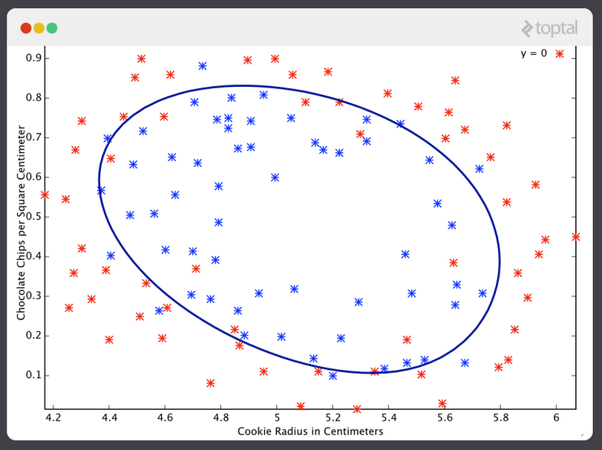
ML generated classification boundary

Slide 7
Note
For simple data sets, your eye-brain is probably better than ML
But things like predicting climate change or how and organism’s genome will be expressed are complex problems.
But are their sufficient reality checks available to detect spurious results?

