Slide 1
NetCDF and Scientific Data Standard
Array of Data file amenable to array operations and good data viewers

Slide 2
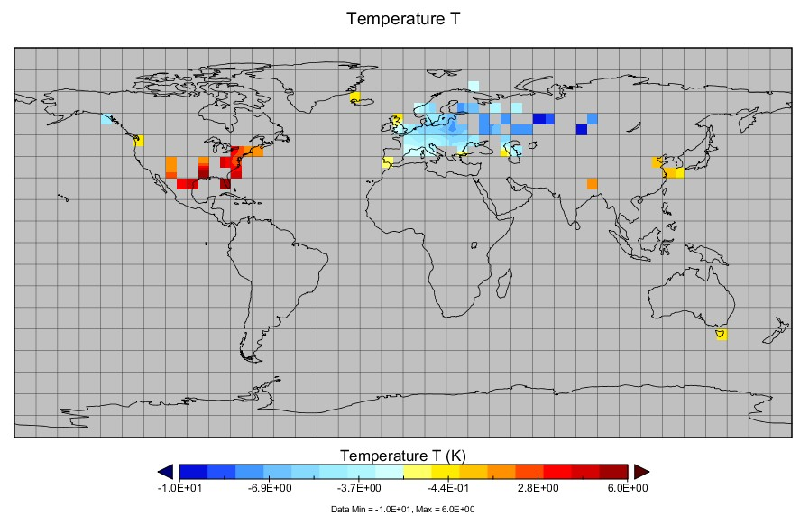

Slide 3
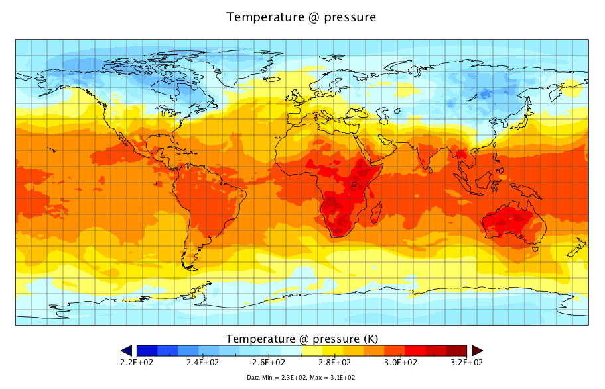

Slide 4
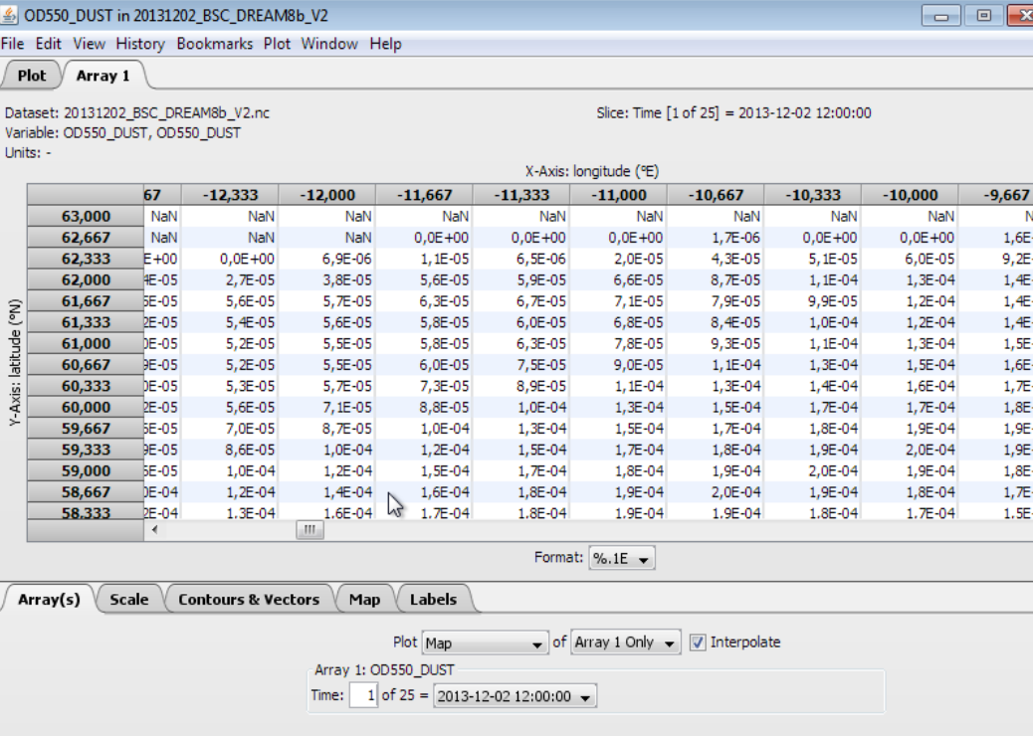

Slide 5
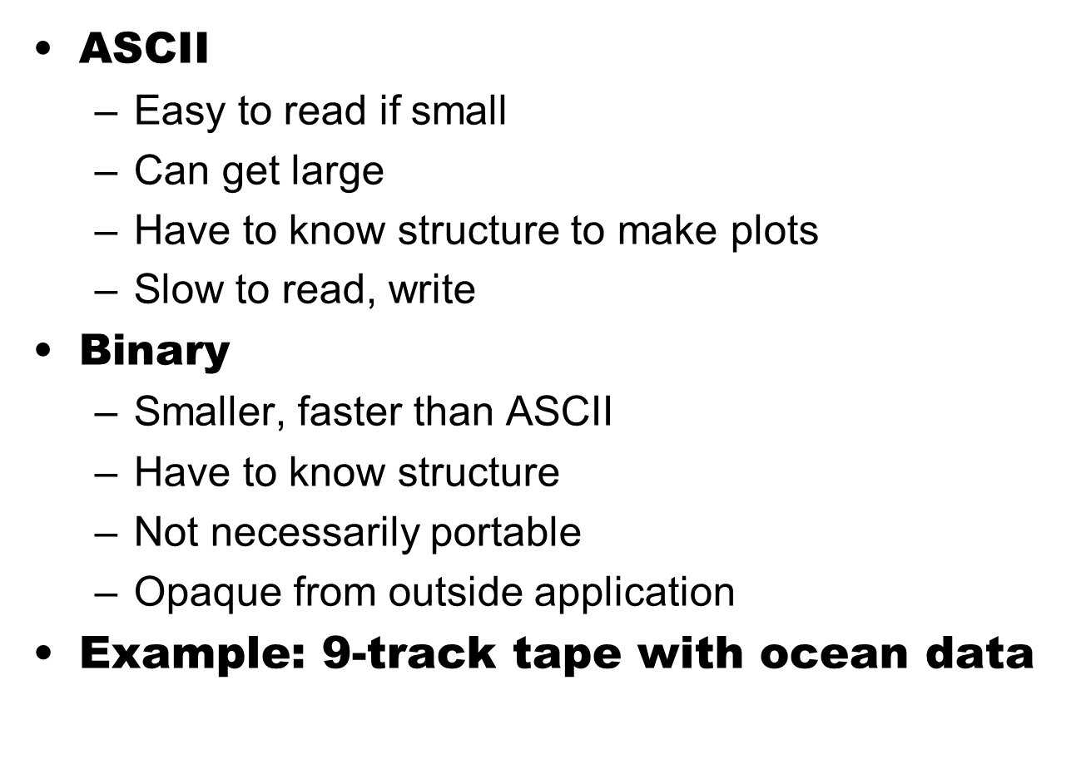
Historical View of Problem

Slide 6
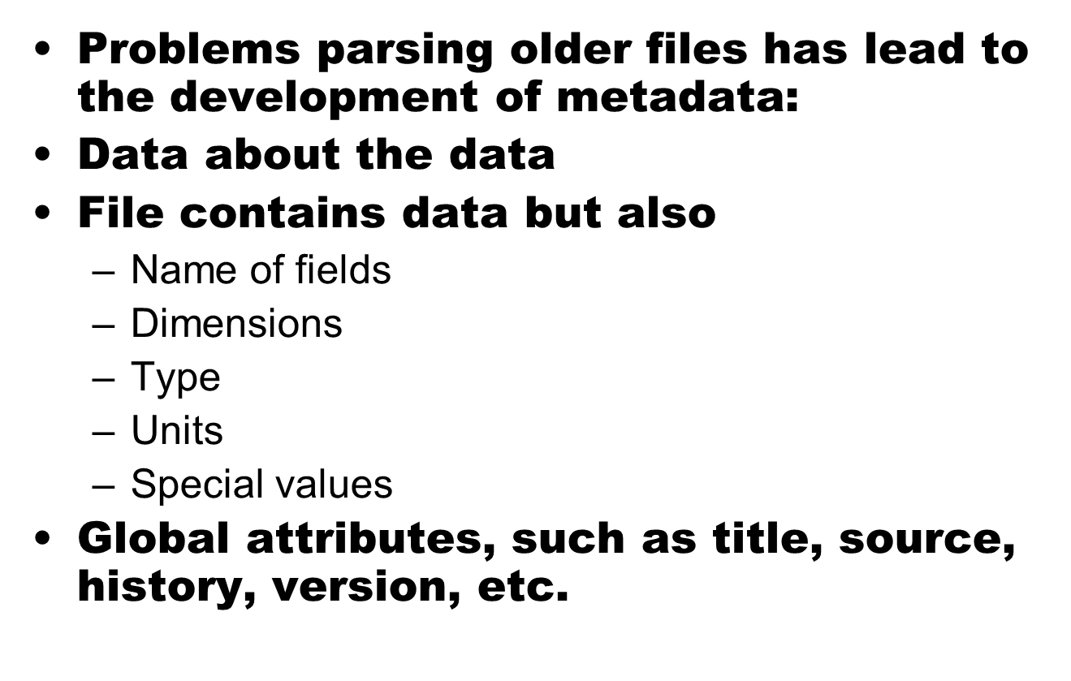
The need for Metadata

Slide 7
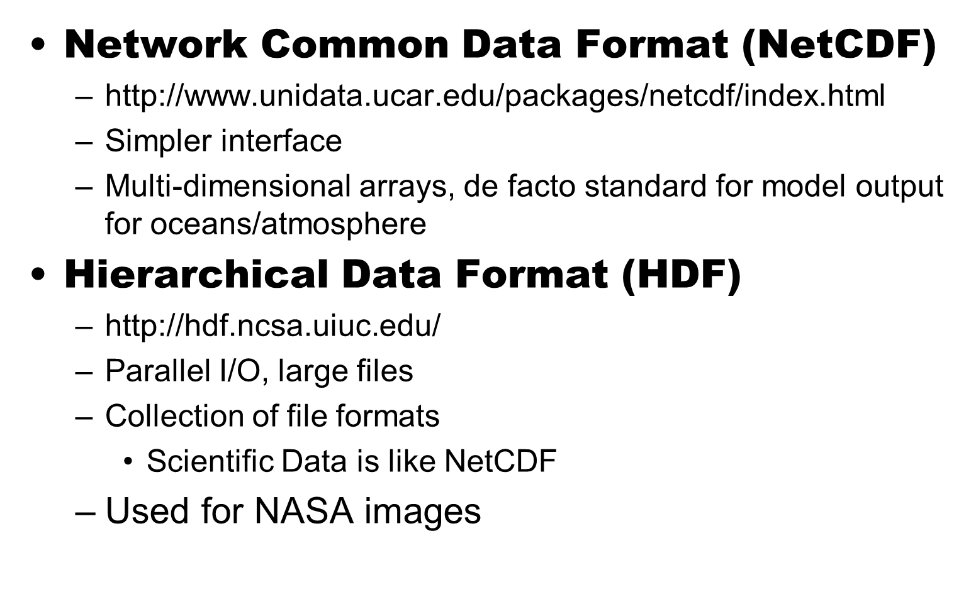
NetCDF and HDF

Slide 8
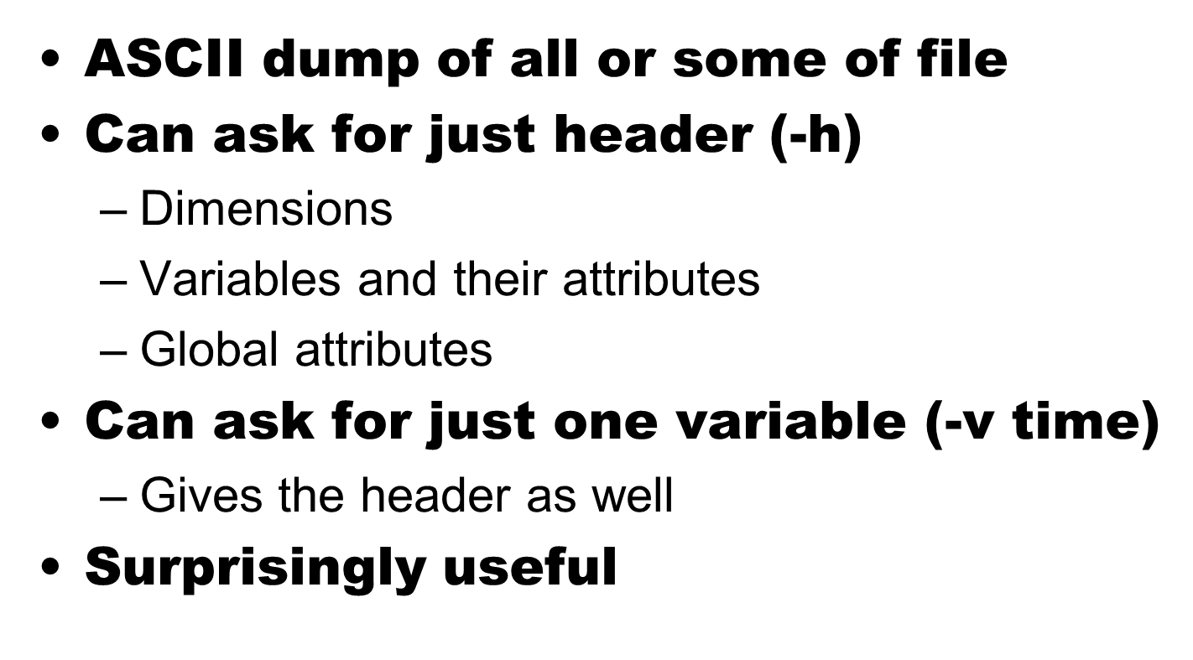
Programs - ncdump

Slide 9
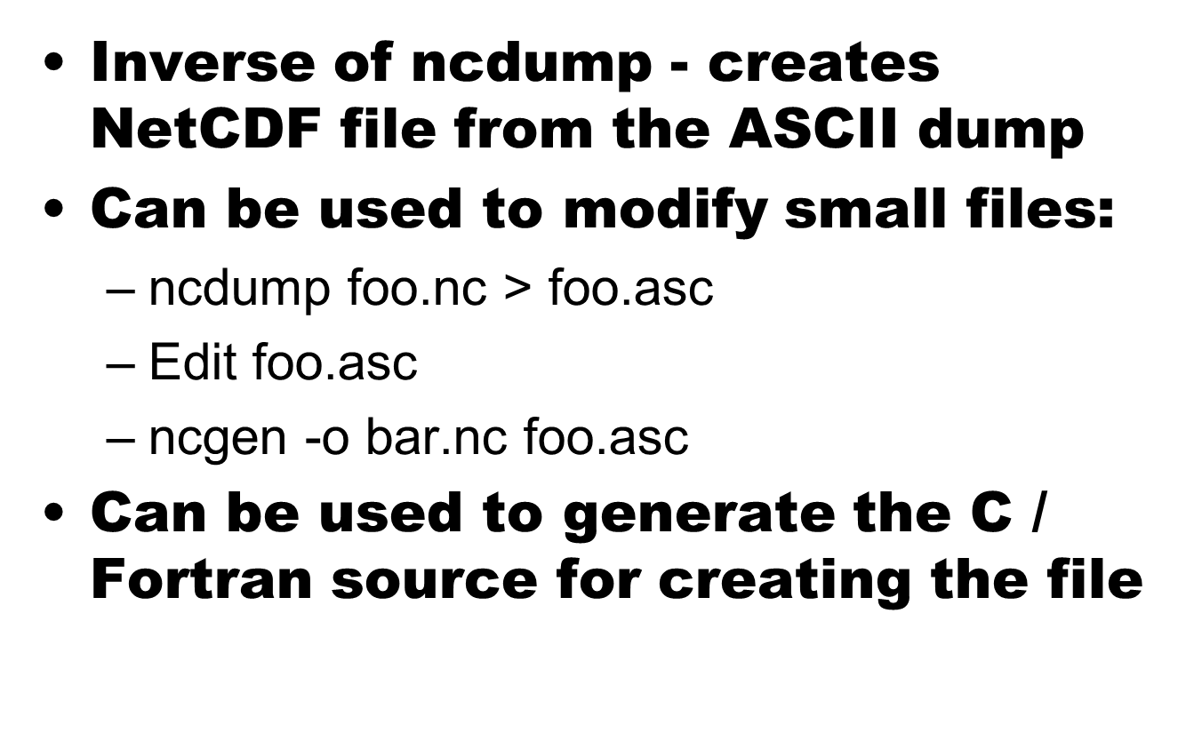
ncgen

Slide 10
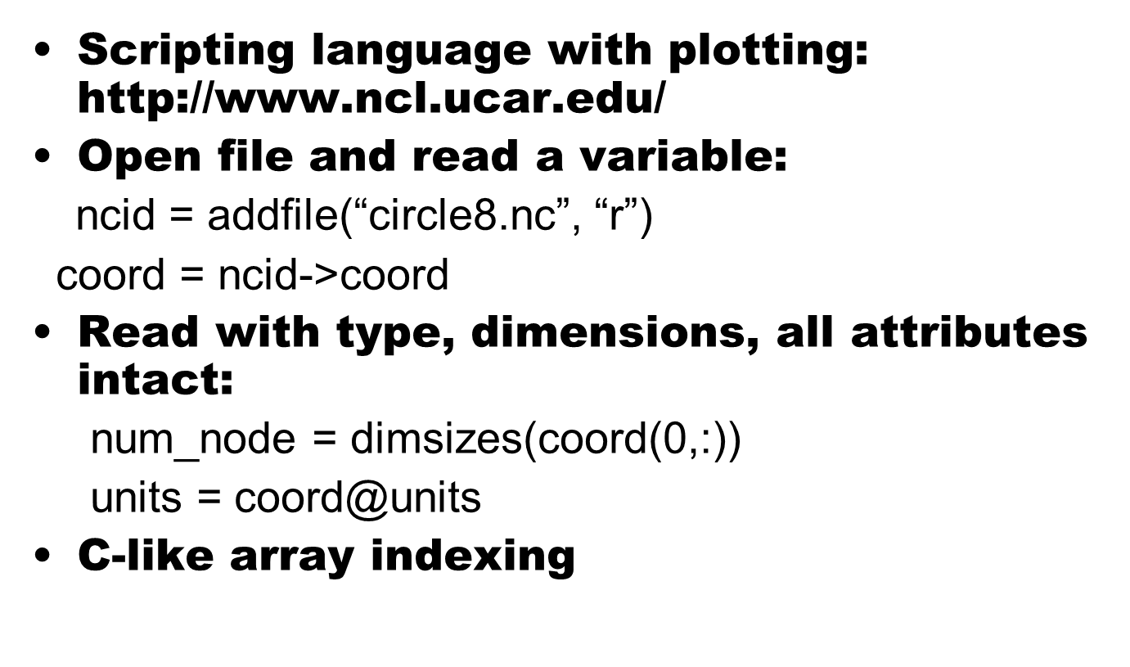
Use NCAR Command Language (NCL)

Slide 11
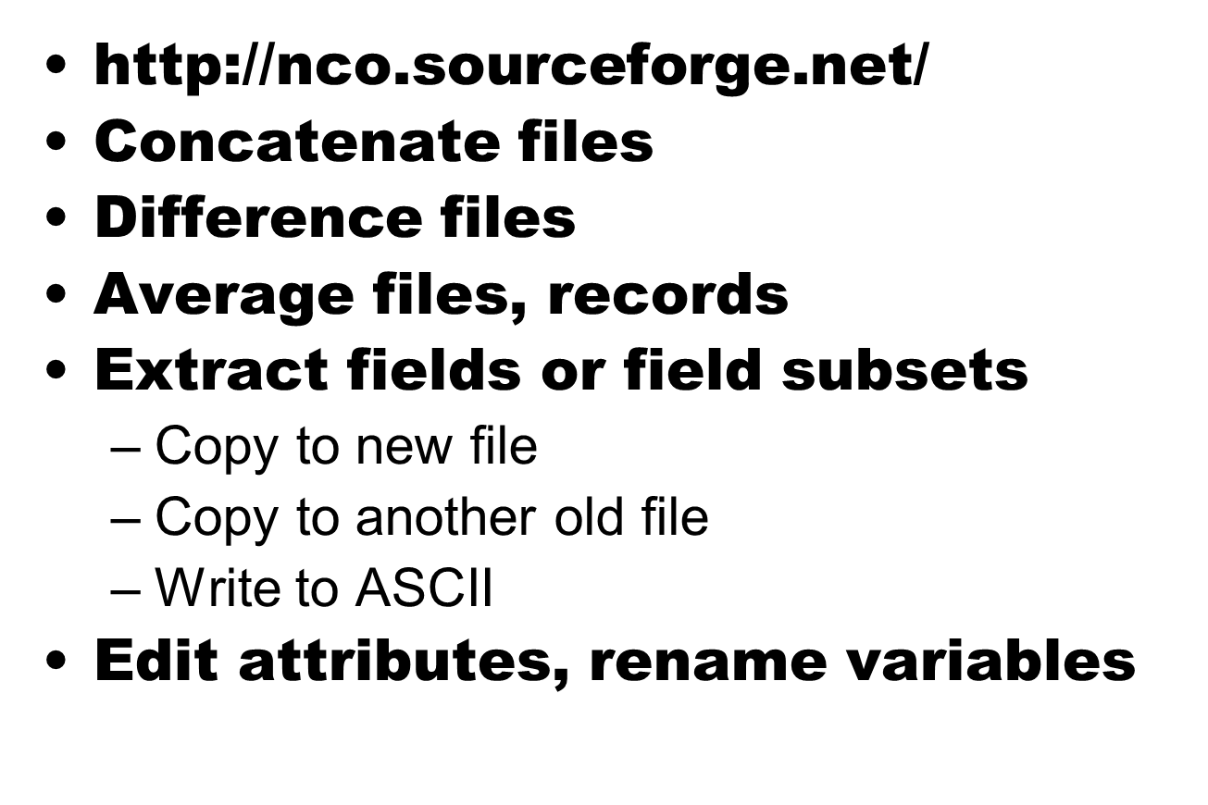
NetCDF Operators (NCO)

Slide 12
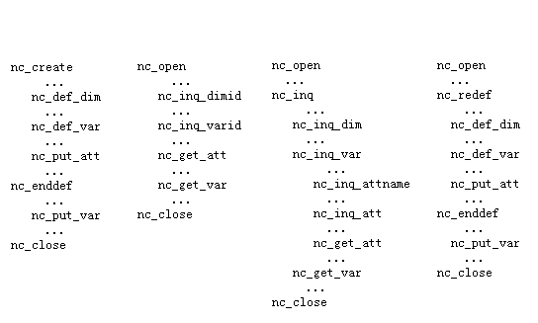
netCDF Library & Programming Model
Modes: definition mode, data mode
IDs: dataset ID, dimension ID, variable ID, attribute number
Create & Write Read by name Read sequencially Add dim,var,att

Slide 13
Why Do this?
Converting to NetCFG is always worth the trouble
  Portability
  Use of tools (ncdump, nco, etc)
New interfaces from scripting languages make it simple to use (available on ACISS)
Makes for great and rapid ability for data visualization using appropriate viewers

