Slide 1
Applied Power Spectrum
This is real data but most of its periodic and so the method will work for sure. Noise in real data does degrade the signal.

Slide 2
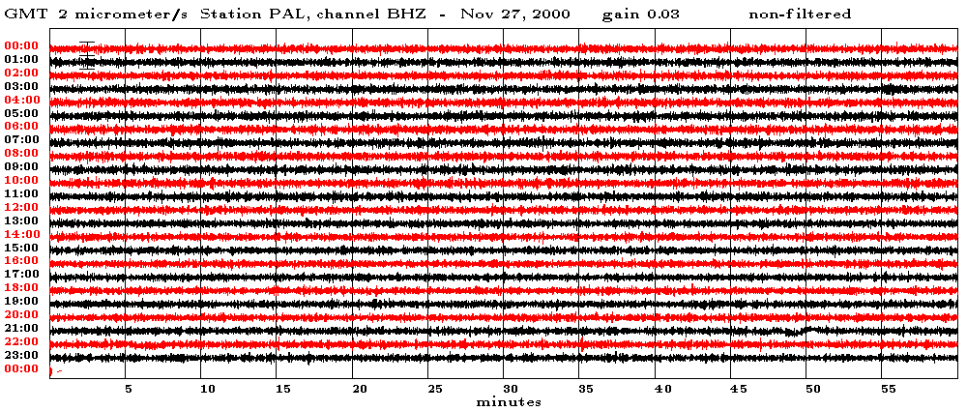
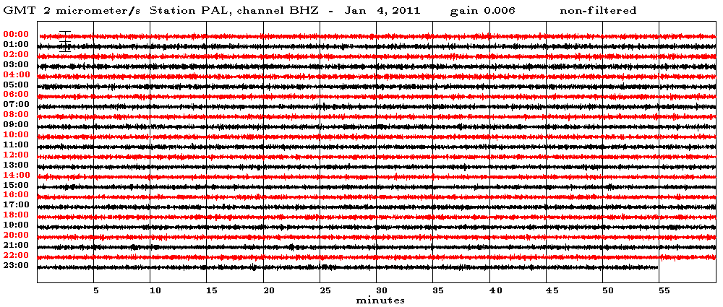
Nov 27, 2000
ground vibrations at the Palisades NY seismographic station
time, minutes
Jan 4, 2011
time, minutes
similar appearance of measurements separated by 10+ years apart
Notes:
This is a time series of ground vibration at Palisades NY.
It’s a seismic record, but no earthquakes are shown, just the time between earthquakes.
Each record is half an hour long, and shows slight up and down motion of the ground caused
by a variety of non-earthquake sources, such as wind and ocean waves.
The two records, though separated by more than ten years, look similar.
This is the basic idea behind the concept of stationarity.

Slide 3
stationary time series
indefinitely long but
statistical properties (like average Power or periods, etc) don’t vary with time. In practice if they vary slowly with time, you can still use these techniques.
Notes:
You might enumerate other examples of stationary time series.
Air temperature would be a good example, because it is stationary over time periods of hundreds
to thousands of years. Even so, it is not stationary through a longer period of time that includes
the ice ages, and may not be stationary into the future because of global warming.

Slide 4
assume that we are dealing with a fragment of an indefinitely long time series
time, minutes
time series, d
duration, T
length, N
Notes:
What we measure is just a little piece of an times series that goes on and on …

Slide 5
when we measure the power spectral density of a finite-length time series, we are making an estimate of the power spectral density of the indefinitely long time series the two are not the same because of statistical fluctuation
Notes:
No calculation based on a short section of time series can completely capture the properties
of the underlying, indefinitely long physical process.

Slide 6
finally we will normally subtract out the mean of the time series so that power spectral density represents fluctuations about the mean value
Notes:
Sometimes, the mean value is of little significance.
For example, when observing ocean tides by measuring the level of the water on a dock,
one can use a completely arbitrary reference level, such as a line painted on the side
of a dock.

Slide 7
Example 1
Ground vibration at Palisades NY
Notes:
The seismometer actually measures the vertical component of ground velocity, in micometers per second.

Slide 8
enlargement
Notes:
Ask the class to gauge by eye the typical period of these oscillations.

Slide 9
enlargement
periods of a few seconds

Slide 10
power spectral density
frequencies of a few tenths of a Hz
periods of a few seconds
Notes:
Students should be encourages to practice switching back and forth
between “period” and “frequency”. Both are useful.
remind them that period=1/frequency.

Slide 11
cumulative power
power in time series
Notes:
Only a limited frequency range, 0.2-0.4 Hz, contributes most of the power.

Slide 12
Example 2
Neuse River Stream Flow
Notes:
The Neuse River hydrograph shows stream flow for a roughly 11 year period.
Ask the class to identify the periodicity (1 year) and its cause (seasonal fluctuations in precipitation).

Slide 13
Example 2
Neuse River Stream Flow
period of 1 year

Slide 14
power spectral density, s²(f)
power spectra density
s²(f), (cfs)² per cycle/day
frequency f, cycles/day
period of 1 year

Slide 15
Example 3
Atmospheric CO₂
(after removing anthropogenic trend)
Notes:
This is the Hawaii CO2 record, with the anthropogenic increase modeled by a parabola and
removed from the record.
Ask the class to estimate the period of the oscillation by counting the number of cycles in a
5 year period and dividing by 5. They should get a period of 1 year.
Discuss why the record has a annual cycle.

Slide 16
enlargement
period of 1 year
Notes:
The period is one year.

Slide 17
power spectral density
1 year period
½ year period
frequency, cycles per year

Slide 18
Example 3:
Tides
90 days of data
Notes:
The actual measurement is the elevation of the sea surface, in feet.

Slide 19
enlargement
period of day½
7 days of data
Notes:
Period is ½ day, the semi-diurnal tide.

Slide 20
power spectral density
about
½ day period
fortnighly
(2 wk)
tide
about
1 day period
cumulative power
power in time series
Notes:
The semidiurnal (12 hr) tide typically contributes the most power.

