Slide 1
Rebinning
Very straight forward but beware the black box

Slide 2
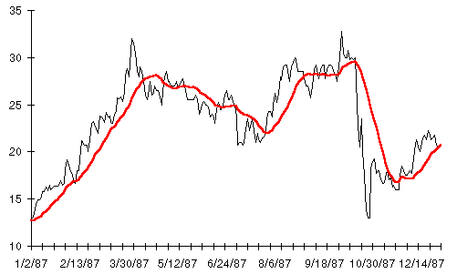
Rebinding of data is quite similar to smoothing
You run a filter over N points, and replace those N points by 1 point using some functional weighting of the N-points

Slide 3
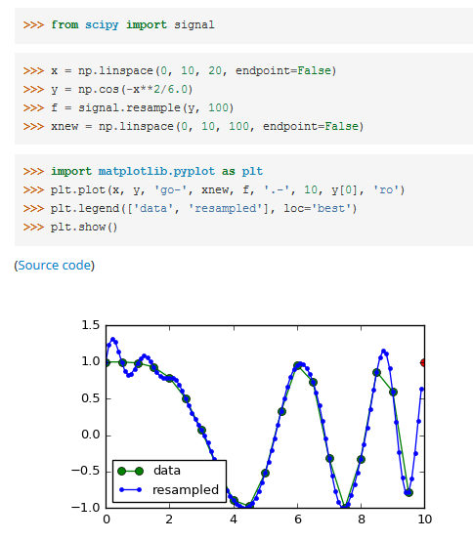
Resample data for rebin

Slide 4
Resampling to RebinNINg
Linear interpolation (replace N points by 1 point = 5 – make a line from N-2 to N+2 and plug and plug the midpoint value in)
Simple boxcar averaging of N points in a time series (boxcars do not overlap – hence resampling and not smoothing).
Kernal rebinning – convolve N points with some function (gaussian)
You need to worry about boundary effects sometimes – always plot the resampled data on the original

