Slide 1
Dealing with Noisy Data
Smoothing Techniques

Slide 2
Want to find overall evolution of some phenomena
In general, most environmental data has a considerable amount of random noise it. The origin of this random noise is
  the phenomena itself has a lot of intrinsic variability - this is especially true with climate data
  the measurements are often difficult and imprecise

Slide 3
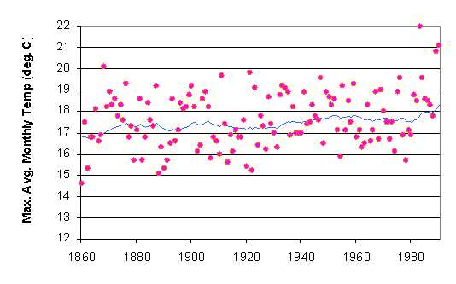
This example shows a time series where the intrinsic variability completely swamps out any potential trend. To identify possible trends it is necessary to smooth the data.
Any data that has significant fluctuations as a function of time may dominate the underlying wave form (trend with time). You therefore want to dampen out the fluctuations to reveal the underlying wave form.

Slide 4
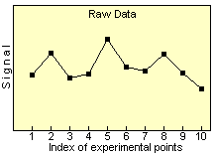
Smoothing vs Averaging
Averaging ends up with fewer actually data points
Smoothing preserves the number of data points and lowers the amplitude of the noise by coupling the data points; smoothing length is a trade-off
  Boxcar smoothing or sliding average: this works best when there is some underlying waveform to the data (long period systematics vs. short period fluctuations) (Note that the Excel function of "moving average" is, in fact equivalent to boxcar smoothing).
  Box Averaging: Replace N data points by the average of those data points. So suppose you have 100 data points and you average them in groups of 3. You will then up with 33 data points.

Slide 5

Exponential Smoothing
Here the smoothed statistic, s_{t} is the weighed average of the previous data value (x_{t-i}) and the previous smoothed statistic, s_{t-i}; α is the smoothing factor (a value between 0 and 1).
This method is often applied to data which has lots of short term fluctuations in it. Financial or stock market data is often treated this way but climate time series also lend itself to this smoothing approach.
The functional form of this smoothing is governed by one smoothing parameter, and it has a value between 0 and 1. Values close to one have less of a smoothing effect and give greater weight to recent changes in the data, while closer to zero have a greater smoothing effect and are less responsive to recent changes. There is no formally correct procedure for choosing the smoothing factor -its a scientific judgement call.

Slide 6
Guassian Kernel Smoothing:
This is very well suited to time series and not used nearly enough
This form of smoothing is a weighted form
The 'kernel' for smoothing, defines the shape of the function that is used to take the average of the neighboring points. A Gaussian kernel is a kernel with the shape of a Gaussian (normal distribution) curve.

Slide 7
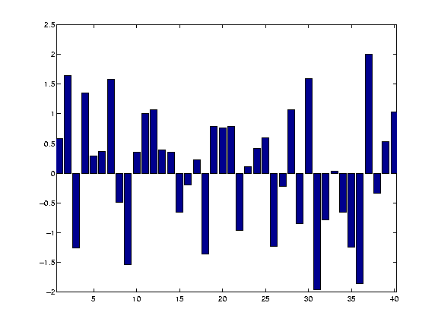
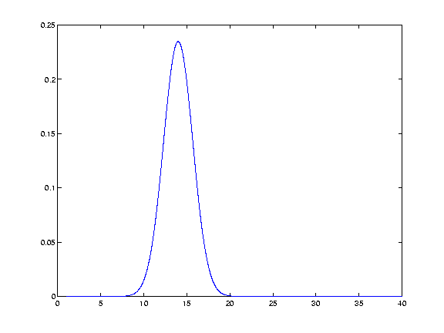
Example Kernel Smoothing
The basic process of smoothing is very simple. We proceed through the data point by point. For each data point we generate a new value that is some function of the original value at that point and the surrounding data points as weighted by the kernel. In this case we have chosen our kernel to have a standard deviation of 2.5 units on the X-axis.

Slide 8
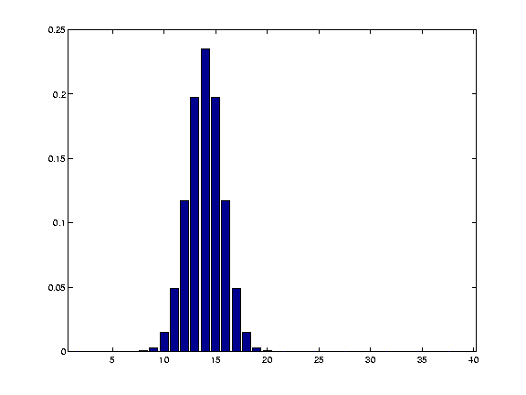
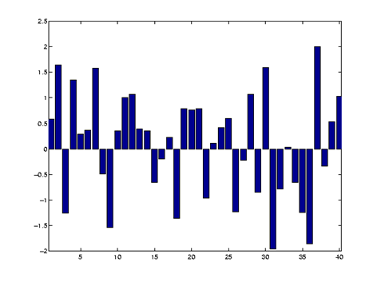
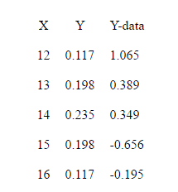
This is the discrete representation of our kernel. Note that the total area under the Kernel must = 1
We center our Kernel at x =14. The table below summarizes the x,y, values of the discrete function above as well as the actual Y-data in the raw case
Note: we used a Gaussian kernel with σ = 2.5. The example used here just uses the first 5 points (eg. ~ +/- 1 σ) which represents 86.5 % of the total area and so contains most of the weight in the smoothing (but you really do want to use all of the kernel to get the best results)

Slide 9
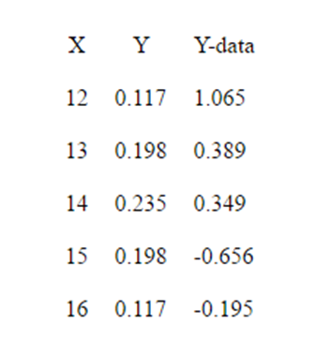
Operational Procedure
We want to produce a new value for x = 14 based on this weighted smoothing function. That means we convolve our function with the data. That sounds onerous, but its really quite simple and works like this.
The new Y-data point at X=14 is then:
0.117*1.065 + 0.198*0.389 + 0.235*0.349 + 0.198*-0.656 + 0.117*-.195 = .141 (compared to the actual data value of .349).
We then apply the same procedure to point 15 etc and end up with a convolved time series.

Slide 10
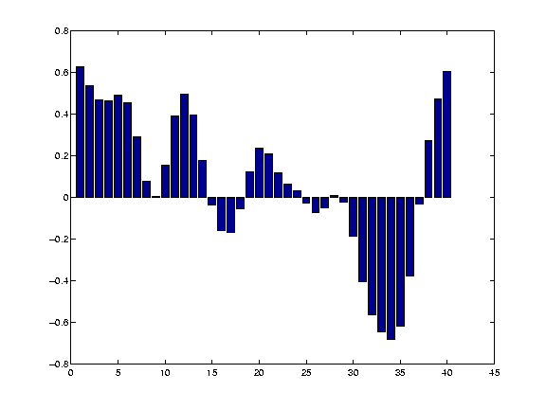
Convolved Time Series
This shows clustering of events and overall form of the data much better
This particular method is very good for image or pattern recognition and can be important for analyzing climate data.

