Slide 1
Trend Extrapolation
Following we will see a series of data that we want to use to predict the value of Y in the 36th year of this data; if that value gets below 2, significant trouble will occur and so we want to know how many years in advance we can feel comfortable versus alarmed.
The World will End if we get below O.

Slide 2
Fitting this data
We will fit the data with three kinds of functions that are commonly used
Least Squares Regression sometimes with weights
Exponential function with changing rates
Y = y_o – (V_o/k) *[1- exp(-kx)]
An auto smoothed cubic spline (which at some point won’t be appropriate)

Slide 3
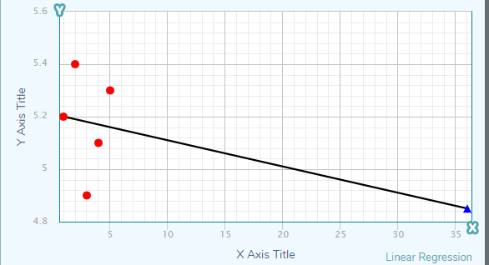
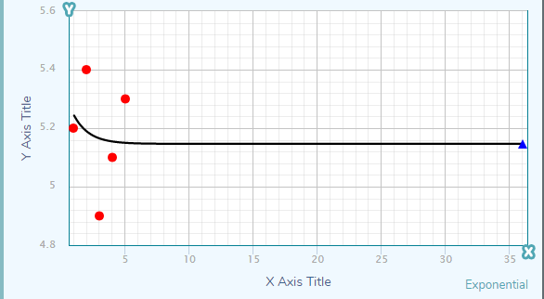
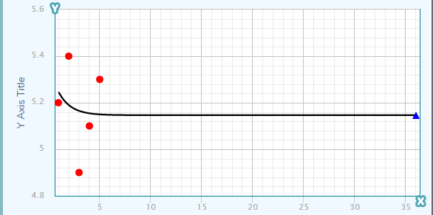
First 5 years of data says nothing
Linear = 4.85
Non linear exp = 5.14
Cubic = 5.14

Slide 4
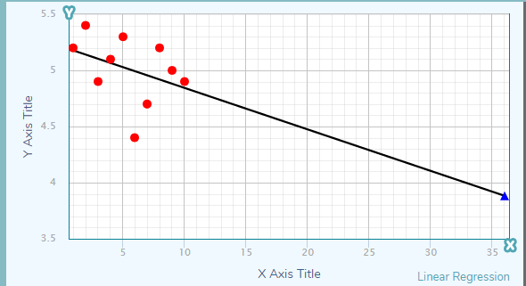
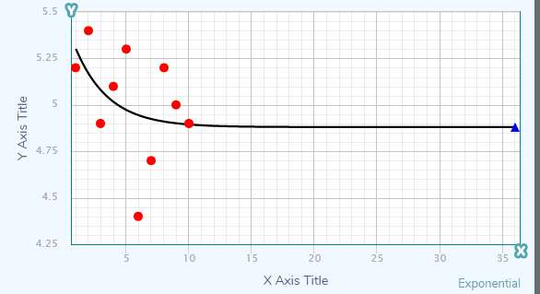
Adding 5 more years doesn’t help much
3.88 4.88 4.76

Slide 5
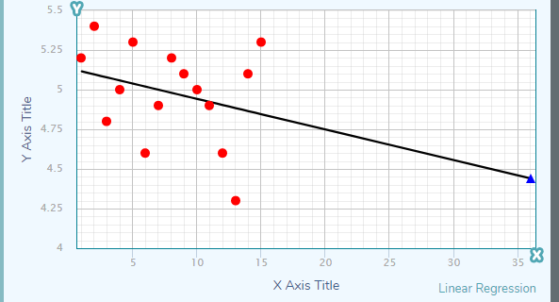
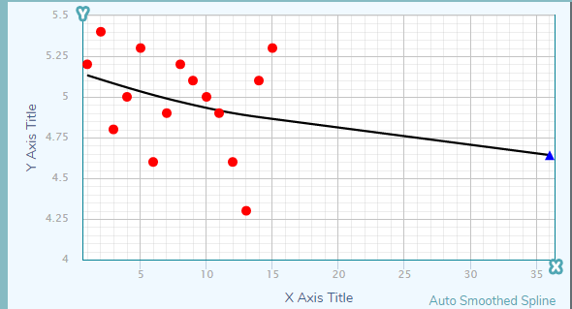
5 more years seems to have increased the noise
4.44 4.89 4.64

Slide 6
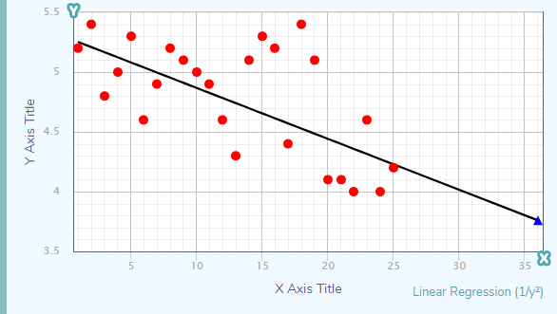
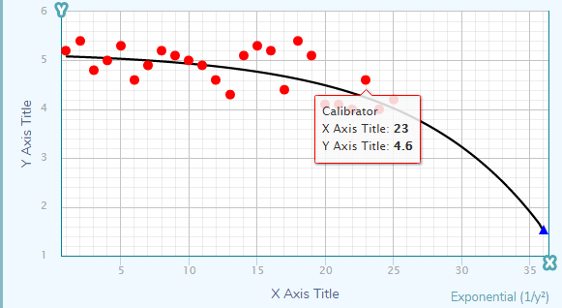
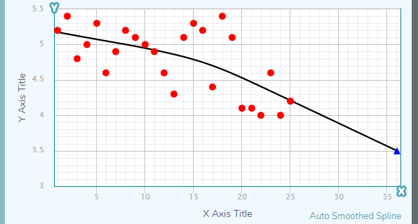
Now add in 10 more years of data to see change
This is a weighted fit where the indicated clump has lower weight
3.76 1.53 3.49
Now we have a policy or interpretation issue
Should we be alarmed?

Slide 7
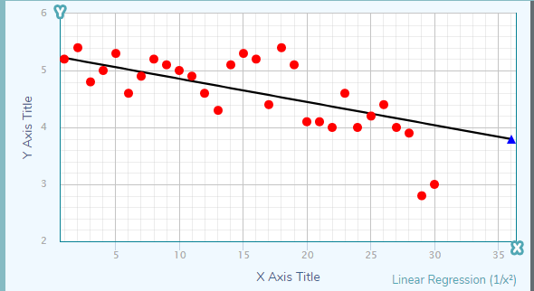
Now we add 5 more years of data.
Weighting the points might actually matter – are the two most recent events (2007 and 2008) significant;
Top graph is yes; bottom is no
3.09 vs 3.79

Slide 8
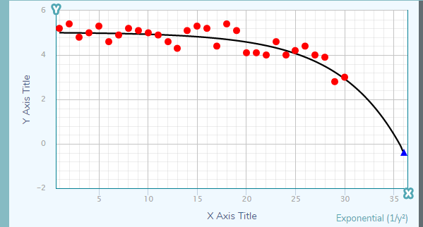
OH SHIT!
This is better – we can relax – 2.79
So now you have to make a bet, do the two lowest points in most recent years mean something – you need to put your scientist hat on

Slide 9
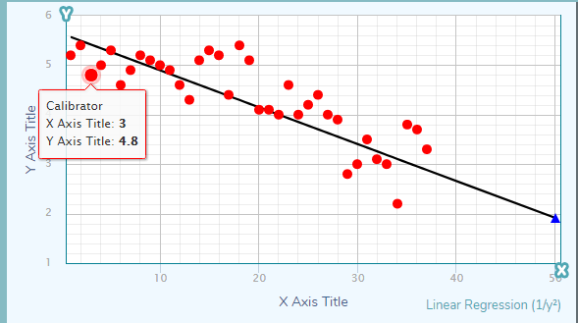
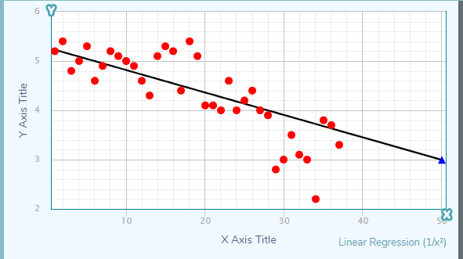
All the Data now; actual x=36 is y=3.7 – so now predict x = 50 (2030)
2.35
1.91
2.99

Slide 10
The Arctic Sea Ice Issue
0.66 – 0/74 depending on the weighting
So what do you pick to represent your Arctic Sea Ice Loss policy for the future?
If you’re the Pentagon you have already concluded that visits to Santa in the ice free Arctic on Sep 15 of some year are coming up real soon …

