Slide 1
Business As Usual
The inability to overcome policy and or institutional inertia in order to pull your head out of your ass and start on a sensible pathway to sustainability
Much more difficult obstacle to overcome than you think – you live in a legacy world.
The REAL world matters and in this course we exam issues always in that context

Slide 2
Business world analogy
The 7 reasons that (business) culture resists change
There isn't any real need for the change
The change is going to make it harder for them to meet their needs
The risks seem to outweigh the benefits
They don't think they have the ability to make the change
They believe the change will fail
Change process is being handled improperly by management
The change is inconsistent with their values

Slide 3
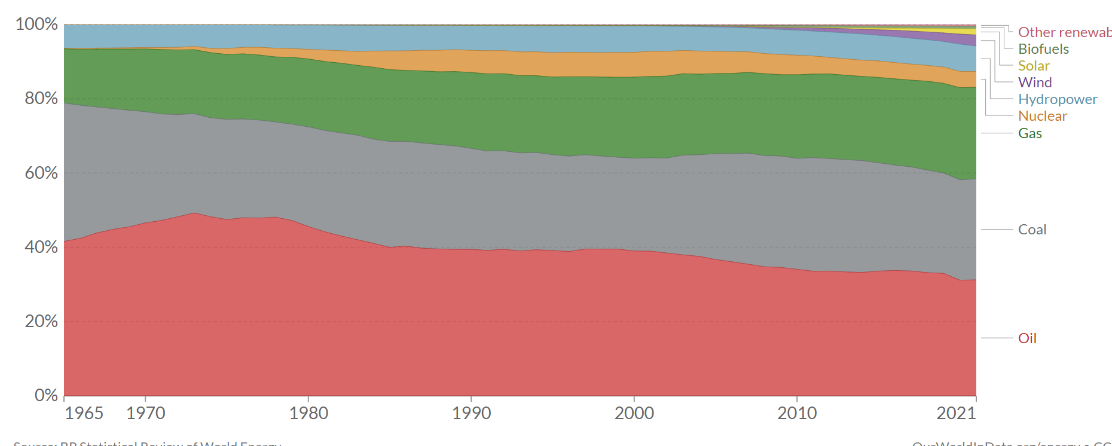
Why Energy Policy Matters
Over 55 years we have reduced fossil fuel use from 93% to 83% → no policy!!
Energy:
Electricity
Heat
Transportation

Slide 4
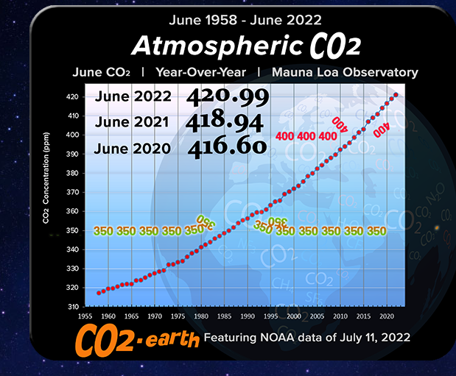
BAU Waveform

Slide 5
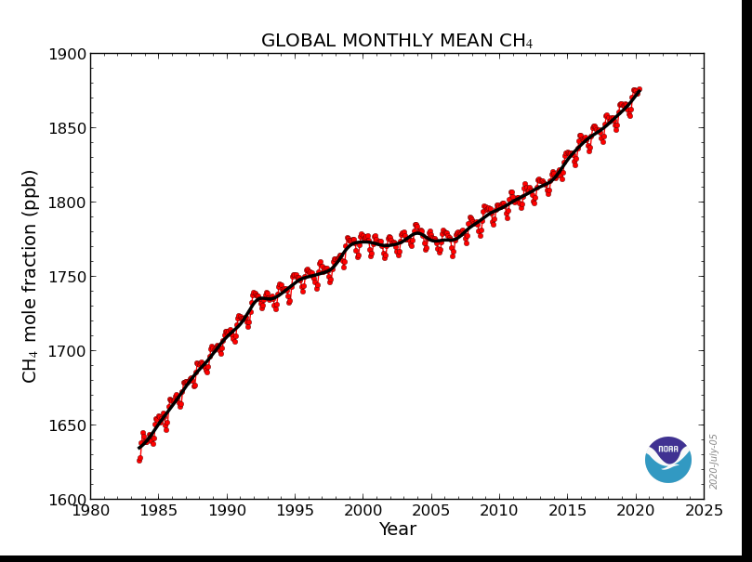
Methane Emissions Growing
Flat from 2000 -2007
Fracking?
Revised IPCC GWP: 21 → 36
CO2 = 420 ppm
CH4 = 1.89*36 = +68 → 488 ppm

Slide 6
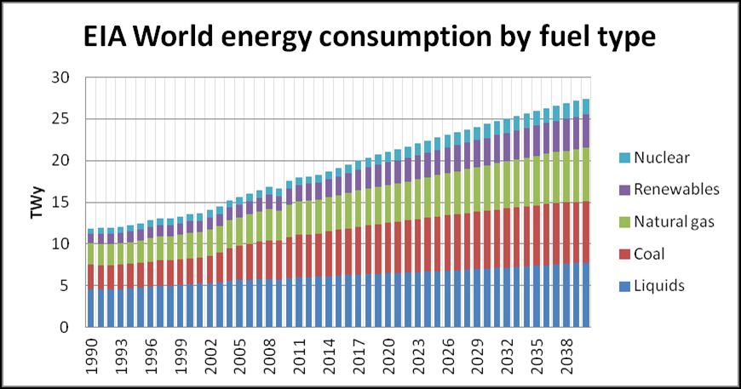
Electricity growth – must occur with carbon free emissions as fast as practical
Currently NG Fired Electricity is growing much faster then renewables

Slide 7
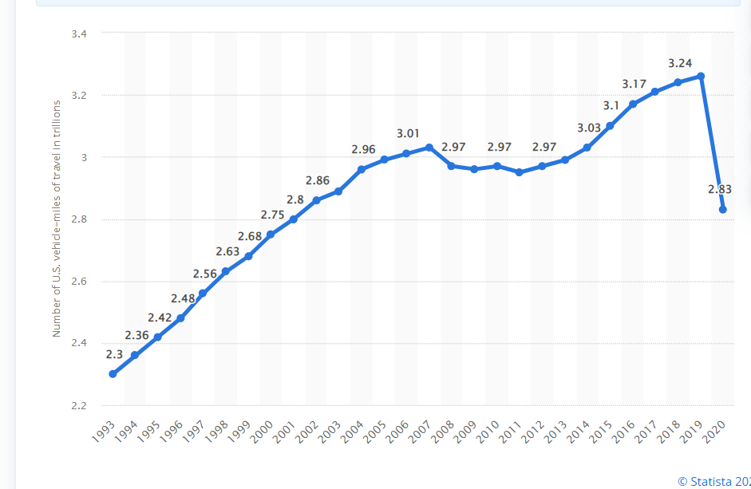
VMT = Vehicular Mileage Traffic: Recession 2007-2015; picks up until 2020 pandemic crash
Transportation and Electricity Production are equal in GHG

Slide 8
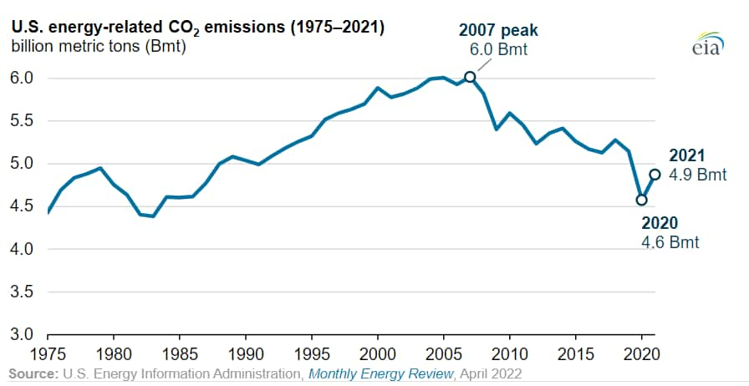
US Reduction in GHG emissions
Overall from 2007-2019 is a reduction of 12 % per year over 13 years
So, Business AS USUAL!
Not policy; better efficiency in electricity sector
Some Mild Winters Post 2007
7% Reduction 2009 Market Crash

Slide 9
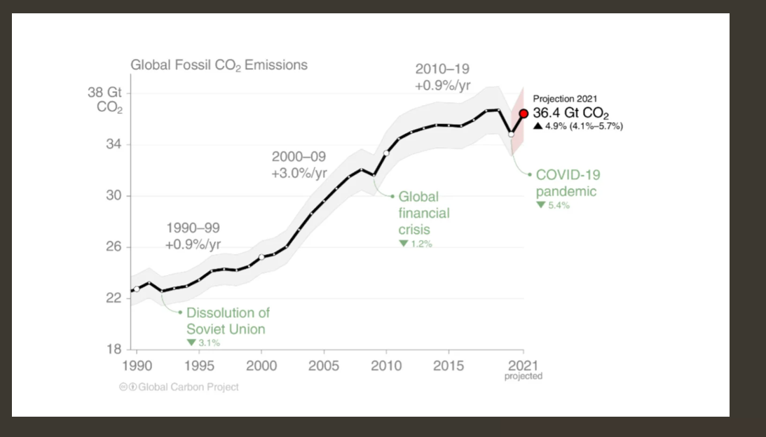
Changes in CO2 emission rates are influenced only by world events; not yet policy

Slide 10
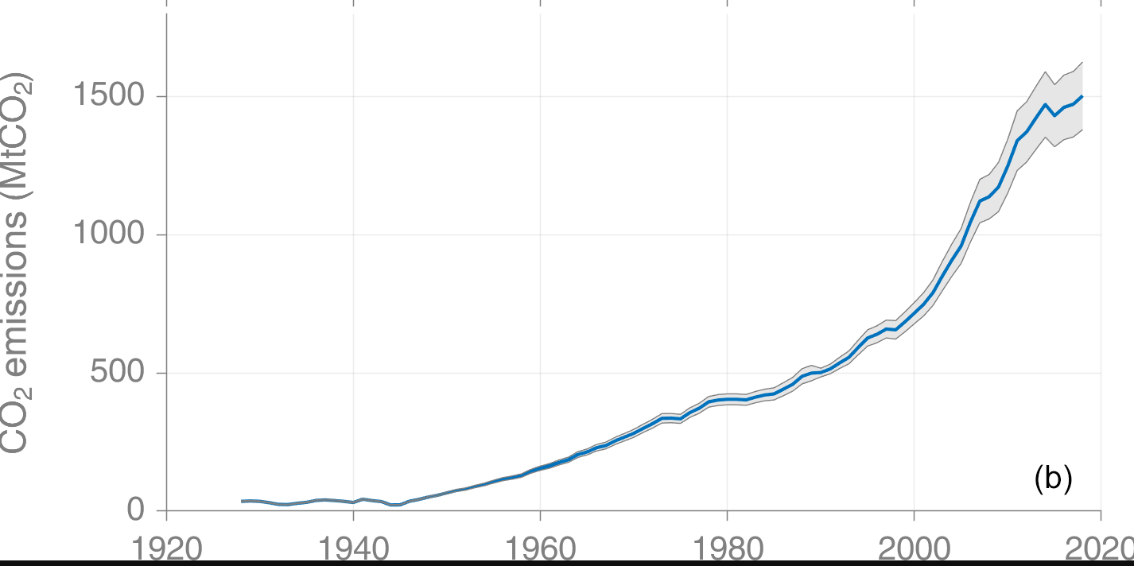
Cement related CO2 emissions

Slide 11
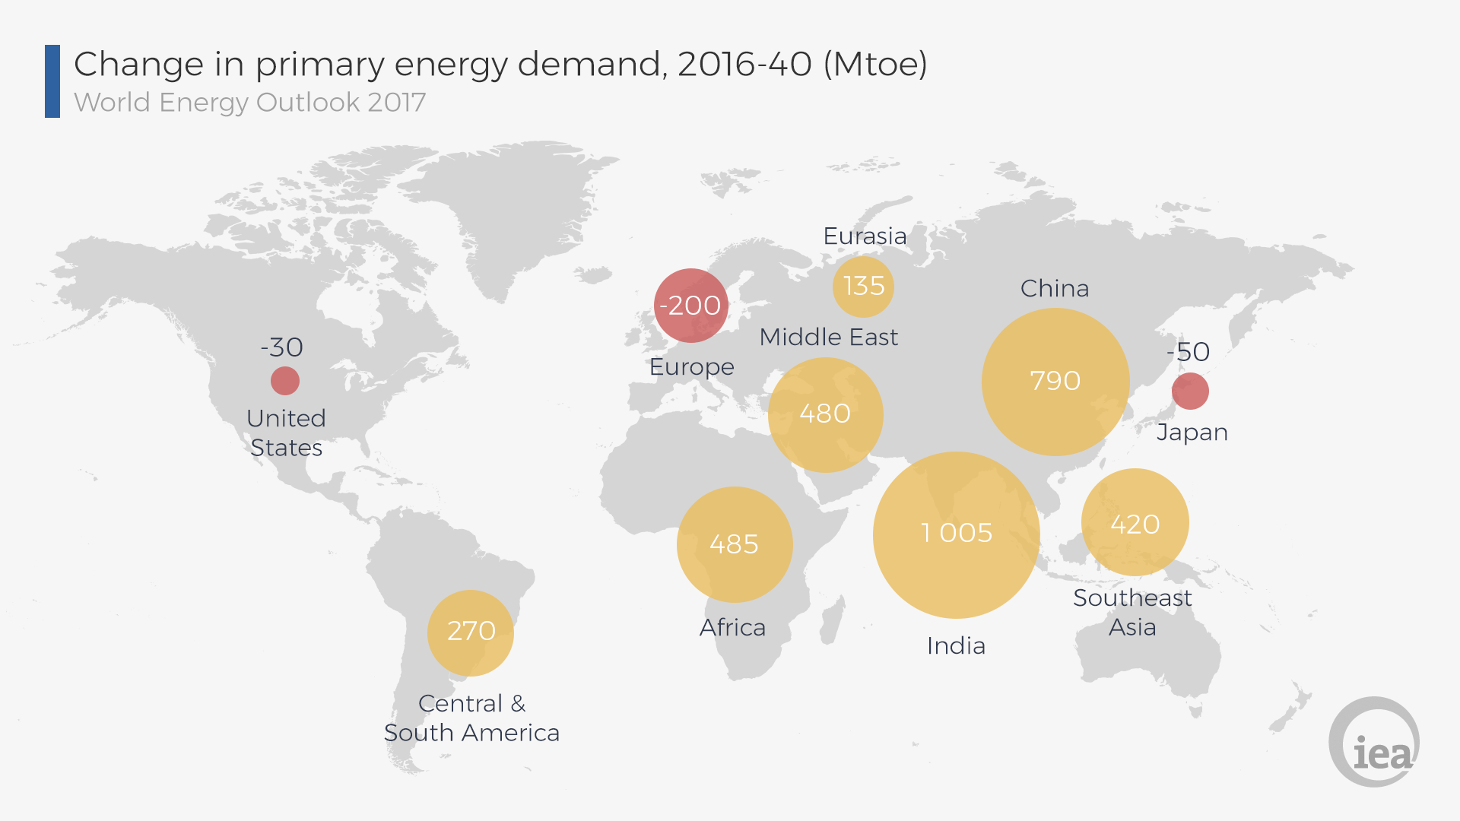
Grow, Grow, Grow

Slide 12
Consumption of Everything is accelerating

Slide 13
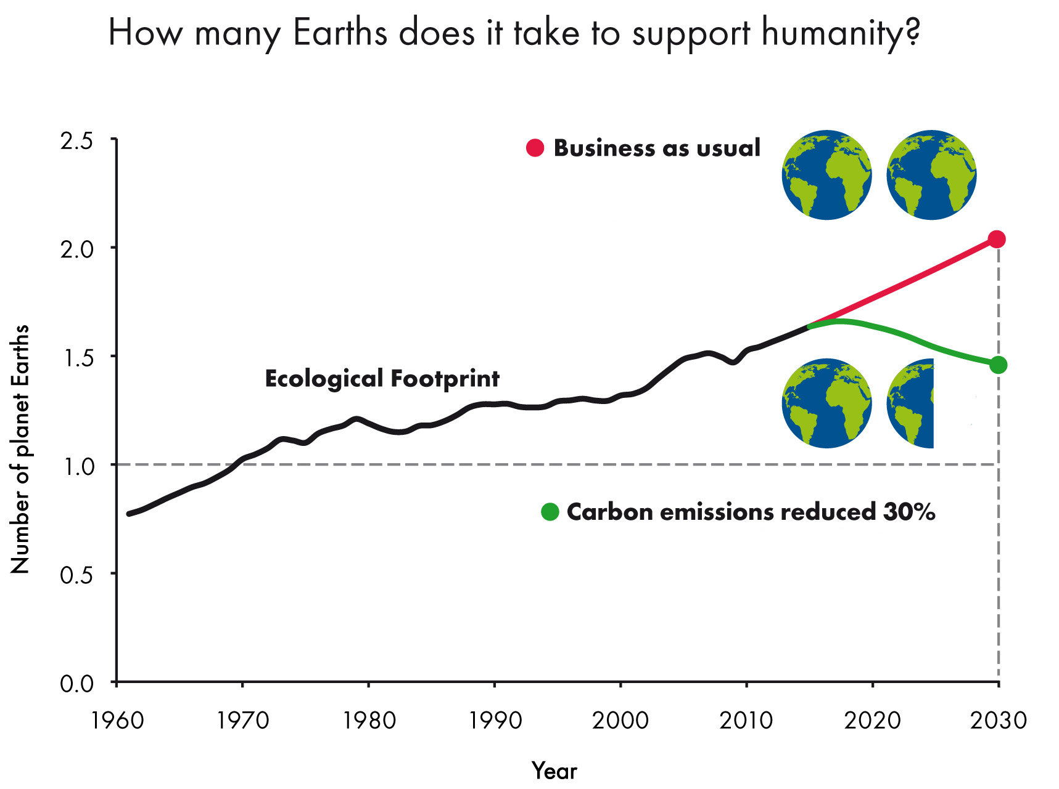
Sustainability Awareness Needs to Begin Here
BRIC
The Price of Consumption

Slide 14
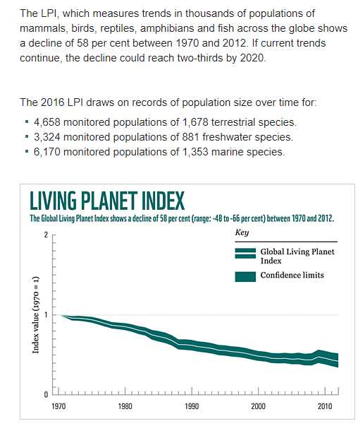
LPR 2016
Operationally we have
become GOD

