Slide 1
The On the Ground Reality
Our increasing global consumption rate leads to resource scarcity
The rate of climate change is accelerating
The time is near (10-20 years) for the end of “cheap” fossil fuels as our energy foundation.
We must start transitioning, at scale, to effectively smooth out declining fossil fuel reserves with increasing renewable energy infrastructure.
The Public needs to become a lot more energy and climate literate for this transition to succeed.
What to Do?

Slide 2
US History of Crude Oil Production

Slide 3
Evaluation Rubric For All forms of Renewables
1. MW output per surface area (MW/KM²)
2. MW output per material use (MW/Ton)
3. MW output per job created (Jobs/MW)
4. MW output versus production time scale to bring on line (months/MW)
5. Capital cost per MW ($/Watt)
6. Realistic Levelized Cost (cents per KWH)

Slide 4
To Evaluate Competing Electricity Generating Technologies
Develop an internally consistent indexing system for the 6 attributes listed previously (the dow jones is an index)
Use real world data and real world physics to best determine the values
Weight the indexes appropriately (real world cares about $/Watt and Jobs Created)
Choose Baseline – we will use Solar in the following exercise

Slide 5
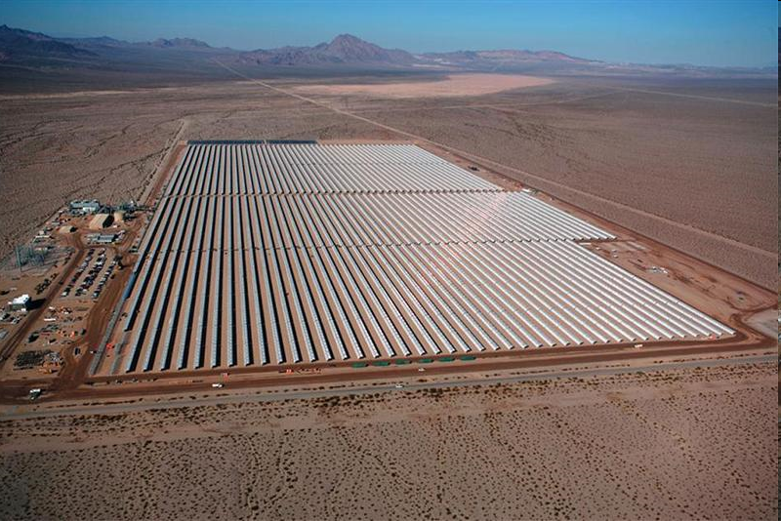
Indexing – Solar Troughs
1. Land ~20 MW/km (over 24 hour day) = 1
2. Materials ~3 tons per kw = 1
3. Jobs ~3 jobs per MW
4. Time ~10 MW per month
5. Capital ~3$ per watt real facility cost
6. Levelized 10 cents per KWH

Slide 6
Attribute | Solar | Wind | Waves | Biomass
1. Land | 1 | 2.5 | 1 | .2
2. Material | 1 | 3 | .2 | 1
3. Jobs | 1 | 1 | 1 | 5
4. Time | 1 | 3 | .5 | .5
5. Capital | 1 | 2.5 | .5 | .5
6. Level | 1 | 3 | .75 | 1
Cumulative Index = 1+2+(1.5)3+4+1.25(5)+1.25(6)
Highest Index is Best

Slide 7
Relative Ranking
Solar = 7
Waves =4.75 (worse due to material intensity)
Biomass =11 (because of jobs created)
Wind = 17 (lower material intensity and low Levelized costs)
In general, wind is will win on any kind of index comparison.

