Slide 1
Using Data to Estimate the Future
Some times its easy; most of the time its complicated

Slide 2
First some basics on exponential growth
For purely exponential growth at constant growth rate (which rarely occurs in the real macro world), the doubling time is a useful tool.
Doubling Time = 70/n years; n = % annual growth
for n = 1% the doubling time is 70/1 = 70 years.
for n =2% the doubling time is 70/2 = 35 years
for n =5% the doubling time is 70/5 = 14 years
for n = 35% the doubling time is 70/35 = 2 years

Slide 3
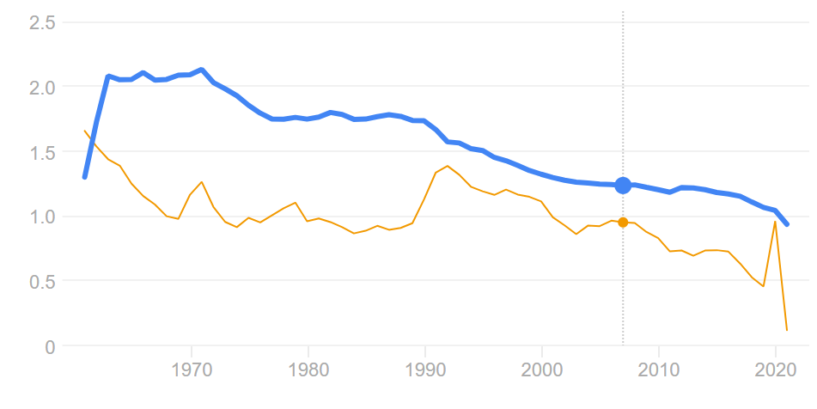
World Population Growth Rate: High was 2.1% (70/2.1) ~ 34 years. Now its 0.9% (70/.9) ~ 78 yrs

Slide 4
Finding the growth rate from the data.
Now this data doesn’t look either smooth or exponential but nonetheless you can use the data to determine a growth rate:
Initial Value (1992) = 400 units
Final Value (2001) =1600 units
Total years = 9
ratio of final/initial = 4
natural log (ln) 4 = 1.39
Growth rate is then 1.39/9 = 15.4% annual
doubling time is 70/15.4 = 4.5 years
Indeed, the sample has doubled twice (400 to 1600) in 9 years or two doubling time which is consistent with the above.

Slide 5
But you have too look at data (plot the data) to make more informed decisions.
Wind growth in Kansas 2000 -2016; looks like a decent exponential fit and derived growth rate is 29.27%

Slide 6
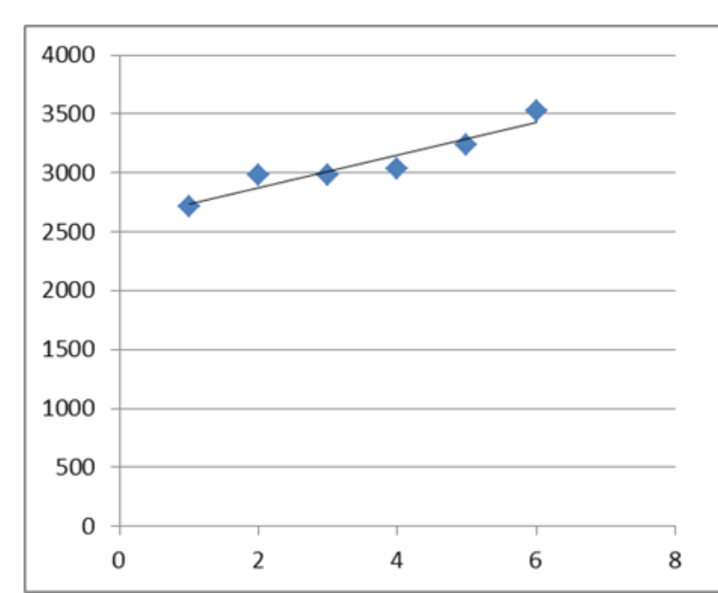
It is often useful to look at time series data in segments; 2000-2008 vs 2011 -2016 to see that the exponential growth was not maintained

Slide 7
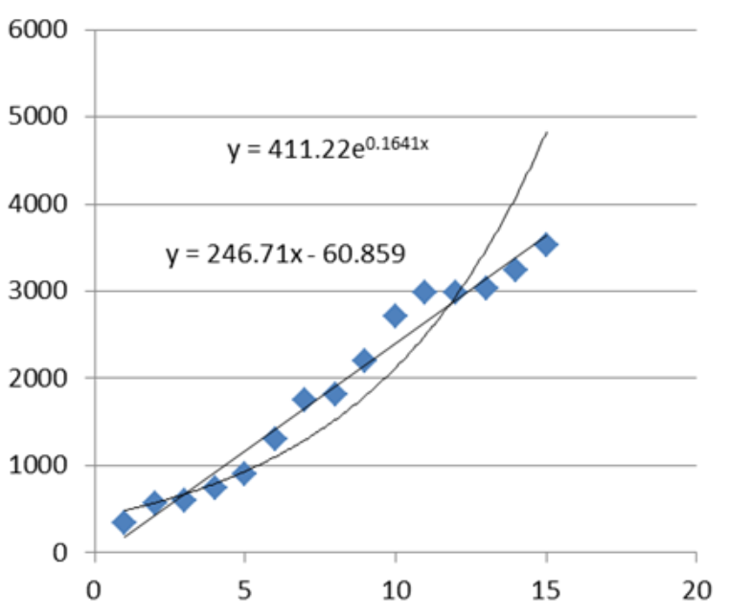
Compare linear vs exponential fits and decide which one is best; most recent data is the best indicator whether or not exponential growth has continued – in this case it has not

Slide 8
Some times the data really can’t be fit to make a good prediction.
Any time series that that shows a few years of no growth (flattening of the curve) makes future predictions almost impossible.

