Slide 1
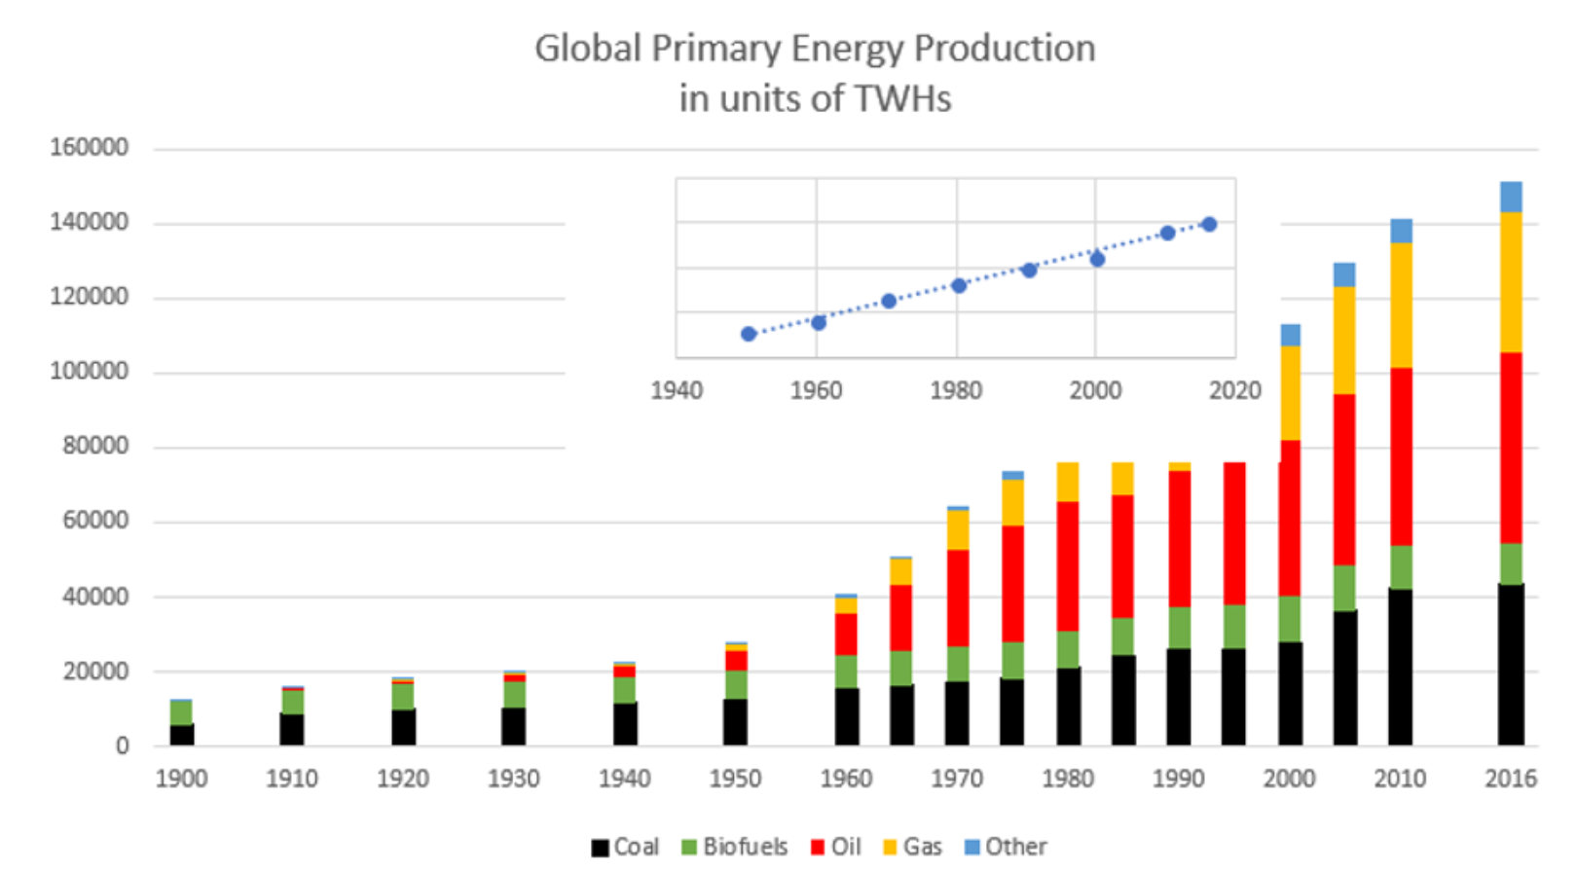
Global Energy Mix

Slide 2
Features of the global energy mix
On the global scale, energy use significantly ramped up following World War 2. Total energy use from 1900 to 1945 was equivalent to use from 1950 --1970.
From 1950 until 2016 growth of world energy consumption is very linear with a slope of ~ 1900 TWHs per year increase. This is shown as the inset linear fit graph in Figure 7.
Coal production slowly increases by a factor of 2.2 from 1900 to 1950 as well as 1950 -- 2000. The post 2000 in coal production is due to the emergence of large scale China coal production which starts around 2003. Specifically, from 2003 to 2013 world coal increased by a factor of 1.42 in just those 10 years.

Slide 3
More features
Oil growth is explosive. Since 1950 annual production of oil has increased by a factor of ~9.5. However, since 2005 oil growth has been strongly limited by world refining capability and this has lead to "plateau oil" as the proper description of the future depletion of crude oil.
NG is experiencing very strong growth. Unlike oil, various NG refining and distribution facilities can be more easily built which can better meet demand. As a result, over the time period of 2000-2016 NG global distribution increased by a factor of ~ 1.5 compared to a factor of ~1.1 for oil. Currently there are very large gas reserves -- not yet available for worldwide -- use in Russia and Iran.

Slide 4
More features
Renewables (Other): This sector is historically dominated by hydroelectricity. Nuclear power emerges in the 1970s and wind and solar are not statistically relevant until about 2005. If we define the 5% level as a significant contribution to the world's energy mix, then the "other" sector this does not become significant until 2000. Since 1990, production in these sources has gone up by about a factor of 2. While encouraging, this production rate has to become much larger in order for these "other" sources to replace fossil fuel sources in the global energy mix.

Slide 5
Electricity Mix can be different that Energy Mix (Canada - heat)(USA – transport)

Slide 6
The Case of China
The case of China is different. China has no need to import NG due to its tremendous coal reserves. Indeed, the challenge for China is whether to continue to burn all of that reserve or to move to more renewable energy sources. A major governmental policy shift did occur in China in 2015 which committed to building out more renewable energy resources and fewer newly constructed coal-fired electricity plants. This transition can be seen in Figure 9 and currently China is making strong progress in constructing alternatives to coal and avoiding the use of NG as much as is practical. This is a noteworthy change from past behavior and dire predictions about China's continued reliance on coal. In turn this has lead to a situation where CO2 emissions that are related to energy generation (Figure 10) have essentially plateaued (though there is a small uptick in 2017). Part of this plateau is related to warmer than average winters in most of Europe the last few years. Increases in global CO2 emissions are now largely driven by increases in transportation and its continued reliance of oil as the primary fuel source.

Slide 8
Global CO2 emissions have stabilized
Major Contributors to stabilization:
Less China Coal
Warmer European Winters
Future increases in global CO2 emissions are now largely driven by increases in transportation and developing world continued reliance of oil as the primary fuel source.

