Slide 1
Global Wind
The Situation as of 2022

Slide 2
Approaching 1 TW (1000 GWs)

Slide 3
China Leads the Way

Slide 5
Lots of Activity now in Off Shore wind

Slide 6
The London
Array

Slide 7
Moray East

Slide 8
100 9.5 MW Turbines ~ 1GW of wind

Slide 9
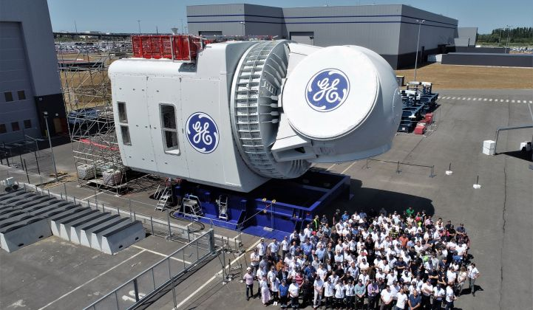
The GE 12 MW

