Slide 1
Integrated Wind + Battery Farm

Slide 2
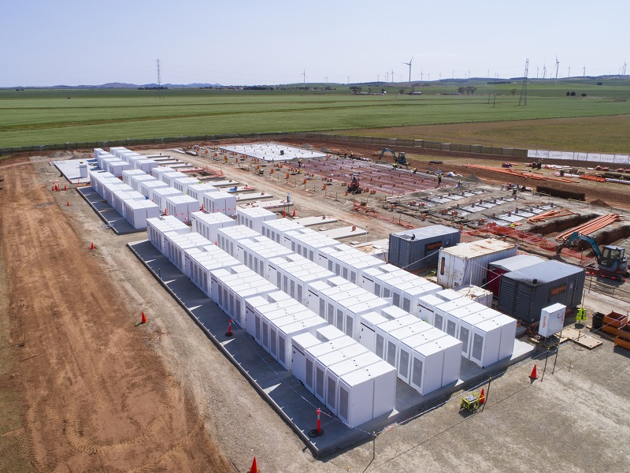
The Tesla Facility in Australia
Hornsdale Power Reserve Project
Phase 1 comes on Line in 2017
The 100MW Hornsdale Power Reserve is the world’s largest lithium-ion battery power reserve located at the 315MW Hornsdale wind farm in Jamestown, Southern Australia.
Extra 50 MW battery capacity was added in March 2020.

Slide 3
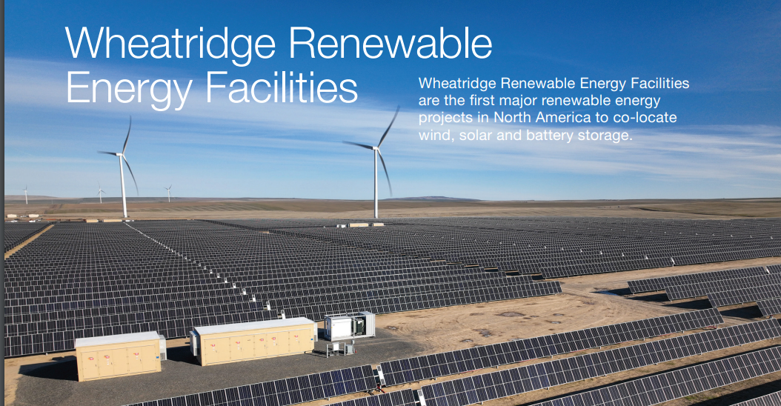
Located near Lexington in Morrow County, Oregon, the Wheatridge Renewable Energy Facility includes a 300-megawatt wind farm, which began operation in December 2020, a 50-megawatt solar facility and a 30-megawatt battery storage system, both of which began operation in the spring of 2022.

