Slide 1
Global Trends in Renewable Electricity Deployment

Slide 2
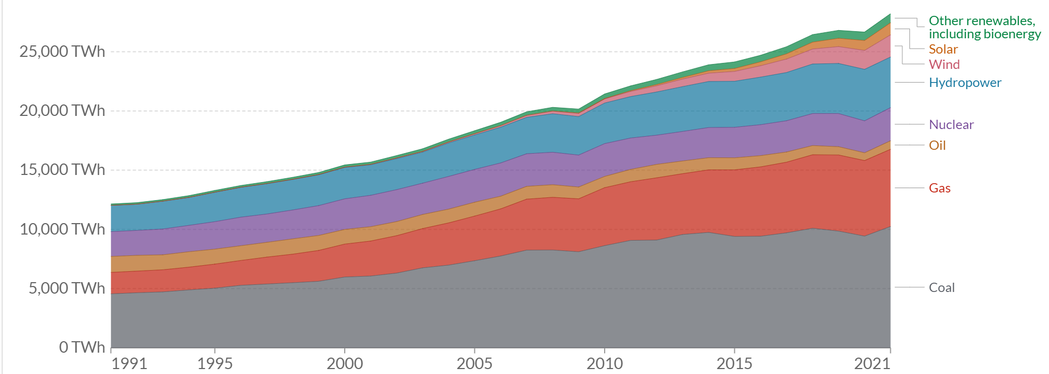
2021 Global Mix
Coal = 36% NG = 23%
Hydro = 15%; Nuclear = 10%
Wind = 6.5%
Solar = 3.6%
1991 Global Mix:
Coal = 37%; NG = 15%
Hydro = 18%
Nuclear = 17 %

Slide 3
Some Notes
1. In 30 years wind + solar has gone from essentially 0% to now 10% - but 10% every 30 years is way too slow
2. From 1991-2021 total electricityuse in the world grew by 2.35x; population grew by 46% ; hence per capita electrcity use is increasing rapidly

Slide 4
Renewables Growth over last 10 years (2011-2021) for electricity
Wind growth is 4.2x in this period but still now is only at 6.5 % of the world
Solar is 15x – but easy to get rapid growth rates when you start from very little. 2011 = 66 TWH; 2021 = 1032 → but solar is still only 3.5% contribution
Hydro has grown by 25%

Slide 5
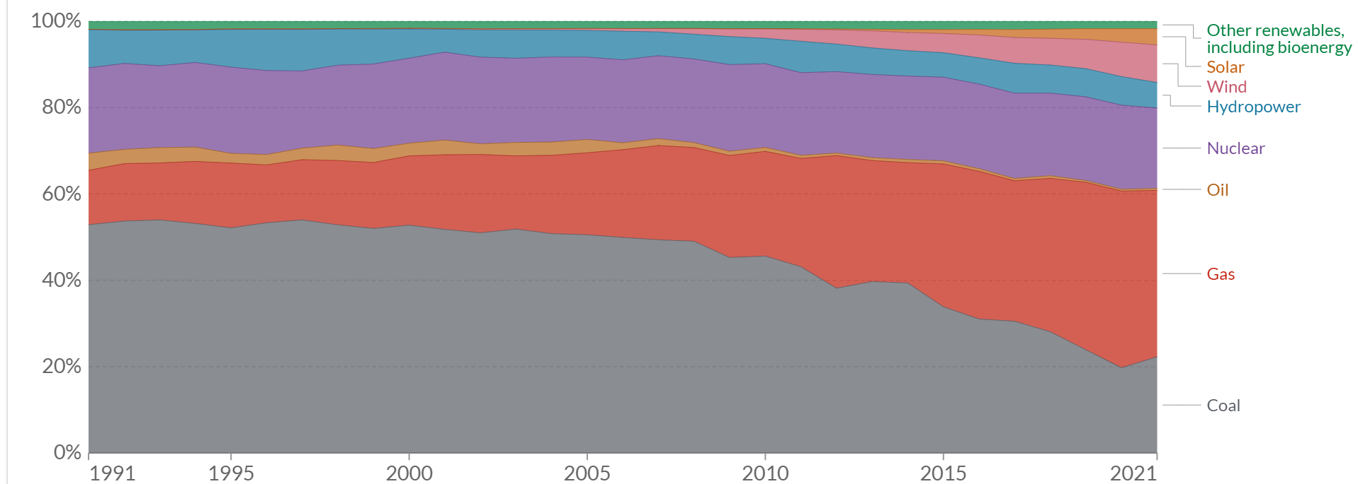
USA
2021:
Coal 22%; NG: 38.5%; Nuc: 18.6%
Hydro 5.8%; Wind 8.7%; Solar 3.7%
1991:
Coal 53%; NG 12%; Nuc 20%
Hydro 8.8%

Slide 6
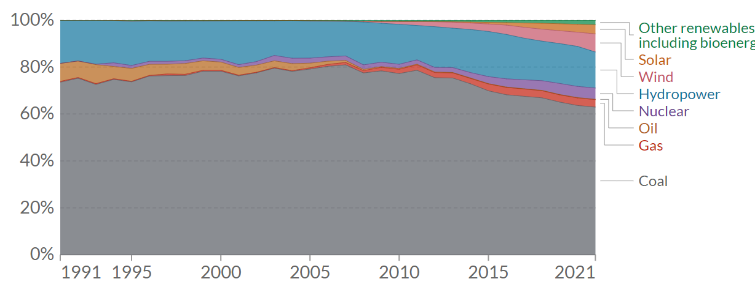
China
2021:
Coal 63%; NG: 3%; Nuc: 5%%
Hydro 15%; Wind 8.%; Solar 3.7%
1991:
Coal 74%; Oil 8%
Hydro 18%

Slide 7
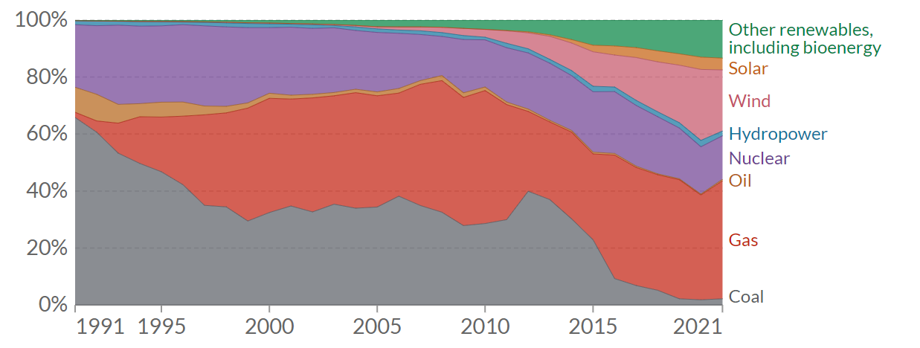
UK
2021:
Coal 2%; NG: 42%; Nuc: 15%
Hydro 2%; Wind 25%; Solar 4%
1991:
Coal 65%; NG 2%; Nuc 22%
Hydro 1.5%

Slide 8
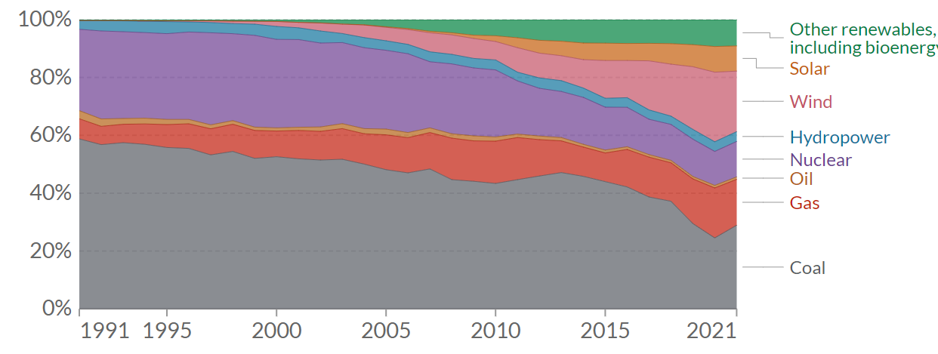
Germany
2021:
Coal 29%; NG: 16%; Nuc: 12 %
Hydro 3%; Wind 22%; Solar 9%
1991:
Coal 59%; NG 7%; Nuc 28%
Hydro 3%

